Slide 1
Colorado Utilization Management
System Overview Training

Slide 2
Housekeeping
If you are experiencing audio or sound issues- you may call into the phone conference line (for Audio only)
Please turn off your camera and keep yourself on mute.
Google Chrome is the preferred internet browser- to avoid potential technical issues please sign in using Google Chrome.
A copy of this training will be posted on the Colorado PAR website.
If you are having difficulty seeing the PowerPoint presentation, please make sure you are looking at the right screen in Teams.
You will not be able to see the presentation or access the chat box for questions if you do not join the webinar (i.e., if you are listening in only by phone).
Notes:
All communication during the webinar will be posted in the chat box

Slide 3
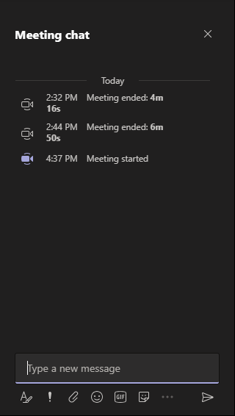
Housekeeping Items
Accessing Chat in Teams
On the Teams meeting screen → Go to the tool bar and click on the ‘Message’ button at the top right corner of the screen.
Meeting Chat →You will now see a list (on the right side of the screen) the Meeting chat. Type new message to all participants in the meeting
Notes:
Some housekeeping items- participants will be kept on Mute, however if you have any questions during the webinar, please enter them into the chat box.
We will have a Q &A session at the end of the presentation.
I have also included the PDF file of this PPT that you can access in the chat box and download at any time during the webinar
This is also where you can download the PDF of the presentation. This is also access the attendance link

Slide 4
Agenda
Provider Login
Creating a Case
Entering Case Information
Completing Questionnaires
Uploading Documents
Responding to Pends
Revisions
Reconsiderations/Peer to Peer
Additional Resources and Support

Slide 5
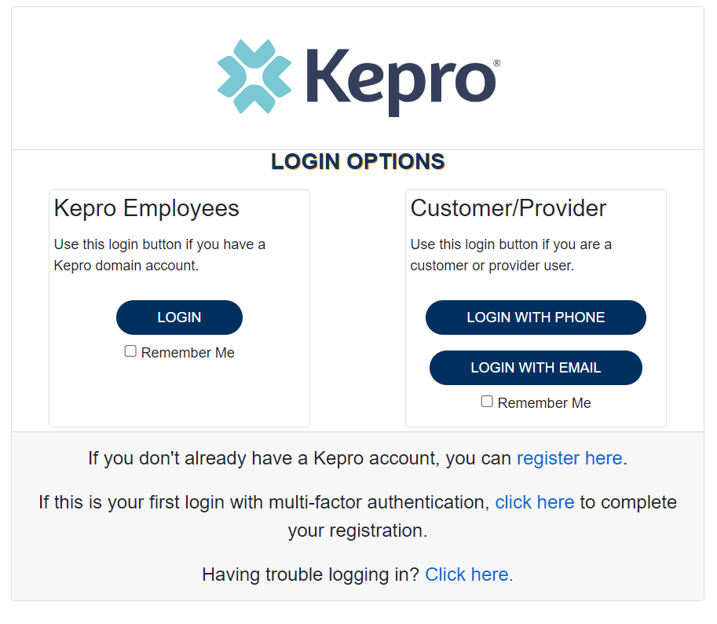
Provider Login
Customer/Provider users are any users who do not have a Kepro account or Kepro.com email address.
These users should use the login button under the Customer/Provider heading to the right-hand side of the login page
After entering the Atrezzo Provider portal URL https://portal.kepro.com/ the login page will display
Atrezzo User Guide: Registration and Login Information

Slide 6
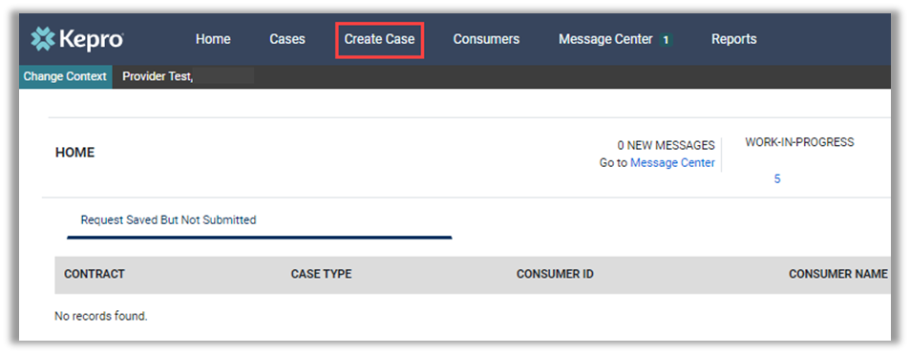
Create Case
Once logged in you will be taken to the Arezzo home screen.
This defaults to display “Request Saved But Not Submitted”.
From the home page, click Create Case.

Slide 7
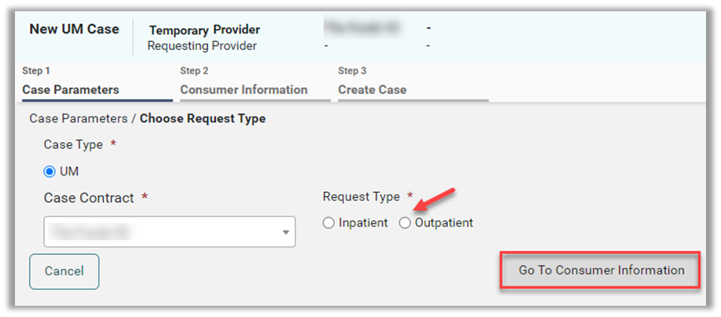
Consumer Search
Some information on this page will auto populate.
If Case Type, does not prepopulate, select UM.
You will not need to select anything under Case Contract (prepopulates).
Select the appropriate Request Type Inpatient or Outpatient.
Then, place the member’s Medicaid ID in the Subscriber ID box and select Search.
If you do not have the member ID , you will need to enter the full name and DOB.

Slide 8
Consumer Search
The Member’s name will generate at the bottom.
Click Choose to select the appropriate member.
Review previous submitted requests to ensure no duplicates.
If no duplicates are found, click Create Case.

Slide 9
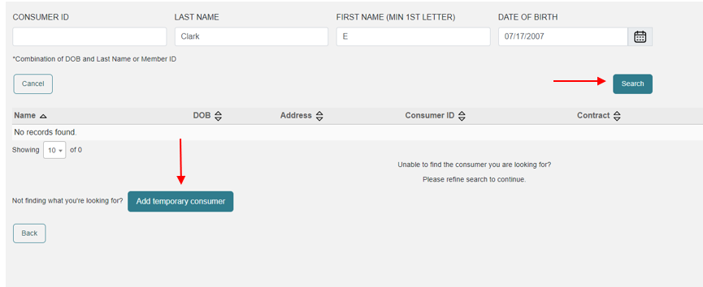
Creating Temporary Consumer
Enter member's name and date of birth.
Click Search.
If member does not have a Medicaid ID yet , results will show no records found. (Verify correct spelling and/or ID number were entered)
Click Add Temporary Consumer.

Slide 10
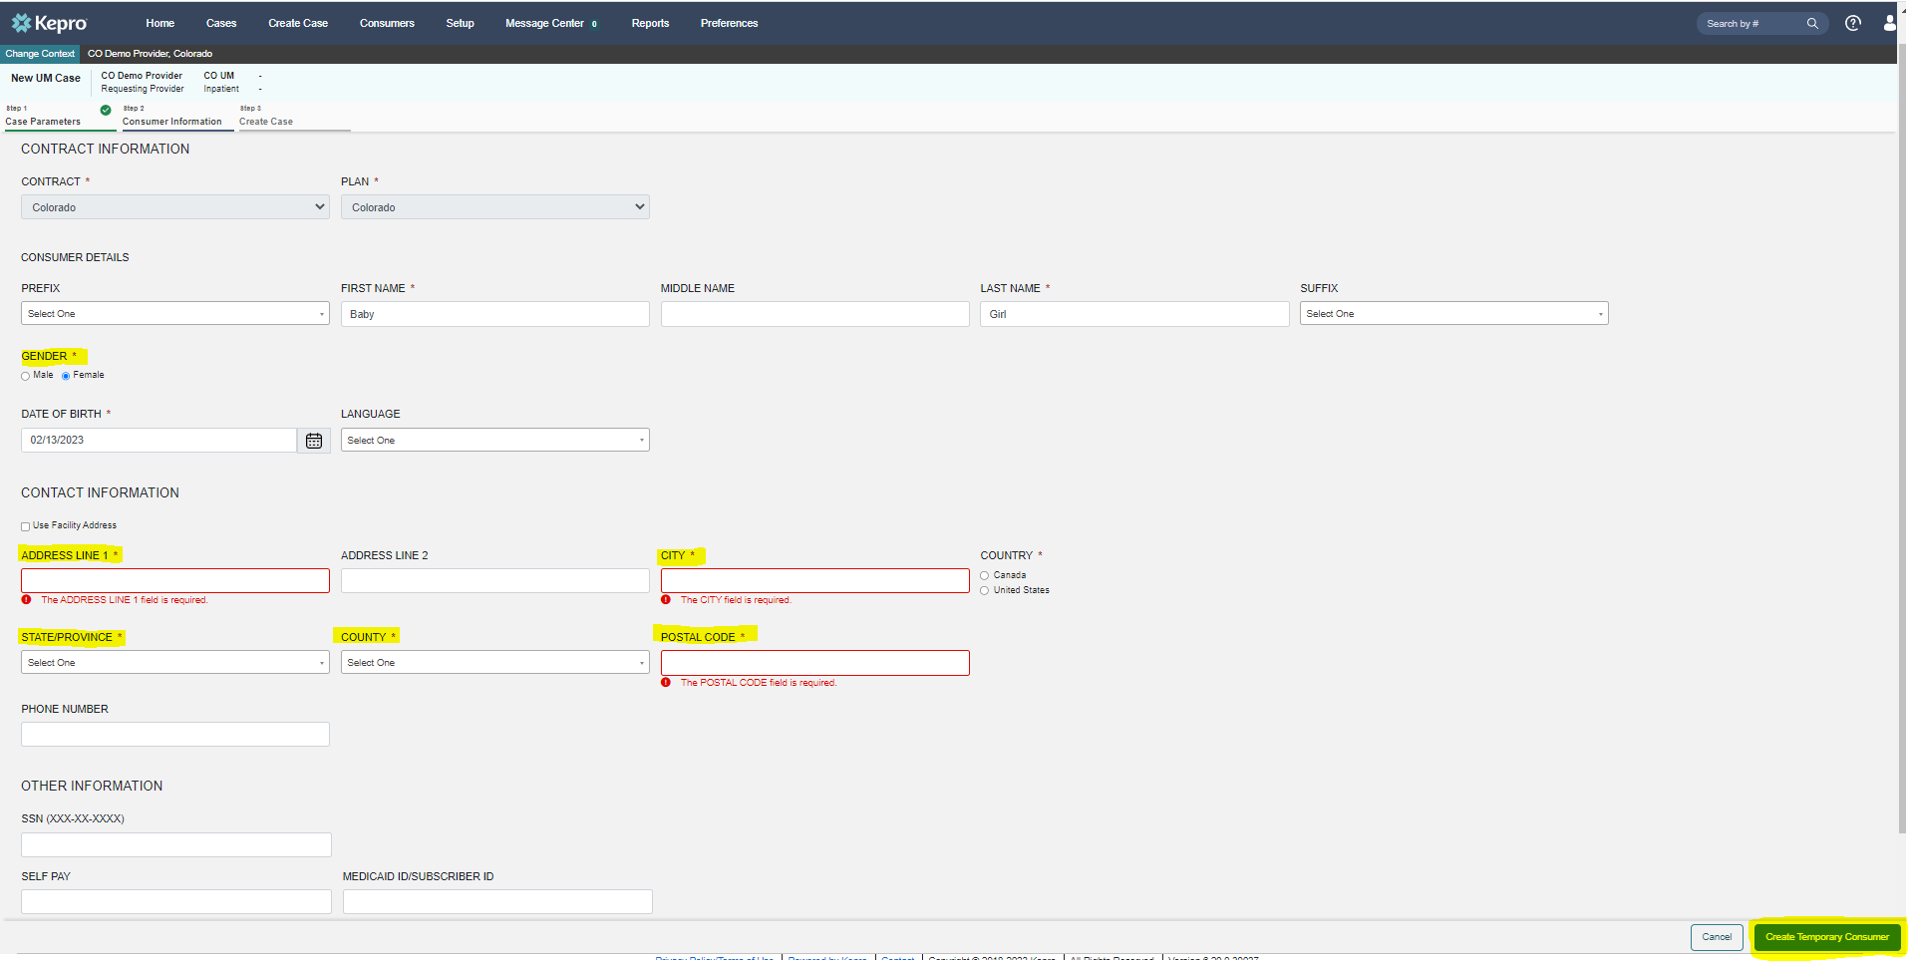
Create Temporary Customer
Complete all required fields with member’s demographics.
Click Create Temporary Consumer.

Slide 11
Create Case
Review previous submitted request to ensure no duplicates.
If no duplicates are found, click Create Case.
Review disclaimer stating case will be created but not submitted.
Click Create Case.

Slide 12
Create Case
The case has been created; notice the additional steps now listed across the top.

Slide 13
Entering Provider Information
The next screen will be where you enter all the information for the service being requested.
Helpful Hints
The Servicing Provider is the billing provider and who will get paid.
The Servicing Provider and Requesting Provider may or may not have the same NPI.
Attending (Ordering) Provider is not required but is recommended.

Slide 14
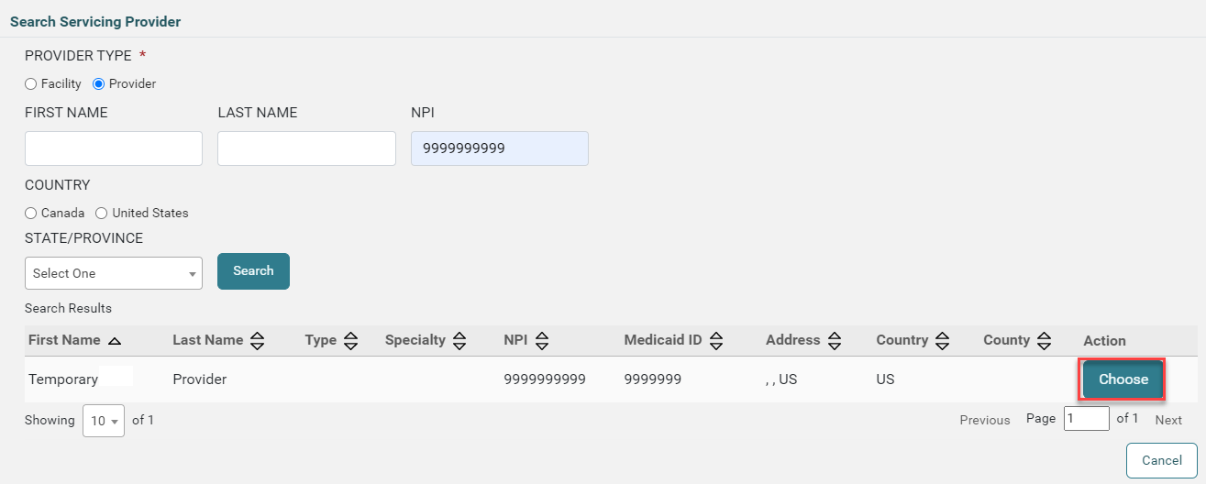
Add Providers
Review selected providers.
Click Update to make changes to servicing providers, if necessary.
Search for new provider.
Click Choose to add the updated servicing provider.

Slide 15
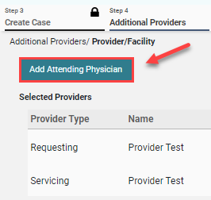
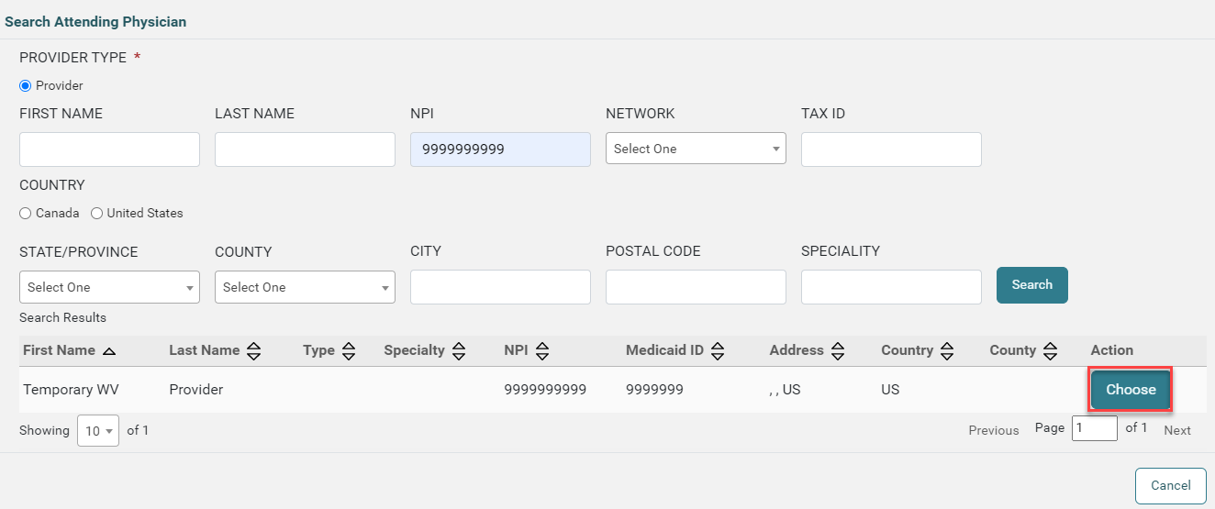
Add Attending Physician
Click Add Attending Physician, if applicable.
Search for Physician.
Click Choose to add the attending physician.

Slide 16
Service Details
Enter fax number if not auto populated.
Click Go to Service Details.
Select appropriate options from drop downs.
Click Go to Diagnosis.

Slide 17
Enter Diagnosis
Select appropriate Code Type.
Enter diagnosis code or description in search box.
Select the proper Code from the results returned.
Click Go to Requests
Repeat these steps to add all necessary diagnosis codes.
To set a primary diagnosis, you can drag and drop it to the top of the list.

Slide 18
Request Type and Procedures
Select the Request Type from the dropdown.
Click Add a Note, if applicable.
Click Go to Procedures.
Code Type will default but can be changed if needed.
Select and enter the appropriate code.
Repeat the above steps to add all necessary codes for which authorization is being requested.

Slide 19
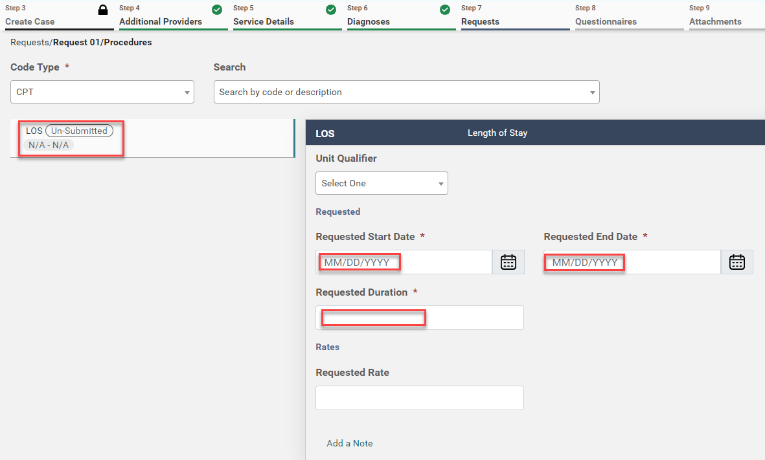
Length of Stay
For Inpatient cases, click into the Length of Stay (LOS) field.
Enter Requested Start Date.
Enter Requested End Date.
Enter Requested Duration.
Entries will autosave but can be changed prior to submission if needed.

Slide 20
Questionnaires
For most cases, you will be prompted to complete at least one questionnaire.
Click Go to Questionnaires, if applicable.
Click Jump to Submit if you do not need to provide any questionnaires, attachments or communications.
All required questionnaires will be populated and need to be completed prior to submission.
Click Take to open the questionnaire in a new tab.

Slide 21
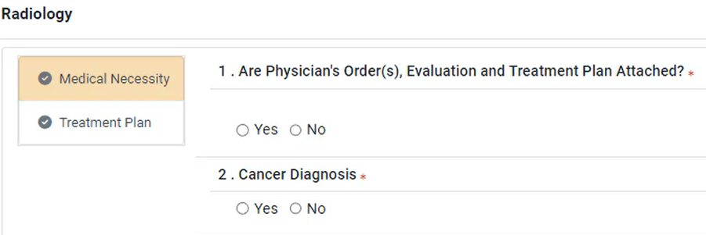
Take Questionnaire
Answer all questions.
Click Mark as Complete to return to the case wizard.
Repeat this process with all questionnaires.
Then, click Go To Attachments.

Slide 22
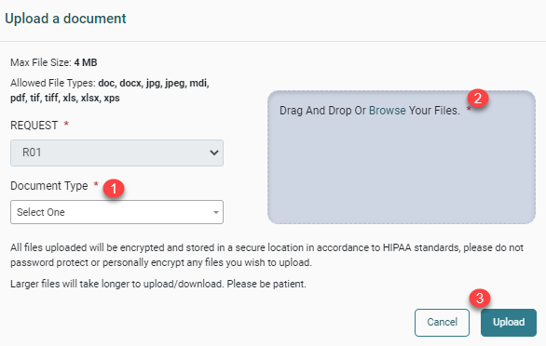
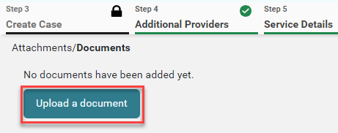
Attachments/Documents
Click Upload a Document in order to attach any needed clinical or other documentation.
Select the appropriate Document Type.
Add the document by dragging and dropping or by clicking Browse.
Click Upload.

Slide 23
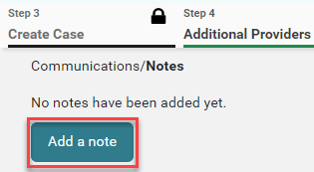
Add Communications
Click Go to Communications.
To add additional information, click Add a Note.
If additional information is not needed, you may click Jump to Submit.

Slide 24
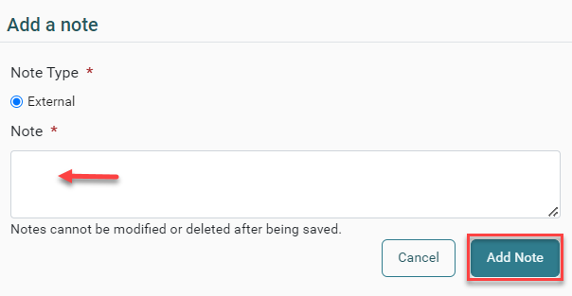
Add Note
Enter your note in the provided text box and click Add Note to save it.
Click Go to Submit.

Slide 25
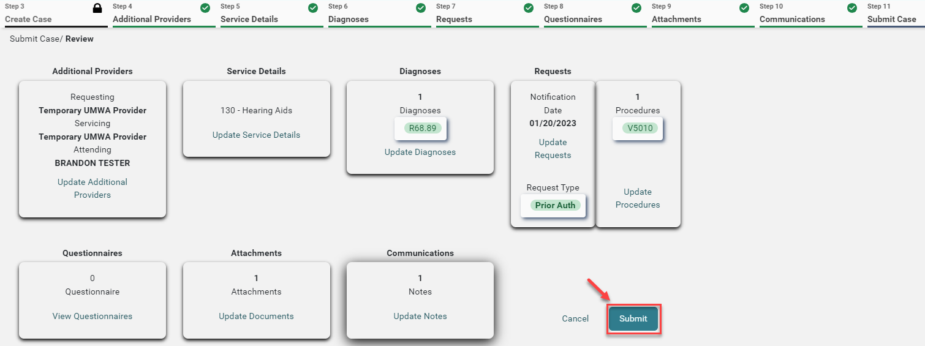
Review Case
The review page will display cards of all information entered.
If needed, click Update on the appropriate card to edit a specific section.
Once your review is complete, click Submit.

Slide 26
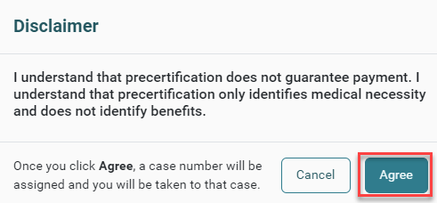
Disclaimer
Read the disclaimer that pops up and click Agree.

Slide 27
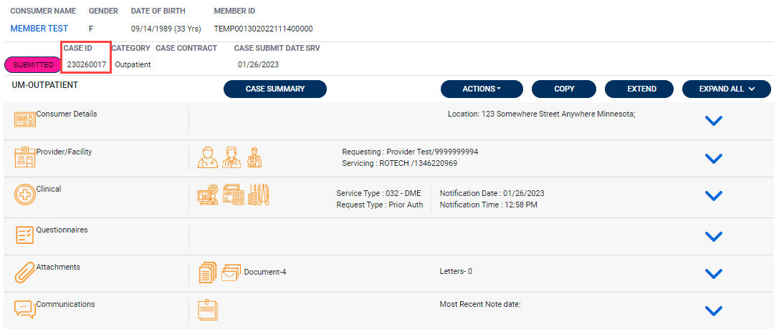
Case ID
The system will submit the case and the submitted case will display.
Make note of the Case ID which is specific to this request and can be used for tracking status later.

Slide 28
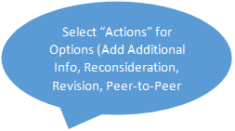
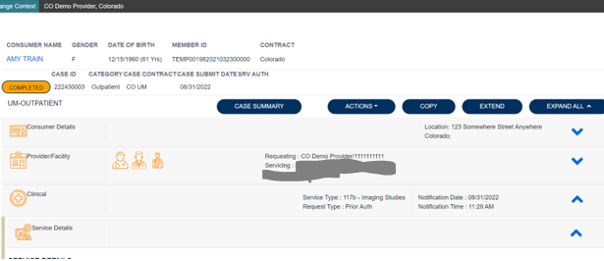
Submitting Additional Information
Once a case is submitted you are still able to submit additional information, or request a revision, reconsideration, or peer-to-peer review.

Slide 29
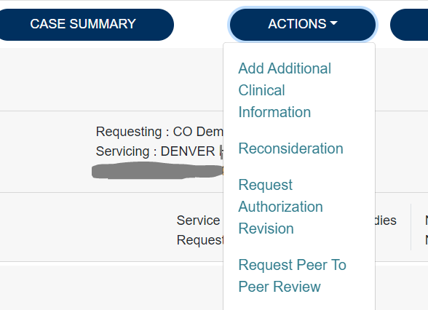
Adding Actions
Here you will choose from the dropdown which action is needed.

Slide 30
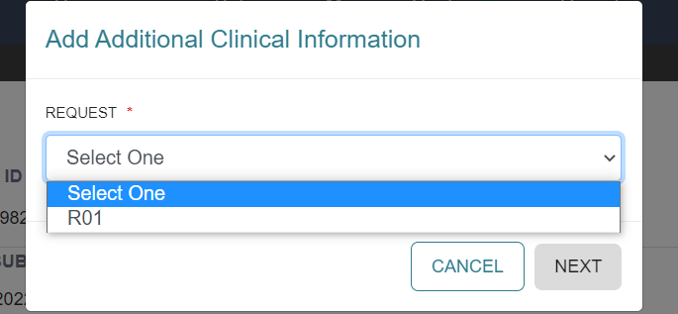
Selecting Request
Select the appropriate request (usually R01) and click next.

Slide 31
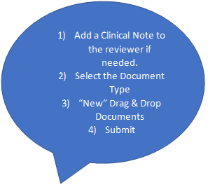
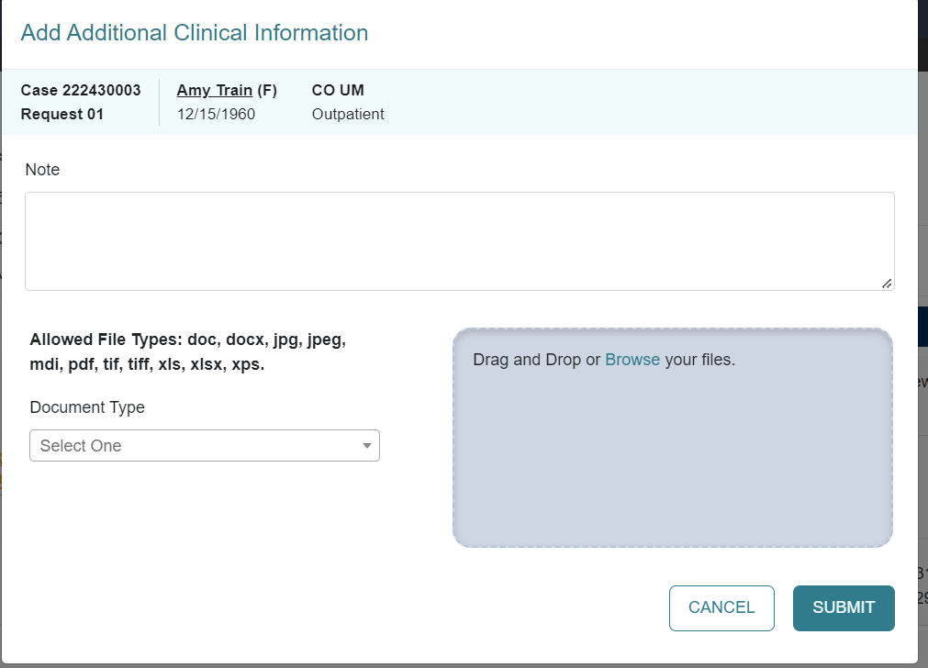
Adding Additional Clinical Information
This is where you will add any additional notes or documents if needed.

Slide 32
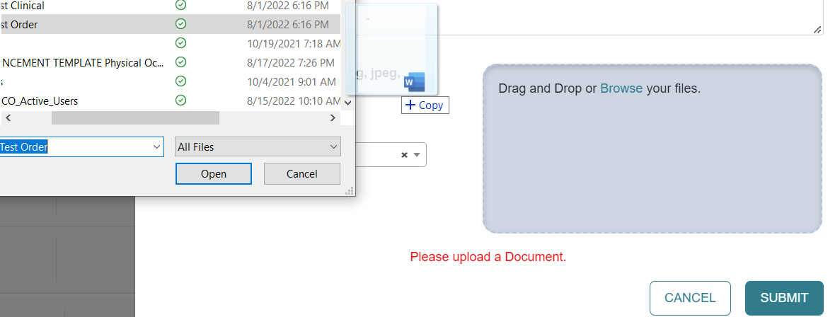
Uploading Documents
Select the documents to Drag & Drop into the box
Submit

Slide 33
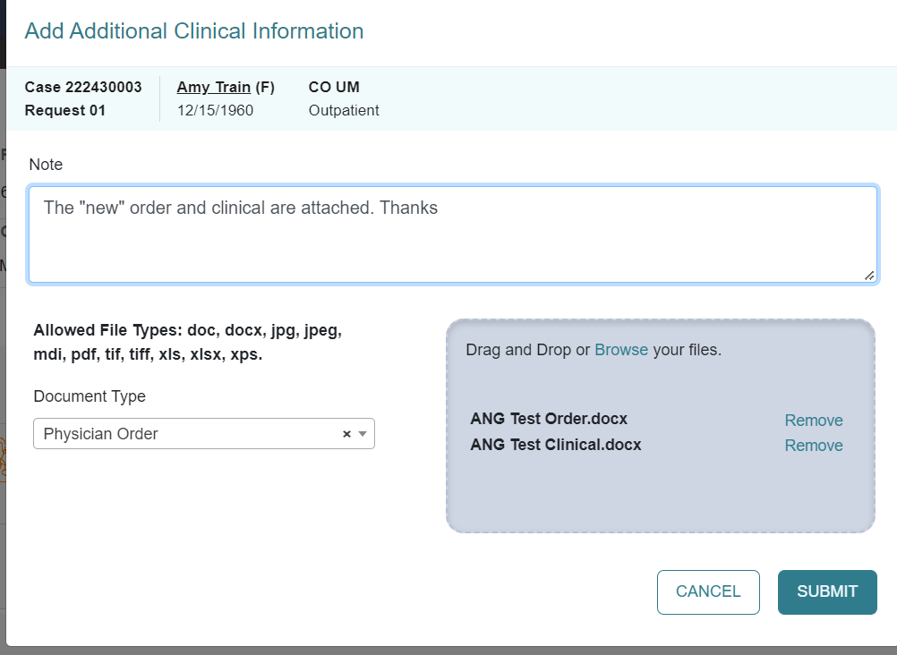
Verifying New Information
Please verify that:
The note is visible.
The Document Type is Chosen.
Document(s) have uploaded.
Then click Submit.

Slide 34
Viewing Additional Info
Once additional information has been submitted the case status will not change. You can verify the items were added by viewing the documents or notes section.

Slide 35
Resources for Providers
24-hour/365 day provider Atrezzo portal can be accessed at portal.kepro.com
Provider Communication and Support email: coproviderissue@kepro.com
Provider Education and Outreach, along with System Training materials (including video recordings and FAQ ) are located at hcpf.colorado.gov/par
Provider Manual is posted at hcpf.colorado.gov/par
Inpatient Hospital Review Program Information: https://hcpf.colorado.gov/IHRP

Slide 36
Additional Resources & Support
For escalated concerns please contact: hcpf_um@state.co.us
Contact Info
Kepro Call Center: 720-689-6340
COproviderissue@kepro.com
Coproviderregistration@kepro.com

