Slide 1
Safety Net Programs Update and 2024 Hospital Reports
Nancy Dolson, Special Financing Division Director
Notes:
Safety Net Programs and Hospital Reports Update
MSB next month with some information about our
CICP sunset proposal as well as our other hospital reports.
Besides the 3 delayed ones on 2/5, the CICP annual report will be published on 2/1 which will go into more details on the state of our safety net. I could give a brief overview of all these reports, focus on CICP and implementation of hospital discounted care, and take their questions. What do you think?
To the simple answer: yes, tobacco tax revenue through the Primary Care Fund is currently and will continue to support FQHCs and other community safety net clinics. In 2021 the legislature directed us to seek federal matching funds on this source of funding, which we have received. Currently, the payments to 36 clinics annually are between $45-$50 million in total including the tobacco tax and federal funds.

Slide 2
Agenda
Colorado Indigent Care Program (CICP), Hospital Discounted Care, and Primary Care Fund
Report
Legislation
Overview of 2024 hospital reports
Colorado Healthcare Affordability and Sustainability Enterprise (CHASE)
Hospital Financial Transparency
Hospital Community Benefit Accountability
Hospital Price Transparency Posting Evaluation
Plus Payment Variation Tool

Slide 3
CICP, Hospital Discounted Care, and Primary Care Fund Report
CICP helps uninsured and underinsured patients access discounted health care at participating hospitals, Community Health Centers, and other safety net clinics
Incomes up to 250% of the Federal Poverty Guideline (FPG)
HCPF established sliding scale
Before Medicaid expansion, about 225,000 Coloradans annually compared to about 40,000 today
Recently, 11 clinics and two hospitals have left CICP
hcpf.colorado.gov/cicp
Notes:
36,450 per year for an individual or $75,000 per year for a family of four

Slide 4
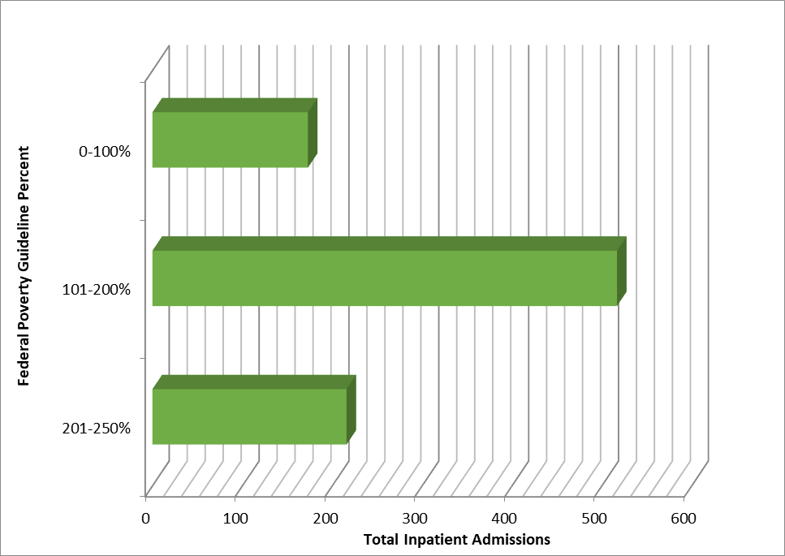
CICP Inpatient Admissions
hcpf.colorado.gov/cicp
Notes:
36,450 per year for an individual or $75,000 per year for a family of four

Slide 5
CICP, Hospital Discounted Care, and Primary Care Fund Report
Hospital Discounted Care (HB 21-1198) minimum requirements for all Colorado hospitals’ financial assistance programs
Incomes up to 250% of the FPG
Limits billing to higher of Medicare or Medicaid rate
Payment plans 4% monthly income for hospital bill; 2% for associated practitioner bill; not longer than 36 months
First nine months, more than 210,000 Coloradans received financial assistance for their hospital bills through Hospital Discounted Care
hcpf.colorado.gov/cicp
Notes:
HB22-1403 delayed implementation from June 2022 to September 2022​

Slide 6
Hospital Discounted Care
Notes:
Hospitals report data that HCPF determines as necessary to evaluate compliance across race, ethnicity, age, and
primary language spoken patient groups with the screening, discounted care, payment plan, and collections practices.​
Data is due annually to HCPF by September 1.
The first data set was due September 1, 2023 and covers September 1, 2022 through June 30, 2023.
All subsequent data submissions will cover the previous state fiscal year, July through June. ​
Of the 84 hospitals required to follow Hospital Discounted Care:
73 submitted data by mid-December, and are included in this presentation;
6 submitted data by early January, and are not included in this presentation;
3 have not submitted complete data; and
2 do not have data available.​
Patients in the Unknown category include patients whose birthdates were not provided and those whose birthdays appeared to be mis-keyed, making them older than 110 or not born yet.

Slide 7
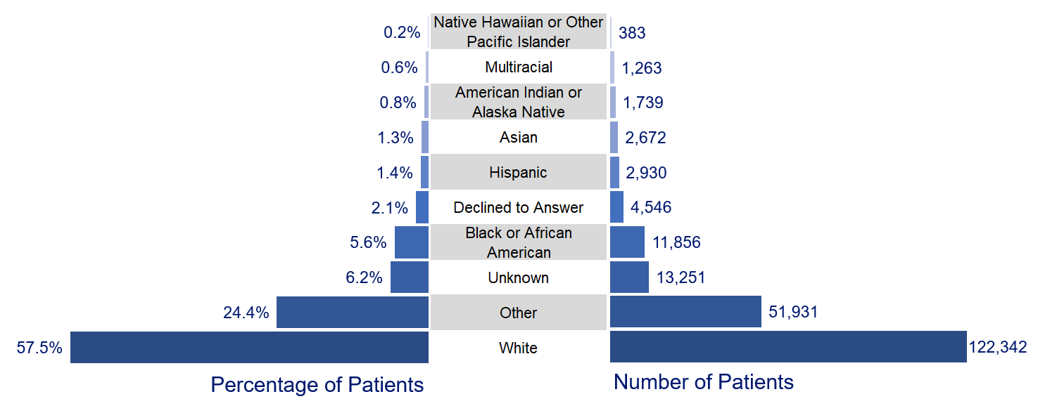
Hospital Discounted Care
Notes:
Patients in the Other group included patients who reported their Ethnicity as Asian, Black, Central American, Cuban, Filipino, Mexican, Multiple, Nepalese, Peruvian, Puerto Rican, and White.​

Slide 8
CICP, Hospital Discounted Care, and Primary Care Fund Report
Primary Care Fund tobacco tax monies to Community Health Centers and safety net clinics
Comprehensive primary care services year round to patients of all ages regardless of ability to pay
Sliding fee scale approved by HCPF
Incomes up to 200% of the FPG
Most recent data shows 36 qualified clinics served more than 115,000 medically indigent patients
SB21-212 directed HCPF to seek federal matching funds resulting in about $40 to 50 million in total funds for clinics annually
hcpf.colorado.gov/cicp
Notes:
Currently $29,160 per year for an individual or $60,000 per year for a family of four.

Slide 9
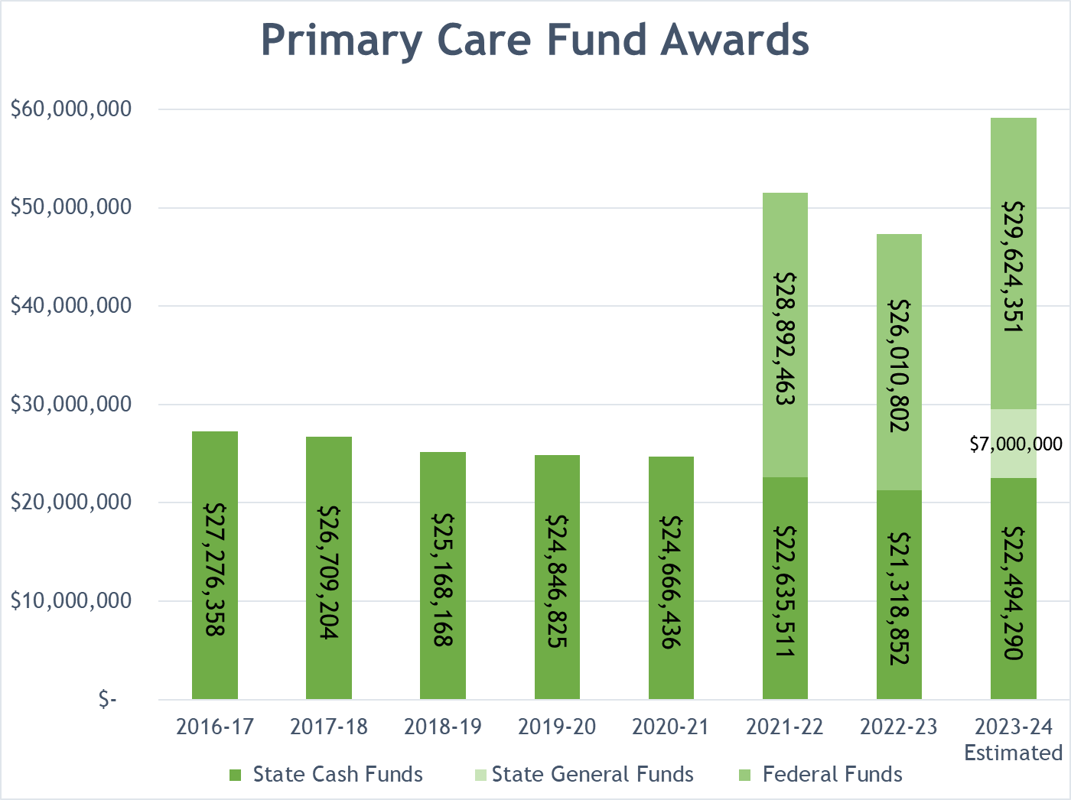
hcpf.colorado.gov/cicp
Notes:
Primary Care Fund clinics received more than $98 million in total funds for FYs 2021-22 and 2022-23 combined.
In FY 2022-23, funding of $47,329,654 was allocated to 36 Primary Care Fund clinics.
With their application for FY 2022-23, Primary Care Fund clinics reported serving 115,040 unique medically indigent patients in CY 2021.
Primary Care Fund payments for FY 2023-24 will include a one-time additional General Fund appropriation of
$7 million for a total of $14 million with federal matching funds to assist Community Health Centers during the COVID-19 public health emergency unwind.

Slide 10
Safety Net Legislation
HCPF agenda bill (not yet introduced)
Sunset CICP
11 clinics and 2 hospital have left so far
80% decline in patients
Patient confusion and administrative burden
Additional Primary Care Funding for safety net clinics with higher sliding fee scales
Ensure access for those with incomes 200-250% FPG
Disproportionate Share Hospital (DSH) payment policy incentivize hospitals to have generous charity care programs
Supported by CICP Advisory Council
HCPF 2024 Legislative Agenda Overview
hcpf.colorado.gov/legislator-resource-center
Notes:
“Colorado’s safety net programs have changed over time to better meet the needs of Coloradans,” said HCPF Executive Director, Kim Bimestefer.
“Given other safety net programs now in place, HCPF appreciates the collaboration of the General Assembly to enact these recommendations
to preserve access to care for low-income Coloradans and reduce administrative burdens for providers and patients.”
Funding for CICP participating clinics was eliminated in fiscal year 2021-22.
HCPF recommends sunsetting the 40-year-old CICP while enhancing the Primary Care Fund and addressing unintended administrative challenges under hospitals’ financial assistance requirements.
HCPF’s recommendations would infuse additional funding into the Primary Care Fund to support access at Community Health Centers and other safety net clinics

Slide 11
Safety Net Legislation
SB24-116, CHA proponent
Addresses administrative challenges in Hospital Discounted Care
Payment plans up to 6% of a patient's monthly income when the bill includes both the facility and the professional services
Hospitals may be Presumptive Eligibility (PE) sites for low income adults
Excludes rural health clinics
Physicians must report data for their services
leg.colorado.gov/bills/sb24-116
Notes:
“Colorado’s safety net programs have changed over time to better meet the needs of Coloradans,” said HCPF Executive Director, Kim Bimestefer.
“Given other safety net programs now in place, HCPF appreciates the collaboration of the General Assembly to enact these recommendations
to preserve access to care for low-income Coloradans and reduce administrative burdens for providers and patients.”
Funding for CICP participating clinics was eliminated in fiscal year 2021-22.
HCPF recommends sunsetting the 40-year-old CICP while enhancing the Primary Care Fund and addressing unintended administrative challenges under hospitals’ financial assistance requirements.
HCPF’s recommendations would infuse additional funding into the Primary Care Fund to support access at Community Health Centers and other safety net clinics

Slide 12
Hospital Reports
Purpose: transparency and accountability
Evaluate financial picture of hospitals and their community investments
CHASE, hospital provider fee (SB17-217)
Financial Transparency (HBs 19-1001 and 23-1226)
Community Benefit Accountability (HBs 19-1320 and 23-1243)
Hospital Price Transparency Posting Evaluation Report (SB23-252)
Plus Payment Variation Tool
hcpf.colorado.gov/hospital-reports-hub
Notes:
help the state, employers and communities collaborate with hospitals to save people money on health care,
prioritize ‘in-lieu-of-tax dollar' community investments,
address outlier hospital financials, and the immediate and lingering impacts of the COVID19 pandemic.
It also helps tackle industry challenges like the health care workforce shortage or mitigating unfunded care

Slide 13
CHASE
Reduces uncompensated hospital care and need to shift costs to private payers
In 2009 hospitals received about $0.54 cents on their dollar of costs for care provided to Medicaid patients; in 2022, $0.81
Increases hospital reimbursement
$464 million in 2022-23
Includes $119 million quality incentive payments and $12 million rural support payments
Funds Health First Colorado and CHP+ health coverage expansions for more than 622,000 Coloradans
hcpf.colorado.gov/hospital-reports-hub

Slide 14
CHASE Payment to Cost
Year | Medicare | Health First Colorado | Insurance | Self Pay | CICP/ Other | Overall
2019 | 0.72 | 0.75 | 1.85 | 0.26 | 0.71 | 1.07
2020 | 0.67 | 0.83 | 1.66 | 0.43 | 0.94 | 1.02
2020 w/ stimulus | 0.74 | 0.89 | 1.73 | 0.49 | 1.01 | 1.09
2021 | 0.73 | 0.80 | 1.72 | 0.35 | 0.99 | 1.05
2022 | 0.70 | 0.81 | 1.63 | 0.32 | 0.95 | 1.01
hcpf.colorado.gov/hospital-reports-hub

Slide 15
Financial Transparency
Net operating income $1.9 billion, $1.3 billion, and $2.0 billion in 2019, 2020, and 2021, respectively, declining 50% to $981 million
Increased labor costs, including contracted labor up 247.6% from 2019 plus inflationary pressure
Net income, which includes investment income, $2.3 billion, $1.8 billion, and $3.4 billion in 2019, 2020, and 2021, respectively, declining to $336 million in 2022
Operating costs plus stock market declines
hcpf.colorado.gov/hospital-reports-hub

Slide 16
Operating Net Income by Peer Groups (in millions)
Year | Large | Medium | Small | Total
2019 | $1,816.8 | $121.9 | -$25.5 | $1,913.2
2020 | $1,267.3 | $38.0 | -$8.8 | $1,296.5
2021 | $1,617.8 | $285.8 | $58.6 | $1,962.3
2022 | $893.6 | $107.2 | -$19.6 | $981.3
hcpf.colorado.gov/hospital-reports-hub
Notes:
small peer group with 25 or fewer beds,
the medium peer group with 26 to 90 beds and
the large peer group with 91 or more beds.

Slide 17
Net Income by Peer Groups (in millions)
Year | Large | Medium | Small | Total
2019 | $2,083.3 | $155.8 | $46.3 | $2,285.4
2020 | $1,662.8 | $53.5 | $127.0 | $1,843.3
2021 | $2,837.7 | $358.7 | $228.4 | $3,424.8
2022 | $255.2 | $39.5 | $41.4 | $336.1
hcpf.colorado.gov/hospital-reports-hub

Slide 18
Financial Transparency
Despite the 2022 shift, indications much of Colorado’s hospital industry is healthy
Except rural hospitals and our largest safety net hospital, Denver Health, disproportionately impacted by the pandemic and the influx of migrants
Net patient revenues are returning to trends seen before the pandemic
2022 median hospital reserve for Colorado was 183 days cash on hand
Stock market has rebounded through 2023
HB23-1226 improves transparency, more frequent data
hcpf.colorado.gov/hospital-reports-hub
Notes:
HB23-1226: Hospital Transparency improves hospital financial transparency data,
adds compliance penalties to the bill, improves M&A activity insights so that we can report on impact and curb mega-systems behaviors,
provides optics into monies leaving the state and going to system headquarters outside of Colorado, and increases data submissions from annually to quarterly.

Slide 19
Community Benefit Accountability
How tax exempt hospitals invest their community benefit dollars
Allows communities to see if their hospitals are investing in what their communities have identified as a health need in lieu of paying taxes
Hospitals’ fiscal year 2021, community benefit investment rose 13% to $1.09 billion
45 hospitals invested 6.9% of their patient revenues in the community
$125 million increase from the previous fiscal year
hcpf.colorado.gov/hospital-reports-hub

Slide 20
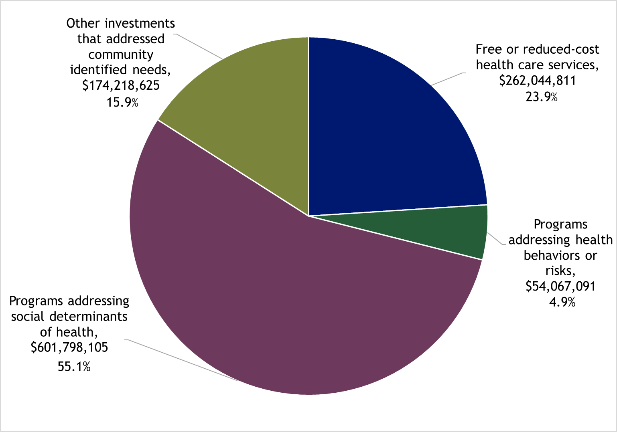
Community Benefit Accountability
hcpf.colorado.gov/hospital-reports-hub
Notes:
Free or reduced-cost health care services, i.e., charity care: $262.0 million, 23.9% of total community benefit.
Programs addressing health behaviors or risks: $54.0 million, 4.9% of total.
Programs that addressed social determinants of health: $601.7 million, 55.1% of the total.
Other investments that addressed community identified needs: $174.2 million, 15.9% of the total.

Slide 21
Community Benefit Accountability
Prioritized Community Health Needs
93.3% of hospitals prioritized behavioral health
80.0% of hospitals prioritized access to care
57.8% of hospitals prioritized chronic disease management
HB23-1243 expands current requirements
More expansive reporting of activities
Additional public engagement requirements
Evidence of how investments improves health outcomes
hcpf.colorado.gov/hospital-reports-hub
Notes:
Behavioral health includes needs such as mental health, substance abuse disorder, eating disorders, among others.
access to care related needs. These needs oftentimes are as simple as being able to access health care services within a reasonable distance from one’s home.
Effective August 2023, HB23-1243 changes hospital community benefit requirements by expanding on the current legislation reporting requirements and the information that will be requested from hospitals to the Department of Health Care Policy & Financing (HCPF). The new reporting requirements will increase the accessibility of hospitals’ public community benefit meetings and information reported from the hospitals to the community. The expansion of reporting requirements under HB23-1243 will allow for a more comprehensive analysis of hospitals’ community benefit investments.
Expanded reporting on community benefit activities, including
Free or discounted health-care services.
Behavioral health.
Community-based health care.
Social determinants of health spending, specifically;
Spending to address individuals needs such as housing, food, transportation, interpersonal violence, education, and job opportunities.
Provider recruitment, education, research and training.
Amount funded for each activity, identifying cash versus in-kind contributions.
Description of how activities and funding align with community priorities.

Slide 22
Price Transparency
Good, Fair, and Poor rating system to measure Colorado hospitals’ adherence to federal price transparency rules
Intended to drive more competitive and affordable hospital prices to benefit Coloradans and employers
Scorecard with evaluation of 101 Colorado hospitals between August and September 2023
Overall, 59.4% of all Colorado hospitals have a quality rating of Good
33% increase from prior evaluation
hcpf.colorado.gov/hospital-reports-hub

Slide 23
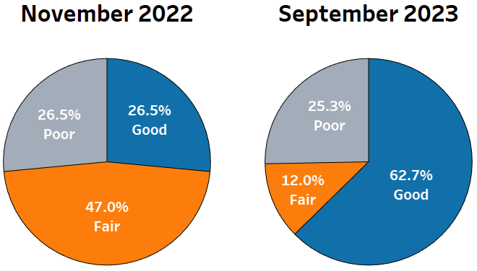
Price Transparency
hcpf.colorado.gov/hospital-reports-hub

Slide 24
Payment Variation Tool
Helps employer groups, insurance purchasers and business leaders save money on health coverage
Uses claims data to compare hospital inpatient payments statewide and identify high- and low-cost providers
By major diagnostic categories or even single procedures
Compare to statewide average or Medicare equivalent
hcpf.colorado.gov/hospital-reports-hub
Notes:
Crucial insights into what drives the cost of hospital care, which is the largest component of Coloradans’, employers’ and the state’s health care spending

Slide 25
Payment Variation Tool
hcpf.colorado.gov/hospital-reports-hub
Notes:
This visual demonstrates how easy it is to identify which hospitals are a high price for insurance carriers, resulting in higher claims payments in the state.
Users can hover over marks to identify the hospital and also see the dollar amount of payments.
Users can select from over 25 major diagnosis categories, such as cardiac or musculoskeletal care.

Slide 26
Questions?

Slide 27
Contact Info
Nancy Dolson
Special Financing Division Director
nancy.dolson@state.co.us
hcpf.colorado.gov/hospital-reports-hub
hcpf.colorado.gov/cicp

Slide 28
Thank you!

