Slide 1
Rural Provider Access & Affordability Stimulus Grant Program
Presented by: Nancy Dolson and Rebecca Parrott
CO.gov/HCPF/rural-provider-access-and-affordability-stimulus-grant-program

Slide 3
Agenda
Overview of authorizing legislation (Senate Bill 22-200) and Federal Requirements
Application requirements and timeline
Submission details/Successful application elements
Questions & Discussion
CO.gov/HCPF/rural-provider-access-and-affordability-stimulus-grant-program

Slide 4
Authorizing Legislation
Senate Bill 22-200 established the Rural Provider Access and Affordability Stimulus Grant Program
$9.6 million in grants to rural hospitals through American Rescue Plan Act (ARPA) State and Local Fiscal Recovery Fund (SLFRF) dollars for rural hospitals to improve health care affordability and access to care in rural Colorado
10 CCR 2505-10, Section 8.8000 provides the regulatory framework
CO.gov/HCPF/rural-provider-access-and-affordability-stimulus-grant-program
Notes:
The purpose of the SB22-200 is to improve health care affordability and access to care in rural Colorado. Grant payments will be allocated into two categories, affordability-related projects and care-related project to rural hospitals.
Colorado received over $3.82 billion in federal State and Local Fiscal Recover Fund (SLFRF) in 2021.
The Office of the State Controller (OSC) is responsible for developing SLFRF guidance, as well as providing oversight of SLFRF expenditures.
Grant managers are responsible for complying with all federal program guidelines, U.S. Treasury guidance, Office of the State Controller guidance, and Office of Management and Budget Uniform Guidance requirements.

Slide 5
SLFRF Federal Funding
Duplication of benefits
Supplanting funding
Best practices
Procurement standards

Slide 6
Notes:
A duplication occurs when a person, household, business, or other entity receives federal assistance from multiple grant sources for the same purpose, and the total assistance received for that purpose is more than the total need. The amount of the Duplication of Benefit (DOB) is the amount received in excess of the total need for the same purpose.
When total need for eligible activities is more than total assistance for the same purpose, the difference between these amounts is an “unmet need.” Grantees of federal grants must limit their assistance to unmet needs for eligible activities to prevent a DOB.

Slide 7
Notes:
Federal grant funds are expended to benefit the intended purpose defined in the authorizing statute
NOT intended to cover expenses that would otherwise be paid out using other funds
Ensures that the level of state and local support for a program remains constant and is not replaced by federal funds
• Supplementing happens when an entity uses federal grant funds in
combination with other funds for a planned expenditure in an existing
budget. Supplementing funds is allowable to the extent they are used
to meet the programmatic purpose and no other provision prohibits
its use this way.
Supplanting happens when an entity uses federal grant funds for a
planned expenditure to replace funds in an existing budget.
Supplanting is not allowed with federal grant funds.

Slide 9
Procurement Standards
2 CFR 200.317 through 200.327
State fiscal rules 24-30-202, C.R.S.

Slide 10
Procurement Standards

Slide 11
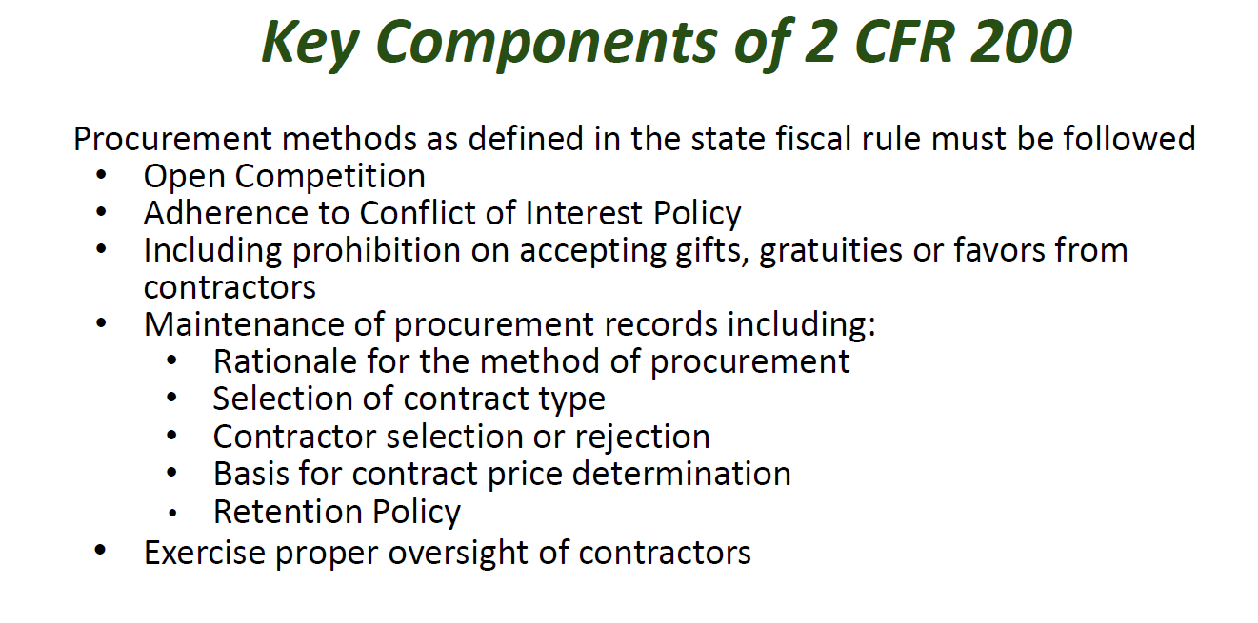
Procurement Standards
Notes:
Expenditures cannot occur prior to fully executed contract or grant agreement or identified start date whichever is later - no back dating.

Slide 12
Application Requirements and Timeline
CO.gov/HCPF/rural-provider-access-and-affordability-stimulus-grant-program

Slide 13
Application Requirements
Must be a Qualified Rural Provider per the regulation
Hospital located in a rural community
Lower net patient revenue or fund balance compared with other rural hospitals
Applicants may apply for up to $650,000 per project.
Projects must be identified as either an access or affordability project
CO.gov/HCPF/rural-provider-access-and-affordability-stimulus-grant-program

Slide 14
Access to Care Projects
Extending hours for access to primary care or behavioral health services
Investing in dual track emergency department management
Expanding access to Telemedicine including remote monitoring support
Providing new or replacement Hospital beds
Expanding access to long term care and recovery care in skilled nursing facilities
Creating or expanding sites that provide maternity care, surgical care, chemotherapy, imaging, and advanced imaging including computerized tomography scans, etc.
CO.gov/HCPF/rural-provider-access-and-affordability-stimulus-grant-program

Slide 15
Affordability Projects
Creating a shared analytics platform and care coordination platforms among Qualified Rural Providers
Enabling technologies, including telehealth and e-consult systems, that allow Qualified Rural Providers to communicate, share clinical information, and consult electronically to manage patient care
CO.gov/HCPF/rural-provider-access-and-affordability-stimulus-grant-program

Slide 16
Timeline
CO.gov/HCPF/rural-provider-access-and-affordability-stimulus-grant-program

Slide 17
Successful Application Elements
CO.gov/HCPF/rural-provider-access-and-affordability-stimulus-grant-program

Slide 18
Application Package
A. Application Information
B. Application
Parts I - III Form & Checklist
Part IV. Project Narrative Questions
Part V. Budget Narrative Questions
Part VI. Budget Worksheet Excel
Appendix
C. Rural Providers Qualified with no Additional Financial Data Needed
D. Scoring Guide
FAQs
CO.gov/HCPF/rural-provider-access-and-affordability-stimulus-grant-program

Slide 19
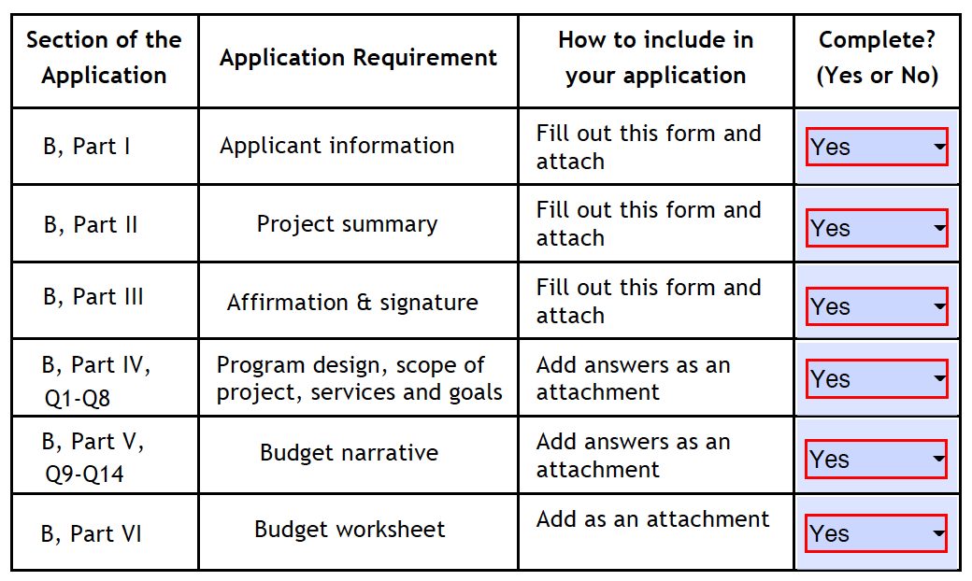
Must be Complete! Please Use this Checklist:
CO.gov/HCPF/rural-provider-access-and-affordability-stimulus-grant-program

Slide 20
Parts I-III: Forms
Include responses to Parts I, II, III:
Applicant Information
Who is applying, address, contact information, lead personnel
What if we are jointly applying? How do we fill out this page?
Project Summary Worksheet
Project title, type of project (access/affordability), total funds requested
Brief project summary (overview, 300 words or less)
Affirmation & Signature
CO.gov/HCPF/rural-provider-access-and-affordability-stimulus-grant-program
Notes:
Additional requirements for project summary worksheet:
Other ARPA grants
Start and end date
NOTE: Projects can commence no earlier than July 1, 2023 and all funds must be spend by grantees by Dec 31, 2026.

Slide 21
Part IV: Project Narrative Questions
Statement of Need – outlines the underlying problem (2 page limit)
Age of plant – what you seek to upgrade or replace & why (capital investments only, 1 page)
Access to specialty care – if applicable, how project will increase access to such care (1 page)
Care coordination – if applicable, how project will improve care coordination (1 page)
Partner engagement – identify partners in the project and their role (½ page)
CO.gov/HCPF/rural-provider-access-and-affordability-stimulus-grant-program

Slide 22
Part IV: Project Narrative Questions
Diversity, Equity and Inclusion – Explain your DEI strategy & how it supports communities (1 page)
Sustainability – How will the project goals & objectives be sustained for at least 5 yrs (1 page)
Financial need – For applicants that are not considered Qualified Rural Providers
Only complete if not listed in Appendix C
Submit information to support financial need (i.e.; low patient revenues and/or cash reserves)
CO.gov/HCPF/rural-provider-access-and-affordability-stimulus-grant-program

Slide 23
Part V: Budget Narrative
Total funds requested between $100K and $650K
Short budget narrative (300-word limit)
If appropriate, budget details: direct/indirect expenses, construction/equipment quotes, other
Indicate if leveraging other income/grants
Does not impact scoring
Can supplement, but cannot supplant
CO.gov/HCPF/rural-provider-access-and-affordability-stimulus-grant-program

Slide 24
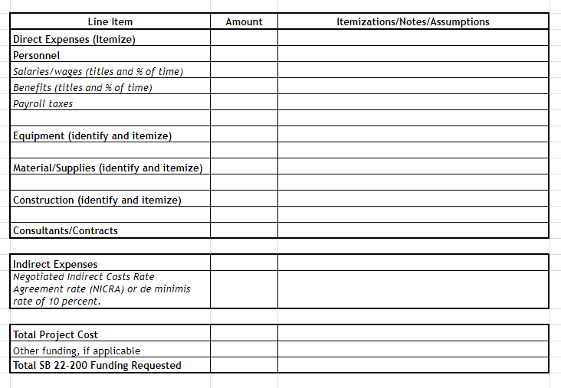
Part VI: Budget Worksheet
CO.gov/HCPF/rural-provider-access-and-affordability-stimulus-grant-program
Notes:
[Example categories shown below. Applicant should include applicable categories for the project and add lines as needed.]

Slide 25
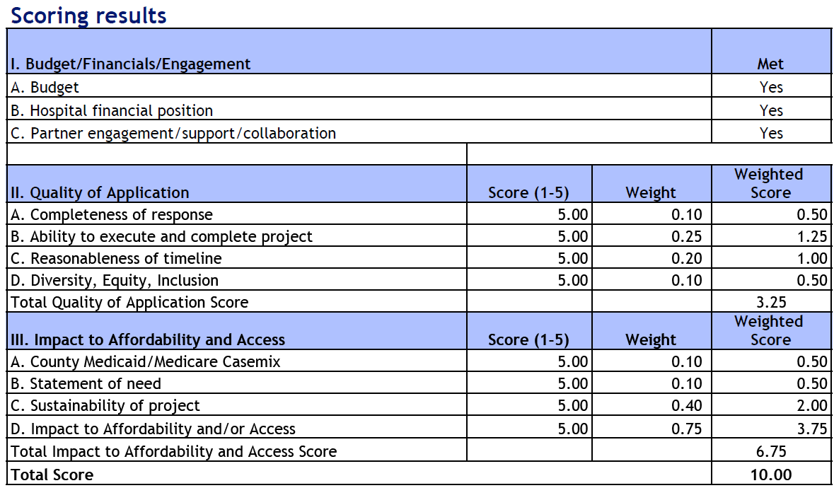
Scorecard
CO.gov/HCPF/rural-provider-access-and-affordability-stimulus-grant-program

Slide 26
Timeline
HCPF_RuralGrantProgram@state.co.us

Slide 27
Questions?
HCPF_RuralGrantProgram@state.co.us

Slide 28
Contact Info
Nancy Dolson
Special Financing Division Director
Nancy.Dolson@state.co.us
For submittal of questions, comments and applications:
HCPF_RuralGrantProgram@state.co.us
CO.gov/HCPF/rural-provider-access-and-affordability-stimulus-grant-program

Slide 29
Thank you!
CO.gov/HCPF/rural-provider-access-and-affordability-stimulus-grant-program

