Slide 1
Nursing Facility Stakeholder Meeting

Slide 2
Agenda
Announcement, Introductions
NF Transitions Presentation
P4P Updates
HB23-1228 Bill Signed - Updates
Sustainability/Innovation Plans
PDPM Transition plan
RUG/PDPM Data
PETI/PNA Rule Update
HB 22-1333 Cost Report Offset Feedback
SFY 23-24 iC Reimbursement Rate
SFY 23-24 Provider Fee & Supplemental Payment
Public Comment

Slide 3
Group In Reach
Community Programs & Supports Informational
Presented by: Chanelle Pugh
Notes:
Hello Everyone,
My name is Chanelle Pugh, I am the In-Reach Unit Supervisor. We wanted to take a quick moment to revisit Group In-Reach, its purpose, the implementation plan and receive some feedback from you all.

Slide 4
Background
The 2022 DOJ findings letter, recommended the state of Colorado make improvements to the Home and Community Based System by:
1. Providing Information to prevent Unnecessary institutionalization
2. Providing Effective transition Services
3. Expanding Access to Colorado’s Community-Based Service System
4. Increasing Access to Integrated Community-Based Housing Opportunities
Notes:
So as most of you know the State received a findings letter from the DOJ. In the letter stated some shortcomings within the State programs and gave us 4 suggestions on improvements. The suggestions were
1. Provide Information to prevent Unnecessary institutionalization
2. Provide Effective transition Services
3. Expand Access to Colorado’s Community-Based Service System
and
4. Increase Access to Integrated Community-Based Housing Opportunities

Slide 5
Purpose
The purpose of Group In-Reach is to educate individuals living in a Skilled Nursing Facility and their natural supports about community-based living options, waivers and supports in a group setting.

Slide 6
Progress to Date
DOJ negotiation are still in process with hopes of reaching an agreement this summer
Last fall stakeholders were informed on BA-07 budget request
proactively addresses the DOJ findings and recommendations
Included in that request are a number of policy changes that build upon the current structure
Group and Individual In-Reach to be conducted bi-annually
Individual In-Reach is not expected to be implemented until 2024

Slide 7
Implementation
Individual In-Reach will coincide with the current CMA timelines
Over the next 12-16 months HCPF Internal team will complete Group In-Reach
At conclusion we will seek feedback on the process for continuance and improvements

Slide 8
Group In-Reach Meeting Format
In Person group setting
Held in the Skilled Nursing Facilities
Visual presentation (where available) with handouts
After presentation provide support with making referrals

Slide 9
Information to be Shared
Qualifications for state programs
Services and Supports
Waiver Program
Transition Services process
Regional Contacts

Slide 10
Skilled Nursing Facility Specific Details
IIn-Reach team will reach out to each contact person at SNF to schedule
We will need space to gather all individuals interested in learning more about their options
Support to inform members of the scheduled meetings
We will bring a poster to hang with information (Best Practices)
Please fill out and share the survey to help identify how best to work with your organization
Notes:
We have added a link in the chat. Group In-reach is required moving forward as it has been approved in the next year's budget. We would like to collect more information on how to best serve the members and make the changes as productive as possible.

Slide 11
Questions?

Slide 12
Contact Info
Chanelle Pugh
In-Reach Unit Supervisor
chanelle.pugh@state.co.us

Slide 13
Thank you!

Slide 14
Open Comment

Slide 15
Pay for Performance
Applications scored appeals finalized
17-1 Hospitalization data unavailable:
The Department has decided to award all homes who applied for this measure and who met all of the minimum requirements for 17-2 and 17-3 the full 3 points for the measure. Scores have been updated in the portal.
Notes:
62 had findings, only 30 have responded There are 32 homes remaining who have not yet addressed their findings

Slide 16
HB 23-1228 Updates
Bill signed May 30th
Initial MSB regulation adopted June 9th
10% increase
PASRR and SBS increase
Removed references to RUG
CMS SPA submitted- they have until 8/15 to respond
Utilization and oversight regulations to follow
Notes:
Notes this was emergency authority and it will be re-reviewed in August to be permanent. Additional regulations are planned in the next few months.

Slide 17
HB 23-1228-Audited Financials
HB 23-1228 contained a requirement for financial oversight:
(I) ANNUAL AUDITED FINANCIAL STATEMENTS, PREPARED BY AN INDEPENDENT ACCOUNTANT, FOR A FACILITY, MANAGEMENT COMPANY, AND ANY RELATED PARTY CONDUCTING BUSINESS WITH A MEDICAID-CERTIFIED NURSING FACILITY, INCLUDING AUDITED AND CONSOLIDATED FINANCIAL STATEMENTS FOR ANY PARENT COMPANY THAT ACCEPTS, OR WHOSE SUBSIDIARIES ACCEPT, MEDICAID PAYMENTS FROM THE STATE OF COLORADO;
(II) DETAILS ON TRANSACTIONS BETWEEN RELATED PARTIES OR ENTITIES THAT HAVE COMMON OWNERSHIP; AND
(III) OWNERSHIP INTEREST IN REAL ESTATE, MANAGEMENT COMPANIES, FACILITY OPERATORS, AND ALL RELATED PARTIES.
HCPF is looking for feedback on timing (i.e. with cost report?)
Notes:
Notes this was emergency authority and it will be re-reviewed in August to be permanent. Additional regulations are planned in the next few months.

Slide 18
HB 23-1228-Sustainability plans
HB 23-1228 contained a requirement for sustainability and innovations plans:
(15) (a) EACH NURSING FACILITY THAT RECEIVES MEDICAID FUNDS SHALL DEVELOP AND SUBMIT A PLAN TO THE STATE DEPARTMENT THAT MEETS STATE DEPARTMENT STANDARDS AND DEMONSTRATES HOW THE NURSING FACILITY WILL:
(I) IMPROVE THE HEALTH AND SAFETY OF THE NURSING FACILITY'S RESIDENTS, INCLUDING INFECTION CONTROL AND STAFFING;
(II) INCREASE ACCESS TO CARE;
(III) IMPROVE FINANCIAL SUSTAINABILITY, INCLUDING OPPORTUNITIES FOR DIVERSIFICATION OF BUSINESS LINES AND STABILIZATION OF REVENUE STREAMS; AND
(IV) PROMOTE INNOVATION TO MEET THE EMERGING NEEDS OF INDIVIDUALS WITH DISABILITIES AND AGING AND OLDER ADULTS
HCPF is looking for feedback on timing (end of year?)
Notes:
Notes this was emergency authority and it will be re-reviewed in August to be permanent. Additional regulations are planned in the next few months.

Slide 19
PDPM Transition Data
RUG acuity is being phased out.
HCPF is using the higher of PDPM vs. RUG for July 2023 rates
117 of 181 will use PDPM rates
64 of 181 will use RUG

Slide 20
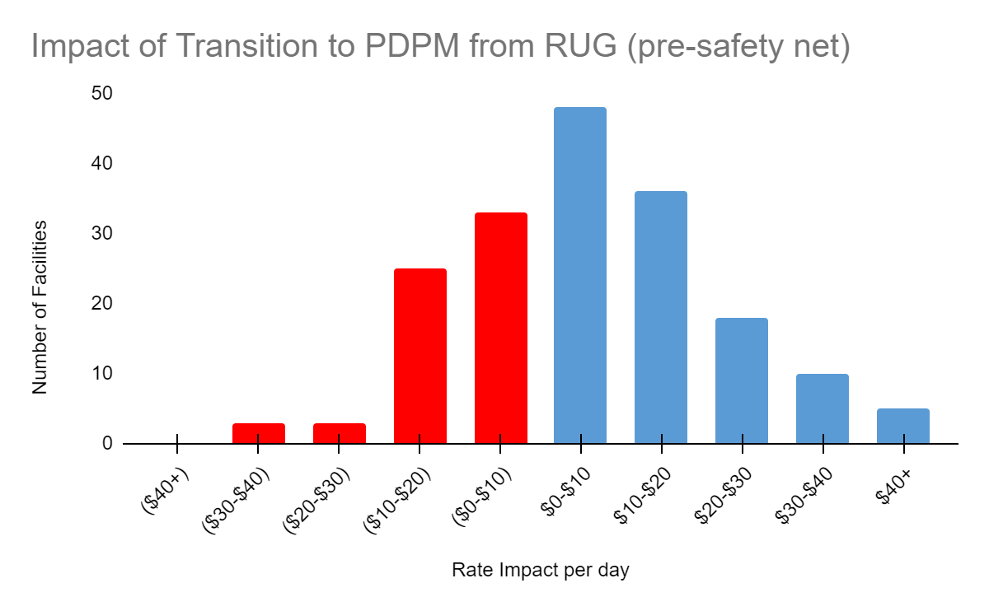
PDPM Transition Data
Notes:
Facilities

Slide 21
PNA / PETI Regulation
HCPF is also updating PNA / PETI Regulations including general updates to 8.400
Intended to clarify and enforce PNA account rules
Direct comments to Richard and Christine
Estate Recovery clarifications are being added
Draft Rules available by Friday June 23rd

Slide 22
HB 22-1333 min wage cost report offset
HB 22-1333 contained a requirement to offset revenues against the cost report.
HCPF intends to use the same formula imposed for HB 22-1247
The offset should be allocated between direct health care, other health care, and Administrative & General (A&G) costs based on the percentage of wages reported in these categories to total wages. These offsets should then be made against Schedule C, Lines 4, 27 and 35.

Slide 23
SFY 23-24 iC Reimbursement Rate
Changes to iC rate calculation
Statewide average iC rate increase from 3% to 10%
Greater-of PDPM and RUG (for SFY 23-24 only)
SFY | Average Core Rate | General Fund Limit | Average iC Rate
SFY 22-23 | $ 296.32 | 3.00% | $ 251.07
SFY 23-24 | $ 327.25 | 10.00% | $ 276.17
# Difference | $ 30.93 | 7.00% | $ 25.10
% Difference | 10.44% |  | 10.00%
Notes:
With 3.00% increase the iC rate would be $258.60 and only a $7.53 increase.

Slide 24
SFY 23-24 iC Reimbursement Rate
Delayed iC Rate implementation
10% allowable increase requires State Regulation and Federal State Plan approval
Received State Regulation approval May 9th
Will receive Federal State Plan approval by August 15th
CMS (Federal Medicaid partners) has 90 days to approve

Slide 25
SFY 23-24 iC Reimbursement Rate
Cannot utilize SFY 23-24 iC rates until 8/16/23
Claims billed during 7/1/23 - 8/15/23 with a DOS 7/1/23 - 8/15/23 will pay using SFY 22-23 iC Rates
For claims billed on/after 8/16/23 with a DOS on/after 8/16/23 will pay using SFY 23-24 iC Rates
Late August 2023 will mass adjust all previously paid claims with DOS 7/1/23 - 8/15/23
Notes:
DOS = Date of Service

Slide 26
SFY 23-24 iC Reimbursement Rate
Mass Adjustment of Previously Paid Claims
Lower-of pricing methodology
(Billed Amount & Calculated Amount)
With rate increase through mass adjustment, claim originally paid using lower-of Billed Amount will not pay with new (higher) SFY 23-24 iC rate.
What is Usual & Customary charges utilized by providers?

Slide 27
SFY 23-24 Fee Model
Change to Fee and Payment
Non-Medicare days increase (117k (2.7%) increase)
Per-diem fee increase w inflation (3.32% increase)
SFY | Fee | Payment
SFY 22-23 | $ 53.4M | $ 106.8M
SFY 23-24 | $ 55.2M | $ 110.4M
# Difference | $ 1.8M | $ 3.6M
% Difference | 3.5% | 3.5%

Slide 28
SFY 23-24 Fee Model
CPS and PASRR Payments
Per-diem * Resident Days
Per-diem based on % of Core rate
CPS increasing from 1% to 2%
PASRR increasing from 2% to 4%
Payments limited by fee/federal matching funds
CPS/PASRR payment increase means corresponding Core Component payment decrease

Slide 29
SFY 23-24 Fee Model
Delay in model utilization
Cannot implement util after Rule/State Plan approval
July fees & payments will be SFY 22-23 monthly fees and payments
August fees & payments will be SFY SFY 23-24 monthly fees and payments with July reconciliation
SFY 23-24 monthly transaction - July transaction

Slide 30
SFY 23-24
Wage Enhancement Payment
Letters provided to all eligible nursing homes June 13th
Payment will be made to eligible nursing homes on Friday, June 30, 2023

Slide 31
Open Comment

