Slide 1
Department Update
Kim Bimestefer, Executive Director
Notes:
Hello everyone, thank you for joining us today. It is great to be with you all today. It is wonderful to see all the Board members and a special thanks to Morgan for stepping up to run the meeting today. I would also like to welcome our newest member James McLaughlin. We are excited to have you on the Medical Services Board.
Board Members Present
Morgan Honea (Contexture),
James McLaughlin (Ute Pass Regional Health)
Simon Hambidge (Denver Health),
Laura Carroll (Medicaid Member),
William Kinnard (SCL Health St. Joseph Hospital),
Barry Martin (UC Health),
Idalia Massa-Carroll (Colorado PsychoEducational Assessment Services),
Christina Mulkey (Geriatric and Family Medicine Associates),
Vincent Scott (Family member with IDD)
Cecile Fraley (Southwest Pediatrics) and An Nguyen (Clinica Family Health) are excused from the meeting.

Slide 2
First month of data (snapshot)
First month of return-to-regular renewals - caution - only one month, snapshot in time, members have additional 90 days to return packets and respond
May data pulled on June 26 matches pre-pandemic rates - 56% renewed (compared to an estimated 57% pre-pandemic)
42% disenrolled (compared to 41% pre-pandemic)
Of those disenrolled, procedural denials (like not completing renewal paperwork) were 26% compared to 12% previously, and only 3% voluntarily disenrolled (should be higher given our outstanding unemployment rate)
Initial opportunities going forward, including our update your address campaign (36% of 26% procedural are “whereabouts unknown”)

Slide 3
Progress Made in Advance
Some of the work done so far:
PHE Unwind Goals
Member continuity of coverage
Smooth transitions in coverage
Minimize impact to eligibility workers & staff
Enhanced business processes and correspondence improvements make it easier for members to renew
Enhanced online tools: PEAK, HFC app, e-signature
34% increase in emails & text sign ups since April ‘22
>1/3 ex parte to reduce processing workload
Children eligible for CHP+ are auto enrolled into CHP+
Collaborated to increase county funding
C4H/HCPF collaboration (SB081) to fund coverage awareness: PSAs, printing, & outreach
Partnering across RAEs, providers, others to Keep Coloradans Covered - members outreach tools
Unwind press release & Website released 7/5 to improve Phase 2 communications and initiative alignment to achieve goals (learn from May insights)
KeepCOCovered.com
Notes:
Starting in March of 2020 and throughout the COVID 19 pandemic, many Coloradans who lost their jobs - and subsequently their employer sponsored health benefits - turned to Health First Colorado and as a result, Health First Colorado and CHP+ now provide health coverage to more than 1.7 million Coloradans or 1 in every 4. That includes more than half-a-million of Colorado’s children.
On December 29th, the federal government passed legislation requiring all states, including Colorado, to end the continuous coverage provision within the Families First Coronavirus Response Act.
Following guidance issued by our federal partners - the Centers for Medicare and Medicaid Services - or CMS – after more than a three-year pause, the Department of Health Care Policy & Financing in a joint effort with our county partners, is resuming our standard eligibility renewal and disenrollment processes for Medicaid and CHP+.
The renewal process will continue month by month, through April 2024, for all 1.7 million Health First Colorado and CHP+ members according to their renewal date, which means that we have already sent renewal notices and related information to any Health First Colorado and CHP+ member scheduled for renewal in May of 2023 and have started communications for those renewing in June.
As you have heard in our stakeholder presentations over the last couple of years, Colorado has focused its Unwind planning on achieving three key operational goals:
1) maximize member continuity of coverage,
2) focus on the member experience and smooth transitions in coverage, and
3) minimize impact to county and eligibility workforce.
In preparation for the end of the PHE, the state has made meaningful systematic advances over the last few years. About 1/3 of our current members will be automatically renewed and won’t need to take any action to remain covered. And children not requalifying for Medicaid but who are eligible for CHP+ will be automatically enrolled into CHP+.
We estimate that about 80% of our current members will still qualify for one of our programs between now and April 2024, and we are focused on ensuring that those Coloradans know what actions they need to take and that they take those required actions to facilitate their coverage renewal.
Additionally, our partnerships and our collaborative efforts are critical as we work together to renew an estimated 1.4 million Coloradans back into our programs while connecting an estimated 325,000 Coloradans to other forms of affordable coverage.
We have also enhanced numerous business processes and made correspondence improvements to make it easier for our members to renew coverage.
We have worked with our county partners, across state agencies and with the Joint Budget Committee, to secure additional funds to assist our counties through this unique chapter.
Colorado has been preparing for the end of the Public Health Emergency for nearly three years and are doing everything we can to meet the number one goal of continuity of coverage. Our partners at CMS recognize Colorado as a leader in our preparation and are confident with the steps we’ve taken to optimize our ability to ensure people stay covered.
if time:
Additionally, we’ve:
Enhanced use of info on hand to renew members without engagement.
Updated renewal packet
Enhanced online tools (PEAK, electronic signature)
Implemented Intelligent Character Recognition to minimize data entry and improve quality
And done Training & business process enhancements

Slide 4
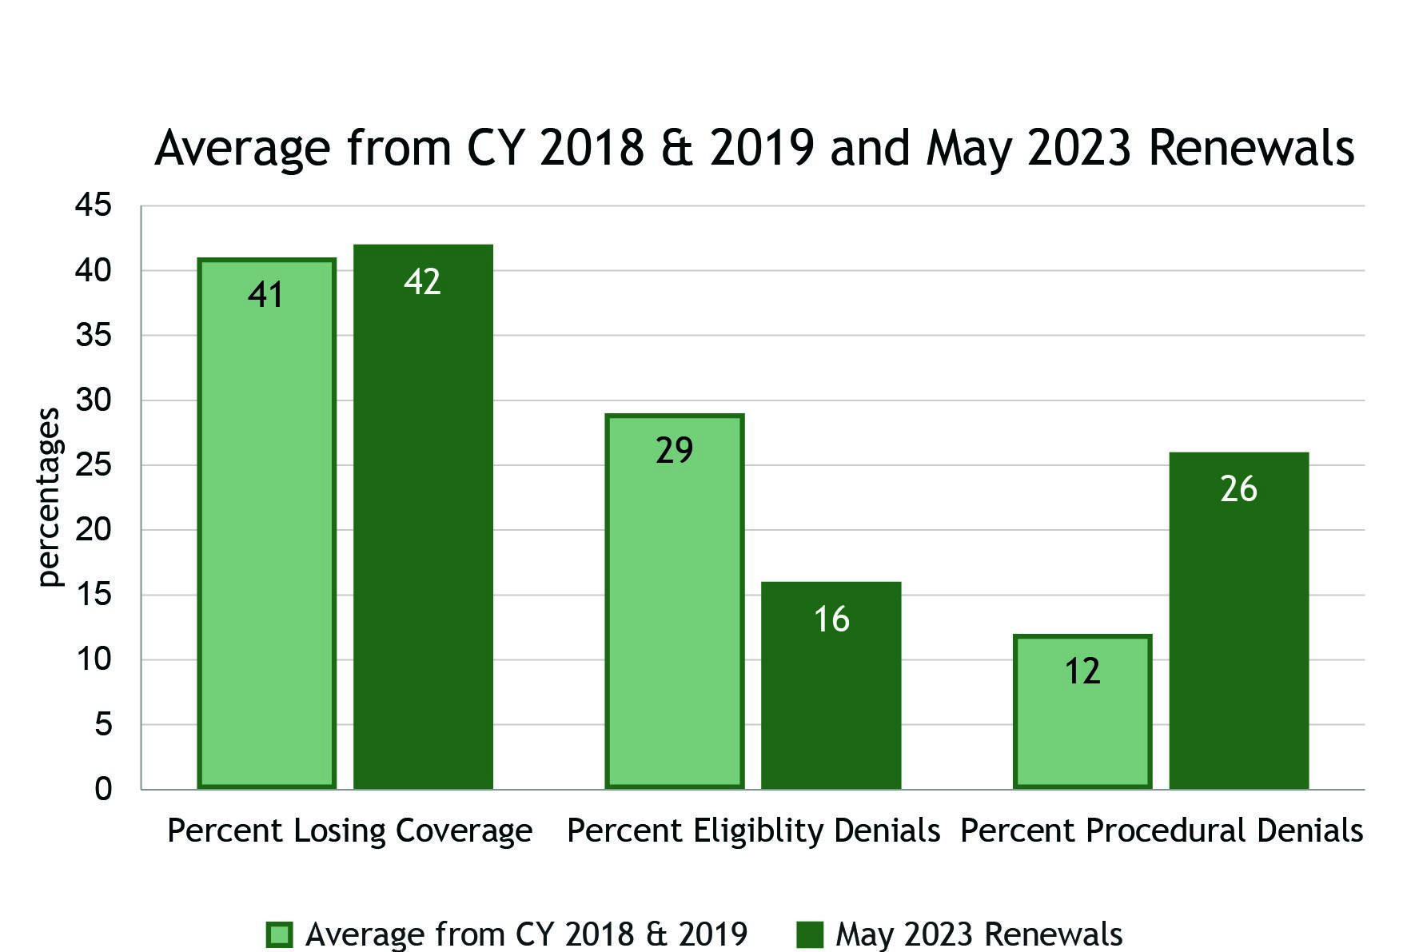
May Renewals & Historical Trends
Actions to reduce Procedural Denials
-Continue Update Your Address Campaign
-Continue Targeted Time to Renew Messaging/ Providers, RAEs & partners
Actions to connect eligibility denials to other coverage
-employer outreach
-C4 partnership
-#KeepCoCovered
Based on pre-pandemic data, on average about half of those losing coverage become eligible for Medicaid again within two years.

Slide 5
Other Communications & Initiatives
Reporting web page launched July 5
Press release went out July 5
Adjustments to outreach strategies to targeted groups based on forthcoming data
Demographic, race ethnicity and regional breakouts (coming in late July in time for quarterly stakeholder meeting)
Increase in other Dept engagement
Monthly files to Connect for Health for outreach
Working on new reporting format that updates each historic month
Seeking grant $s for additional outreach targeted to procedural denials

Slide 6
Join HCPF leaders as we share:
What we accomplished together last year
Address priorities for this fiscal year
Listen to your feedback and comments
Register: CO.gov/HCPF/events/2023-annual-stakeholder-webinar

Slide 7
Appendix

Slide 8
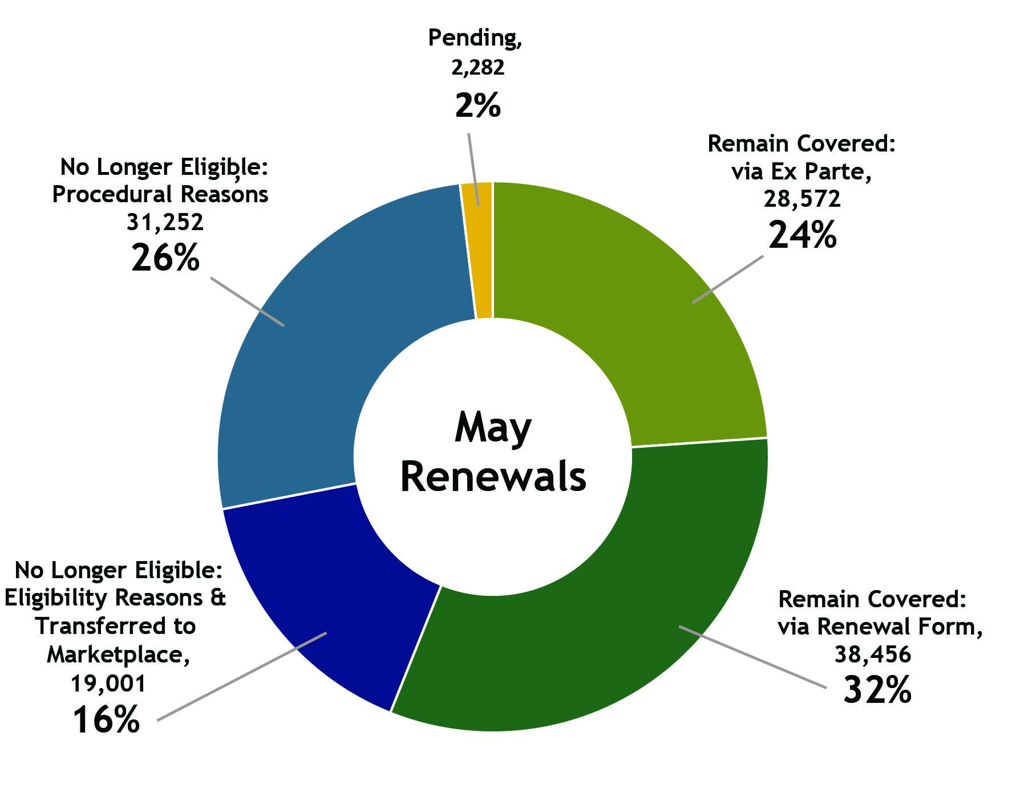
And Now…The DATA!
Procedural denials examples: didn’t respond, didn’t provide verification, didn’t sign renewal
Eligibility denials examples: over income, moved to Medicare, out of state, passed away, etc

Slide 9
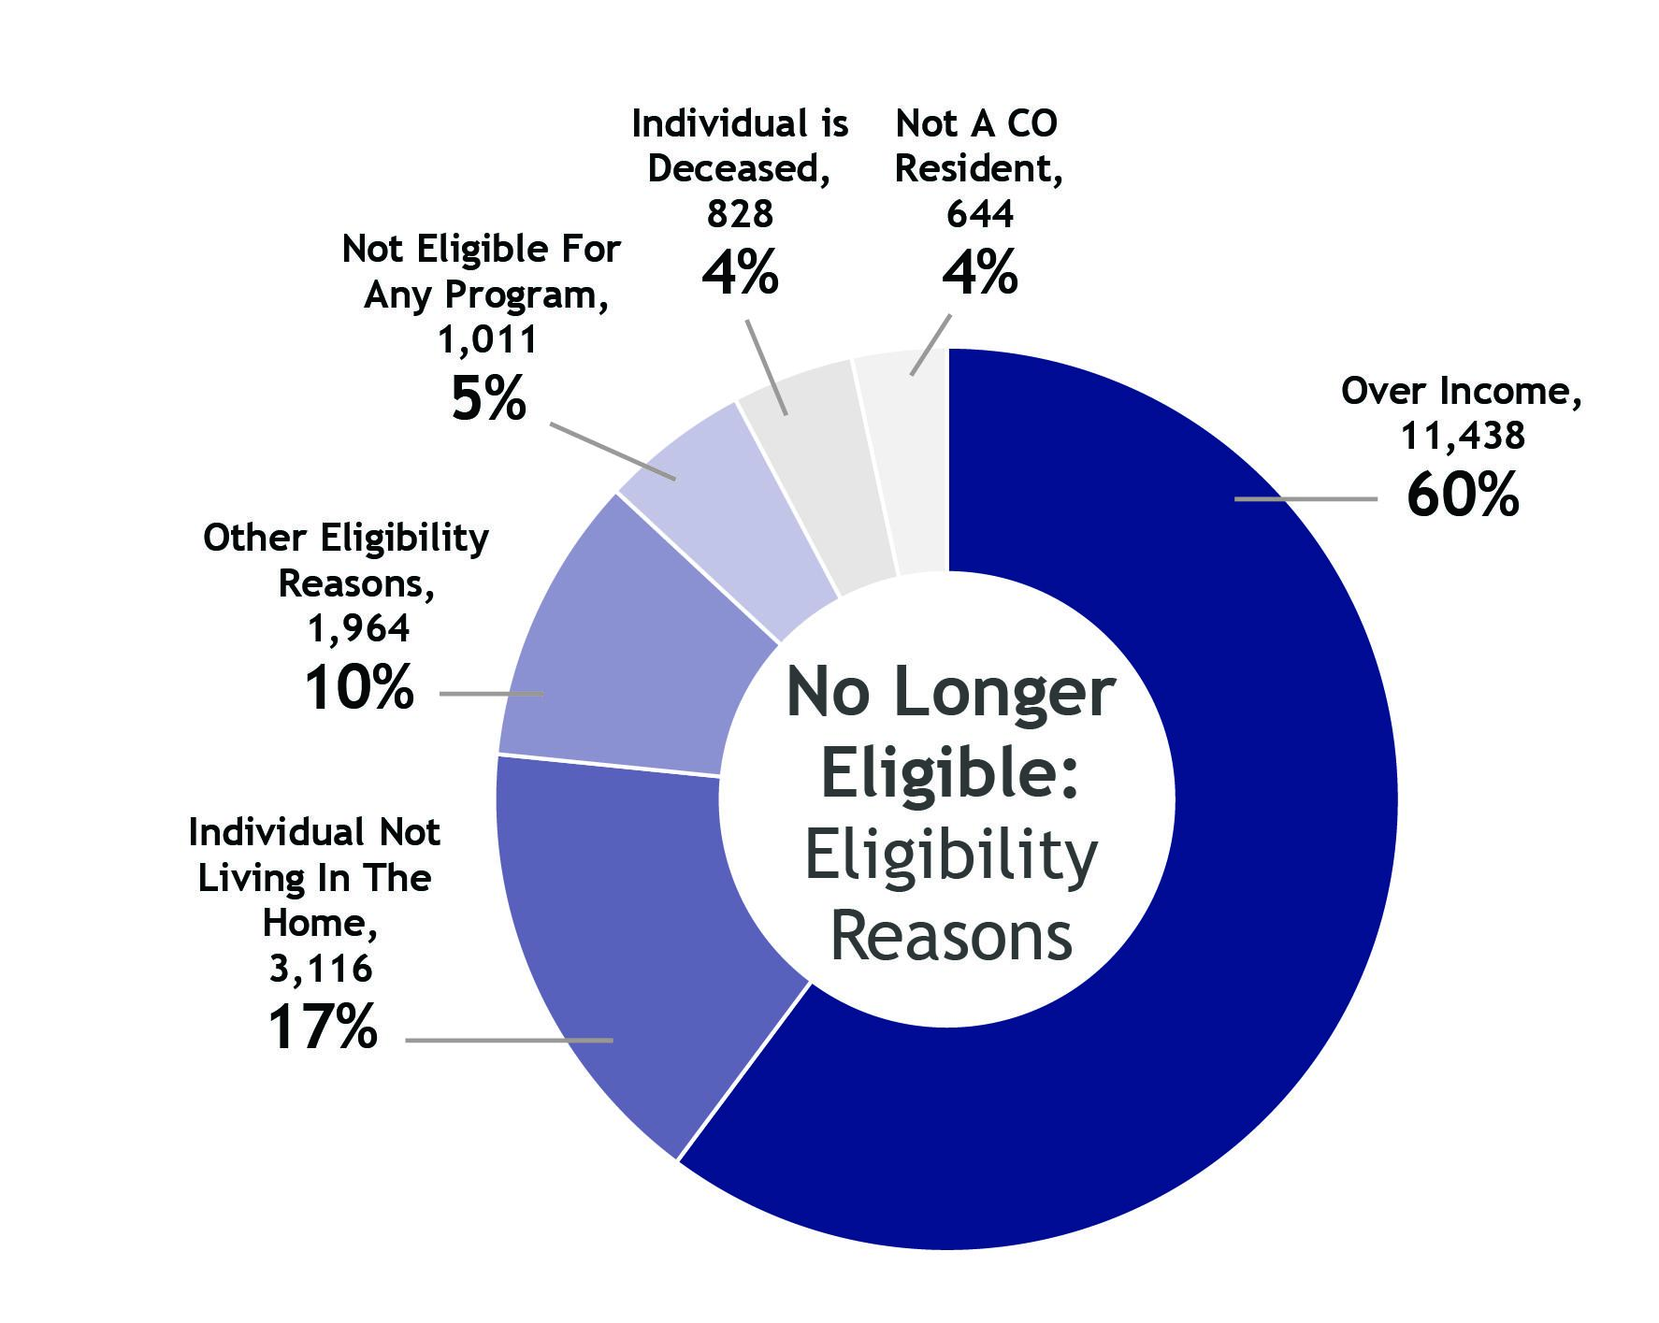
Top Eligibility Denial Reasons -
Majority Over Income (60%)
NOTE: CMS data reporting includes all eligibility denials within “sent to marketplace”. The marketplace is prioritizing outreach to certain denial reasons.

Slide 10
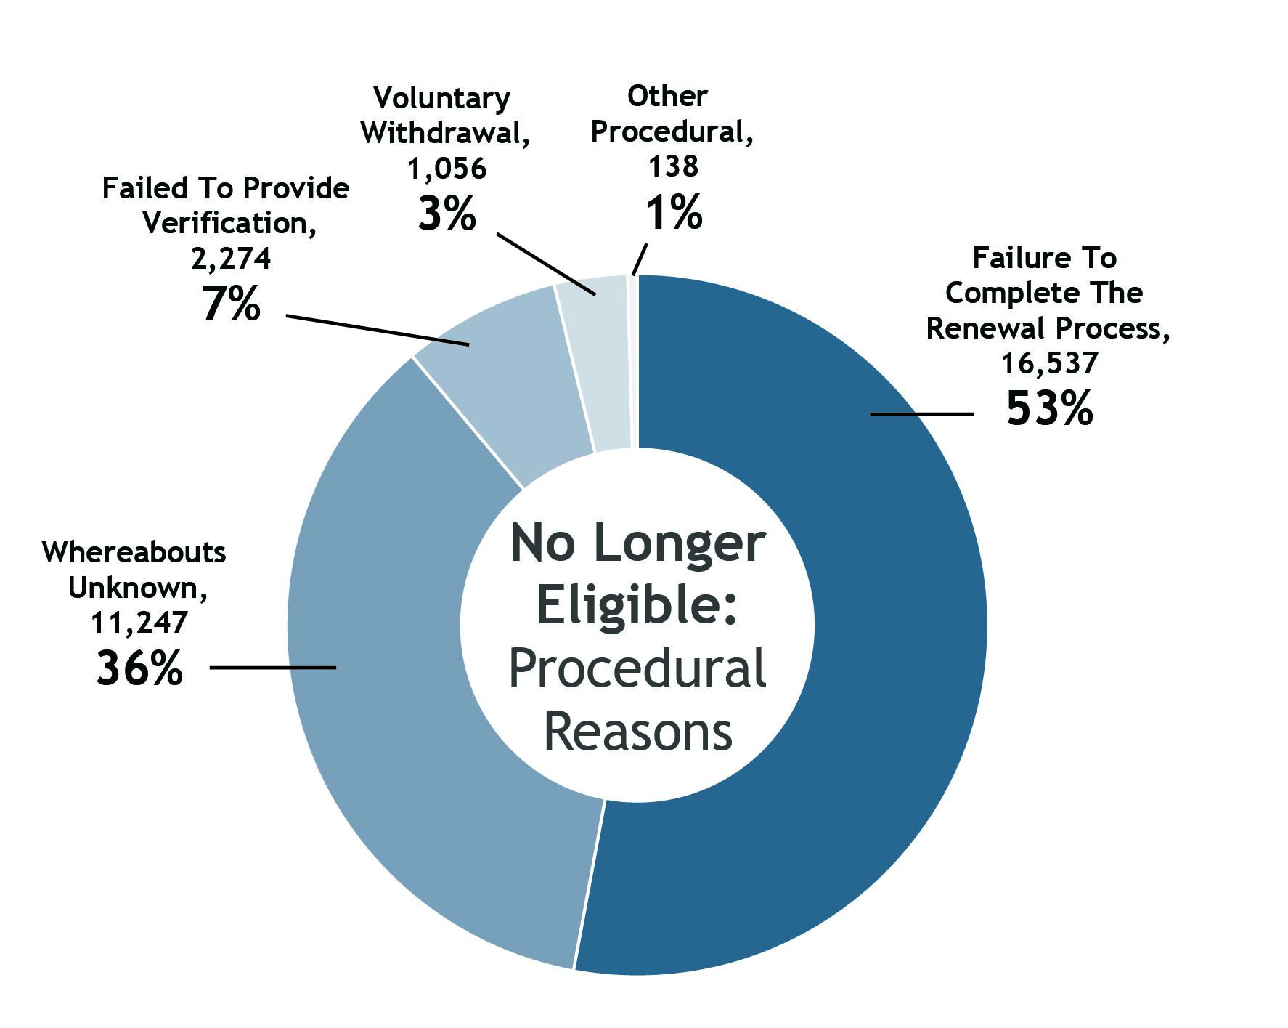
Top Procedural Denial Reasons -
Did Not Return Renewal Packet (53%) & Could Not Reach (36%)

