Slide 1
HOSPITAL STAKEHOLDER ENGAGEMENT MEETING
Friday, May 2, 2025
9:00 AM - 11:00 AM
Location: Online Only
All Hospital Zoom Meeting: Dial Toll-free 1-877-853-5257 / Meeting ID: 870 4490 0719 / Passcode: 245046
Topic Suggestions, due by close of business two weeks prior to the meeting. Send suggestions to Della.Phan@state.co.us.

Slide 2
Welcome & Introductions
Thank you for participating today!
We are counting on your participation to make these meetings successful

Slide 3
About this Meeting
We will be recording this meeting.
Please speak clearly when asking a question and give your name and hospital
A recording of this meeting will be posted to the Hospital Engagement Meeting website for later viewing.
Hospital Generated Topics: Please contact Della Phan at Della.Phan@state.co.us with requests to cover questions or topics in future hospital engagement meetings. Topics requested fewer than 2 weeks before the next meeting may need to be pushed to future meetings depending on availability of personnel with knowledge of those topics.

Slide 4
Dates and Times for 2025
General Hospital Stakeholder Engagement Meetings
Dates of Meetings | Meeting Time
January 10, 2025 | 1:00pm-3:00pm
February 7, 2025 | 9:00am-11:00am
March 7, 2025 | 9:00am-11:00am
May 2, 2025 | 9:00am-11:00am
June 13, 2025 | 1:00pm-3:00pm
July 11, 2025 | 1:00pm-3:00pm
September 5, 2025 | 9:00am-11:00am
November 7, 2025 | 9:00am-11:00am
The agenda for upcoming meetings will be available on our external website on a Monday the week of the meeting.
https://www.colorado.gov/pacific/hcpf/hospital-engagement-meetings
Please note the offset dates and times to work around holidays AND Medical Services Board

Slide 5
AGENDA
May 2025 Hospital Stakeholder Engagement Meeting Topics – mm:ss
Staffing Update – 4:20
June Hospital Engagement Meeting – 4:55
Hospital Specialty Drugs – 6:19
Senate Bill 25-205 (SFY25-26 Long Bill) – 19:00
2nd 30-day Review of Select Inputs to Inpatient Rates Rebasing – 20:28
Inpatient-specific Regulatory Updates – 24:38
Update to EAPG Version 3.18 Transition – 27:46
General EAPG Updates – 29:48
Regulatory Updates – 31:45

Slide 6
STAFFING UPDATE
Sean Paschke
Outpatient Hospital Rates Analyst
This Photo by Unknown Author is licensed under CC BY-NC

Slide 7
June Hospital Engagement Meeting
Department to host additional Hospital Stakeholder Meeting
June 13, 2025, 1:00 PM – 3:00 PM
Topics to include:
Update on Inpatient Hospital Base Rates
Discussion of Transplant DRGs
Transplant procedure costs
Organ acquisition cost review
General Updates
Meeting to be recorded, posted

Slide 8
Hospital Specialty Drugs
Hospital Specialty Drug Definition
Physician-administered drug (PAD) administered in an inpatient or outpatient hospital setting and billed on the UB-04 or 837I transaction
May also be referred to as a hospital-administered specialty drug
Approved Hospital Specialty Drugs are listed on Appendix Z
Claims are paid outside of the APR-DRG and EAPG methodologies
Member-specific prior authorization (PA) requests must be submitted directly to the Department
Most applicable request form is required, in addition to all clinical documentation
The PA must be approved prior to administration of the Hospital Specialty Drug
Retroactive requests are not usually considered
An approved PA does not guarantee payment
Note: Acentra does not currently process prior authorizations for Hospital Specialty Drugs
Any PA request submitted to and approved by Acentra for Hospital Specialty Drugs is not considered an approved PA
An approved PA is on file when a PA authorization number is received directly from Department PAD staff

Slide 9
Billing for OP and IP Administration
OP Administration
OP claim is billed and includes the following
Amount billed
Acquisition cost
Cost per NDC unit multiplied by the number of NDC units administered to the member
NDC of the drug administered to the member
Claim must be billed for a valid and reimbursable HCPCS/NDC combination
Units
Amount of drug administered to the member
Both HCPCS and NDC units must be billed
Invoice
Claim will be denied if no invoice is attached
Applicable policies: PAD, 340B, and IP/OP
IP Administration
Inpatient hospital claim is billed
IP claim must be in paid status before the next steps can be completed
Outpatient hospital claim is billed
All requirements for OP administration apply
Date of Service must fall within FDOS and TDOS of IP claim
In addition:
Modifier “SE” must be billed on the OP claim line
PAD and IP/OP policies apply
340B exception
340B inventory cannot be used when a Hospital Specialty Drug is administered in an Inpatient setting and billed on an Outpatient claim

Slide 10
Resources and Helpful Links
Appendix X: Healthcare Common Procedure Coding System (HCPCS) / National Drug Code (NDC) Crosswalk for Billing Physician-Administered Drugs
Valid and reimbursable HCPCS/NDC combinations
Billing Manuals: PAD, 340B, and Inpatient/Outpatient (IP/OP) Billing Manuals
Physician-Administered Drug Provider Resources web page
Additional policy information, procedures, forms, Appendix Z
Provider News
Sign up to receive communication regarding policy implementation, updates, and changes via monthly provider bulletins, weekly newsletters, provider type specific email blasts, etc.
Helpful Links
https://hcpf.colorado.gov/physician-administered-drugs
https://hcpf.colorado.gov/billing-manuals
https://hcpf.colorado.gov/bulletins
https://hcpf.colorado.gov/provider-news

Slide 11
Senate Bill 25-206 (Long Appropriations Bill)
Senate Bill 25-206 (State Fiscal year 2025-2026 Long Bill) signed by Governor Polis on April 28, 2025
Includes 1.6% across the board rate increase base rates, effective July 1, 2025:
Inpatient hospital
Outpatient hospital
Specialty hospitals
Freestanding psychiatric hospitals
More information to come on implementation dates of rates

Slide 12
2nd 30-day Review of Select Inputs to Inpatient Rates Rebasing ends on May 22, 2025
The 30-day review for Education-related Data/CMS Data/Other Data Inputs for FY25-26 Inpatient Rates closed April 16, 2025.
Thank you to those who responded and alerted the Department to a few changes which resulted in a second 30-day review of certain data elements within CMS Data/Other Inputs.
The following is a list of the specific data that has been updated and was posted for a second 30-day review on April 22, 2025:
Hospital Acquired Conditions (HAC) File: The HAC file available as of January 10, 2025, contained HAC scores for 2024. 2025 HAC scores were posted on the Centers for Medicare & Medicaid Services (CMS) website on February 19, 2025. The Department received notification of the timing mismatch and drafted modified language to its Code of Colorado Regulations. On April 11, 2025, the Medical Services Board approved the Department’s request to modify the regulatory language regarding inpatient base rate setting to allow for this difference in timing. Therefore, the HAC file was reposted with 2025 scores.

Slide 13
2nd 30-day Review of Select Inputs to Inpatient Rates Rebasing ends on May 22, 2025, cont’d
Payer Mix 3-Year Average used to create the Payer Mix Add-on: The Department’s original posting relied on information from hospital cost reports added to CMS’ Healthcare Cost Report Information System (HCRIS) after January 10, 2025. As a result, the Department has retrieved the intended cost report data to re-calculate the Payer Mix 3-year average.
3-Year Average Discharges used to create the Low Discharge Add-on: As this add-on is calculated from the same cost reports as the Payer-Mix add-on, the Department re-calculated the Low Discharge 3-Year Average.
Solvency Metric Calculations: The aggregated totals for system hospitals were incorrectly calculated and were amended.
As the 30-day review period for Graduate Medical Education and Indirect Medical Education data has expired, the Department will not consider further changes to this data. The Department will incorporate any changes that were reviewed and approved by Myers and Stauffer during the initial 30-day review period.

Slide 14
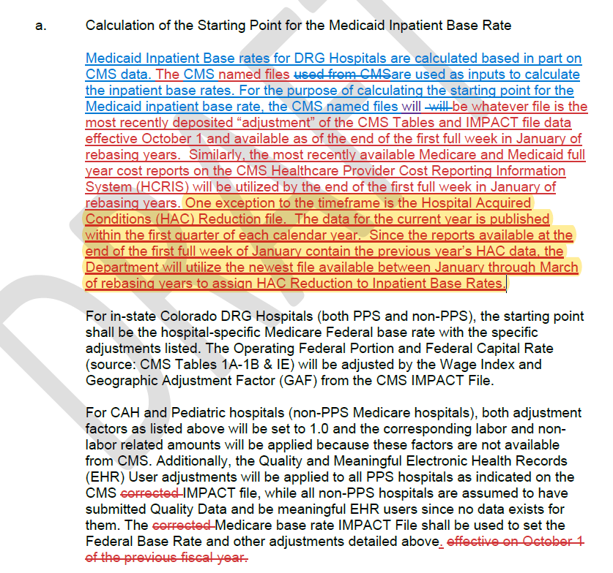
Final Rule Changes allowing for CMS file availability changes
This screenshot shows the yellow highlighted portion of the paragraph deposited in 8.300.5.A.3.a: “Calculation for the Starting Point for the Medicaid Inpatient Base Rate.”
This language allows for using the new Hospital Acquired Conditions (HAC) file on the CMS website if it is available within the first quarter of the calendar year in rebasing years.

Slide 15
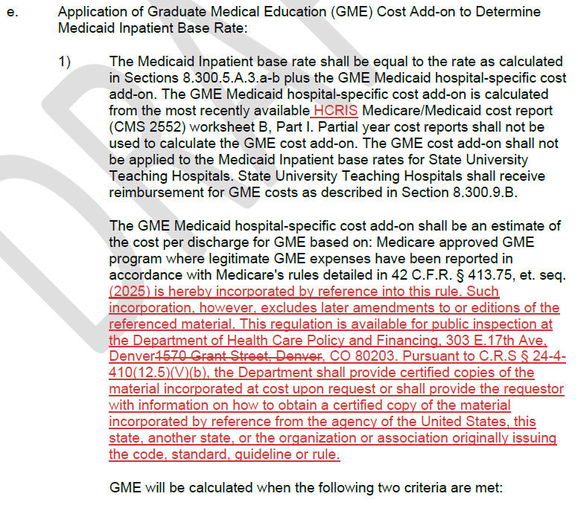
Rule Changes suggested by the Attorney’s General Office
This screenshot shows the necessary language required to “incorporate by reference” Medicare’s rules. This is standard language that was missed during the Rule change process two years ago.

Slide 16
Timeline on Inpatient Hospital Regulatory Changes
Next up on Colorado Rule Changes: These rule changes were presented to the Medical Services Board (MSB) on April 11, 2025, with the final adoption scheduled for May 9, 2025. Here’s the link to the MSB website if you’d like to attend: https://hcpf.colorado.gov/medical-services-board.
Colorado State Plan Changes: State Plan changes will be submitted later when rates are finalized, and we know the budget neutrality factor for FY 2025-26. The exact same nature of changes in Rule shown here today and March’s Hospital Engagement Meeting will be made to Colorado State Plan 4.19A and 4.19B.
If any stakeholder would like to get a copy of the proposed Colorado Rule and/or State Plan changes, please email Diana Lambe and Andrew Abalos at diana.lambe@state.co.us and andrew.abalos@state.co.us.

Slide 17
Update to EAPG Version 3.18 Transition
Proposed EAPG Weights Posted to Outpatient Hospital Payment Website on March 14, 2025
Email sent March 17, 2025, deadline for feedback April 18
No feedback received
Department will be implementing proposed EAPG weights for Version 3.18, to be effective for outpatient hospital claims for dates of service on or after July 1, 2025
Solventum to include Colorado EAPG 3.18 configuration in upcoming release
Will not be in use until all SPA approvals received
Initiated system re-configuration process to accommodate new version

Slide 18
General EAPG Updates
EAPG Module Update
Solventum released General Availability Version 2025.1.0 on March 27, 2025
Installed within interChange April 1, 2025
Applied quarterly CPT/HCPCS updates
Upcoming releases
General Availability release Version 2025.2.0 on June 26, 2025
Anticipated installation within first week of July 2025
To include settings for EAPG Version 3.18 (see previous slide)

Slide 19
Regulatory updates
Inpatient Hospital Housekeeping Update
State Plan Amendment
Public Noticing required
Code of Colorado Regulations Update
Presented to Medical Services Board April 11, 2025
Effective July 1, 2025
340B Rate Reduction (80% -> 65%)
State Plan Amendment
Public Noticing required
Code of Colorado Regulations Update
Presented to Medical Services Board April 11, 2025
Rule failed – will be presented to Medical Services Board June 13, 2025 as emergency rule for July 1 effective date

Slide 20
Regulatory updates cont’d
Senate Bill 25-206 1.6% Rate Increase Effective July 1, 2025 for:
Specialty Hospitals (Per Diem)
Freestanding Psychiatric Hospitals (Per Diem)
Inpatient Hospital Base Rates (DRG)
Outpatient Hospital Base Rates (EAPG)
State Plan Amendments required, related public noticing to occur

Slide 21
Questions? Comments? Solutions?

Slide 22
Thank You!
Kevin Martin
Fee for Service Rates Division Director
Kevin.Martin@state.co.us
Andrew Abalos
Facility Rates Section Manager
Andrew.Abalos@state.co.us
Diana Lambe
Inpatient Hospital Rates Analyst
Diana.Lambe@state.co.us
Sean Paschke
Outpatient Hospital Rates Analyst
Sean.Paschke@state.co.us
Della Phan
Specialty Hospital Rates Analyst
Della.Phan@state.co.us
Raine Henry
Hospital and Specialty Care Section Manager
Raine.Henry@state.co.us
Chris Lane
Specialty Care and Facilities Unit Manager
Christopher.Lane@state.co.us
Diva Wood
Hospital Policy Specialist
Diva.Wood@state.co.us
Jessica Short
Hospital Policy Specialist
Jessica.Short@state.co.us

