Slide 1
HOSPITAL STAKEHOLDER ENGAGEMENT MEETING
Friday, March 7, 2025
9:00 AM - 11:00 AM
Location: Online Only
All Hospital Zoom Meeting: Dial Toll-free 1-877-853-5257 / Meeting ID: 870 4490 0719 / Passcode: 245046
Topic Suggestions, due by close of business two weeks prior to the meeting. Send suggestions to Della.Phan@state.co.us.

Slide 2
Welcome & Introductions
Thank you for participating today!
We are counting on your participation to make these meetings successful

Slide 3
About this Meeting
We will be recording this meeting.
Please speak clearly when asking a question and give your name and hospital
A recording of this meeting will be posted to the Hospital Engagement Meeting website for later viewing.
Hospital Generated Topics: Please contact Della Phan at Della.Phan@state.co.us with requests to cover questions or topics in future hospital engagement meetings. Topics requested fewer than 2 weeks before the next meeting may need to be pushed to future meetings depending on availability of personnel with knowledge of those topics.

Slide 4
Dates and Times for 2025
General Hospital Stakeholder Engagement Meetings
Dates of Meetings | Meeting Time
January 10, 2025 | 1:00pm-3:00pm
February 7, 2025 | 9:00am-11:00am
March 7, 2025 | 9:00am-11:00am
May 2, 2025 | 9:00am-11:00am
July 11, 2025 | 1:00pm-3:00pm
September 5, 2025 | 9:00am-11:00am
November 7, 2025 | 9:00am-11:00am
The agenda for upcoming meetings will be available on our external website on a Monday the week of the meeting.
https://www.colorado.gov/pacific/hcpf/hospital-engagement-meetings
Please note the offset dates and times to work around holidays AND Medical Services Board

Slide 5
AGENDA
March 2025 Hospital Stakeholder Engagement Meeting Topics – mm:ss
Update to EAPG Version 3.18 Transition – 3:17
EAPG Category Payment Differentials – 11:40
Observations on Payment Changes – 12:11
Correction to Hospital Acquired Conditions Version in APR-DRG Settings – 20:08
Clarification on Interpretation of Present on Admission Indicators - 22:14
Upcoming 30-day Review of Inputs to Inpatient Rates Rebasing – 24:17
Proposed Inpatient-specific Regulatory Updates – 27:51
Regulatory Updates – 36:10
Provider Services Call Center Changes - 37:50

Slide 6
Update to EAPG Version 3.18 Transition
Identify all in-state FFS EAPG-paid claims with service dates within CY23
Identify Medicaid-only Claims
Remove instances of duplicate drugs billed in dataset
Remove claims where non-EAPG payment was made on any line (LARCs, specialty drugs, opioid antagonists)
Use 3M/Solventum Software to reprocess all claims identified under EAPG 3.18 using rates effective January 1, 2023 for entire dataset
Equally weight payments across year, reduce seasonality effects

Slide 7
Update to EAPG Version 3.18 Transition.
Determine Scaling Factor
Determine number to uniformly multiply Solventum national weights by for EAPG Version 3.18 such that total payments across system is equal total payments calculated from prior version in Solventum software
Drug re-weighting (3.47% reduction, 42.93% increase) to still apply throughout transition
Reprocess claims in Solventum software using scaled National Weights for version 3.18
Compare total claims payments between 3.18 and 3.16
Identify variances in payments by hospitals, services

Slide 8
.Update to EAPG Version 3.18 Transition
1.9 million fee for service outpatient hospital claims analyzed
~9 million billed services
Total Allowed Payments using version 3.16, 65% 340B Rate Reduction
$741.9 million
Total Allowed Payments using version 3.18, 65% 340B Rate Reduction
$283.1 million
Scaling Factor: 2.620542

Slide 9
EAPG Category Impacts
Top 10 Payment Changes per EAPG Category (Positive Impacts)

Slide 10
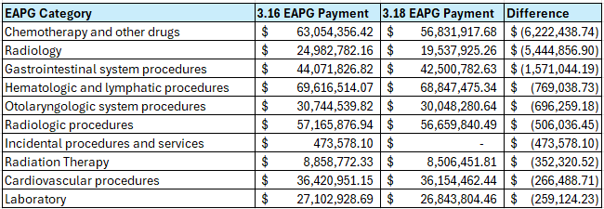
EAPG Category Payment Differentials
Top 10 Payment Changes per EAPG Category (Negative Impacts)

Slide 11
Observations on Payment Changes
Chemotherapy and Drug EAPGs
Several of the changes in drug payments attributable to decreasing Average Sales Price
Radiology
EAPG 288 (Level I Diagnostic Ultrasounds) is currently being separately paid when billed with more resource dominant procedures, therefore now eligible for bundling instead of always being separately payable
Gastrointestinal System Procedures
Lower weight over versions – i.e. service is relatively cheaper to provide

Slide 12
Radiology Example
SCENARIO:
Patient visits Emergency Room with Unspecified Chest Pain
Diagnostic procedures include basic ultrasound and CT scan
Example below when both are provided:
EAPG | Procedure | Prior EAPG Version | New EAPG Version
288 (Level I Diagnostic Ultrasound) | 93971 Extremity Ultrasound | Separately Payable | Packaged (no separate payment)
302 (Computed Tomographic Angiography) | 71275 CT Scan of Blood Vessels of Chest w Contrast | Separately Payable | Separately Payable
Extremity ultrasound (or more broadly, services in EAPG 288) will still separately reimburse in version 3.18 when provided as a standalone service
Costs associated with these codes built into more resource-dominant EAPG payments (Significant Procedures, Medical Visits), slightly higher payments

Slide 13
Further Observations on Payment Changes
Certain diagnoses have higher weights over time, i.e. increasing relative costs for outpatient hospital treatment, including:
Viral Illnesses (including COVID-19)
Upper respiratory tract infections
Bacterial skin infections
Open wounds, punctures, other open traumatic injuries

Slide 14
Payment Differentials
To be posted week of March 10, 2025
Full EAPG Service Category Differentials
Hospital-specific Payment Differentials
Proposed EAPG 3.18 Weights
Seeking hospital feedback on proposed weights by April 18, 2025
Please email all questions and concerns to Andrew Abalos (andrew.abalos@state.co.us)

Slide 15
CORRECTION: HAC Version
November 2024 Hospital Engagement Meeting, Slide 13 contained incorrect information
HAC Version – HCPF uses HAC version for Medicaid, not Medicare
Medicaid setting has been used since APR-DRG implementation (January 2014)
For Medicaid HACs, HAC 10 (Deep Vein Thrombosis / Pulmonary Embolism) is excluded for pediatric (less than 18 years of age) & obstetric patients
APR-DRG version 40 Grouper Settings from November 2024 Hospital Engagement Meeting
Documentation on Inpatient Hospital Payment page to be updated

Slide 16
Corrected APR-DRG Ver 40 Grouper Settings
Here’s the APR-DRG Version 40 Grouper Settings Colorado Medicaid uses to process inpatient hospital claims on the 3M Grouper. This will appear on the revised Version 40 weight table in a separate tab.
Reimbursement Scheme: Colorado Medicaid
Keyed by: Discharge date
Grouper Version: APR DRG Grouper Version 40.0 (10.1.2022)
Interpretation of Undetermined POA Indicators: 0 - W treated as N; U treated as N
PPC version: None
HAC version: HAC Version 40.0 for Medicaid (10.1.2022)
Payer Logic Indicator: None (Standard 3M APR-DRG)
Birth weight option: Coded weight with default
Discharge DRG option: Compute excluding only non-POA Complication of Care codes
Entered code mapping: Automatically Determine Code Mapping
Mapping Type: Historical
Mapping based on: Discharge date

Slide 17
Interpretation of Undetermined POA Indicators
Clarify ambiguity on Interpretation of Undetermined Present on Admission (POA) Indicators
For APR-DRG Grouping, the Department uses:
W treated as N; U treated as N
Aligns with information on previous slide
For HACs, the Department uses:
W treated as Y; U treated as N
Cannot be altered by HCPF, hard-coded into 3M/Solventum module
APR-DRG Grouping relies on POA indicators in DRG and Severity of Illness Assignments, in addition to Complication of Care and High mortality rate diagnoses

Slide 18
Timeline for Education-related data 30-day Review Period rates effective 7/1/2025
Timeline for Education-related adjustments/add-ons | Due Date
Myers & Stauffer (M&S) pulls from HCRIS the most recently available cost reports as of the end of the first full week in January of each rebasing year | 1/10/2025
M&S performs calculations and have data available for delivery to Department | 3/10/2025
The Department reviews and posts Indirect Medical Education (IME) Ratios/Graduate Medical Education (GME) cost per Discharge to website for hospital review/sends Constant Contact email notifying stakeholders | 3/17/2025
30 Day IME/GME Hospital Review Period ends | 4/16/2025
M&S works with hospital responses to amend as necessary | 4/30/2025
Department receives finalized IME/GME data to include in inpatient base rate model worksheet | 5/1/2025
This is essentially the same timeline we used for our prior rebasing. Dates were adjusted to avoid due dates on weekends/holidays.

Slide 19
Timeline for CMS data 30-day Review Period rates effective 7/1/2025
CMS Data 30-day Review period will be available for review in same GME/IME workbook posted on 3/17/2025 with any requested changes due by end of day 4/16/2025 to diana.lambe@state.co.us.
Hospitals will need to provide an email containing copies of letters from their Hospital Intermediary showing the incorrect data and the correction that will be used to adjust their hospital’s data points used in rate building to Diana Lambe and Andrew Abalos at diana.lambe@state.co.us and andrew.abalos@state.co.us.
Below are the specific data elements that hospitals can request a change if still incorrect after the final "correcting" files posted by CMS as of the end of the first full week in January have been posted.
Medicare Labor-related amount | Operating Indirect Medical Education (IME) %
Wage Index | Capital IME %
Medicare Non-labor Related Amount | Value Based Purchasing (VBP) Adjustment Factor
Federal Capital Rate | Readmission Factor
GAF (Geographic Adjustment Factor) | Hospital-Acquired Condition (HAC) Payment Reduction

Slide 20
New this year, we'll be posting Payer Mix, Low Discharge and Solvency Metric data for review
HCRIS and Hospital Transparency Data that make up the following three add-ons will be available in the same workbook as Education-related data/ CMS Data Inputs: Payer Mix, Low Discharge and Solvency Metric.
If hospitals dispute the data points that make-up the three add-ons, please provide copies of HCRIS data and/or submissions of Hospital Transparency Data showing the specific difference to Diana Lambe and Andrew Abalos at diana.lambe@state.co.us and andrew.abalos@state.co.us by the end of the 30-day review period on 4/16/2025.
Please be aware that there is an additional 30-day review of the final rates after the State Budget Action is announced and the rate workbook is approved by upper management and posted to the department website: https://hcpf.colorado.gov/inpatient-hospital-payment.

Slide 21
Correction on November Slide for Payer Mix Columns & Lines Pulled
The example created for the discussion on Payer Mix last fall, should have included Line 18 in both the numerator and denominator.
Please know our data mobilization has always included Line 18 in both numerator and denominator, despite having no data in Line 18 to date.
FY25-26 Payer Mix Data Pulls for Worksheet S-3, Part 1 are detailed below.
PAYER MIX NUMERATOR: COLUMN 7, LINES 2,3,4,14,16,17,18.
PAYER MIX DENOMINATOR: COLUMN 8, LINES 14,16,17,18.

Slide 22
Proposed Changes CO Rule to address naming convention changes to CMS Tables/Impact data file “adjustments”
Below is a list of proposed amendments to Rule to address the change in naming conventions that we encountered this year with CMS Tables/IMPACT data file “adjustments,” and other housecleaning items:
The Department is amending Colorado Rule 8.300.5.A.3.a with a new paragraph that describes what files will be used this year and in the future to the best of our ability. These changes will eliminate specific file naming in subsequent portions of rule describing the base rate methodology.
Additionally, we amended the date of January 1 to “the end of the first full week in January” since January 1st is a holiday.
We also made a correction in the rate methodology portions of rule to correctly reference the “Definitions” portion of Rule for hospital types located at 8.300.1.L instead of the incorrect reference of 8.300.1.K.

Slide 23
New Paragraph to be added to the Colorado Rule 8.300.5.A.3.a
Here’s the verbiage of the new paragraph that we will add to 8.300.5.A.3.a, “Calculation of the Starting Point for the Medicaid Inpatient Base Rate”:
“The named files used from CMS will be whatever file is the most recently deposited “adjustment” of the CMS Tables and IMPACT file data effective October 1 and available as of the end of the first full week in January of rebasing years. Similarly, the most recently available Medicare and Medicaid full year cost reports on the CMS Healthcare Provider Cost Reporting Information System (HCRIS) will be utilized by the end of the first full week in January of rebasing years.”
This paragraph is intended to describe what files are used in Inpatient rebasing and remove the need for specific naming of files in subsequent portions of Rule.

Slide 24
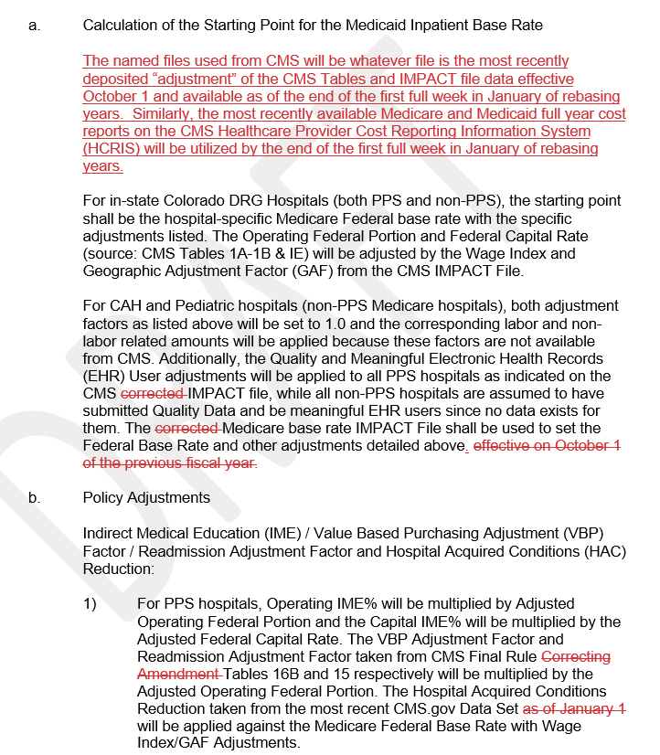
Examples showing nature of Rule Changes
This screenshot shows the new paragraph deposited in 8.300.5.A.3.a: “Calculation for the Starting Point for the Medicaid Inpatient Base Rate.”
The screenshot also shows the deleted portions of named files and timing since it is all now addressed in the overarching paragraph above.

Slide 25
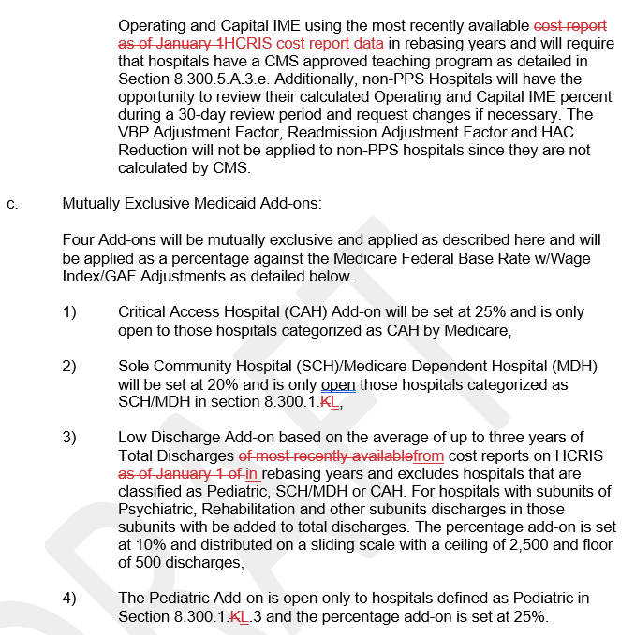
Examples showing nature of Rule Changes cont’d
8.300.1 is the “Definitions” portion of rule and lists 12 different definitions related Hospital Services. Three of those definitions in 8.300.1.L are specific to Pediatric, Sole Community Hospitals (SCH) and Medicare Dependent Hospitals (MDH) which are detailed in the Mutually Exclusive Add-ons section of Rule.
This screenshot shows the reference for Sole Community Hospital (SCH) and Medicare Dependent Hospital (MDH) as well as the Pediatric Hospital definition being amended from K to L in the definitions portion of Rule.

Slide 26
The exact same nature of changes are being made to Colorado State Plan
When the Department changed Colorado State Plan to accommodate the new inpatient base rate methodology effective 7/1/2023, we made sure to add the exact same language to Rule where possible since there is no reason why it should be different. The nature of the changes to Colorado State Plan 4.19A and 4.19B will consist of the exact same nature of changes shown here today.
For brevity, I won’t be showing those changes since it is very duplicative. However, if any stakeholder would like to get a copy of the proposed Colorado Rule and/or State Plan changes, please email Diana Lambe and Andrew Abalos at diana.lambe@state.co.us and andrew.abalos@state.co.us.
Please get back to us by end of day on Friday, March 16, 2025, with any concerns regarding Rule or State Plan changes discussed here today.
These rule changes will be presented to the Medical Services Board (MSB) on April 11, 2025, with the final adoption scheduled for May 9, 2025. Here’s the link to the MSB website if you’d like to attend: https://hcpf.colorado.gov/medical-services-board. State Plan changes occur later in the year after we know the budget neutrality factor for FY 2025-26.

Slide 27
Regulatory Cleanup
Repealing the following section of rule through the Medical Services Board process:
10 CCR 2505-10 8.220 Competitive Procurement and Selective Contracting, Including Global Fee Payment Programs
10 CCR 2505-10 8.221 General Provisions
These sections of rule describe an obsolete procurement process for organ and other transplants services
Reviewed in 2017 and 2022's Regulatory Efficiency Reviews
The Department does not have SPA authority for process as described
Cross referenced citations no longer exist in CCR
Medical Services Board webpage
Contact Raine Henry with any questions

Slide 28
Regulatory updates
Inpatient Hospital Housekeeping Update
State Plan Amendment
Public Noticing required
Code of Colorado Regulations Update
To be presented to Medical Services Board April 11, 2025
Effective July 1, 2025
340B Rate Reduction (80% -> 65%)
State Plan Amendment
Public Noticing required
Code of Colorado Regulations Update
To be presented to Medical Services Board April 11, 2025
Effective July 1, 2025, regardless of EAPG version update timeline

Slide 29
Did You Know…

Slide 30
What is not changing
Optum is only taking over management of the Provider Services Call Center. Gainwell will continue as the vendor for the Colorado interChange and the Provider Web Portal.
Many provider-facing processes and functionality will stay the same, including:
Provider Web Portal General Functionality and password resets (excluding Secure Correspondence)
Provider payment and Remittance Advice
Provider enrollment and revalidation
Other call centers (Member, Pharmacy, CCM, RAE, Dental)

Slide 31
What is changing
When Optum takes over management of the Provider Services Call Center, there will be some changes.
The Provider Services Call Center will operate separately from the larger MMIS contract.
Optum and Gainwell will partner to ensure providers receive accurate and helpful customer service for questions that relate to Gainwell’s MMIS.
There will be a new phone number for the Provider Services Call Center.
Providers can answer an after-call survey to give feedback.
…more enhancements to come!

Slide 32
Stay Informed
HCPF website
Provider Contacts page
Provider News page
HCPF news
Provider Bulletin (sign up here)
At a Glance (sign up here)

Slide 33
Questions? Comments? Solutions?

Slide 34
Thank You!
Kevin Martin
Fee for Service Rates Division Director
Kevin.Martin@state.co.us
Andrew Abalos
Facility Rates Section Manager
Andrew.Abalos@state.co.us
Diana Lambe
Inpatient Hospital Rates Analyst
Diana.Lambe@state.co.us
Gabriel Hottinger
Hospital Rate Analyst
Gabriel.Hottinger@state.co.us
Della Phan
Specialty Hospital Rates Analyst
Della.Phan@state.co.us
Raine Henry
Hospital and Specialty Care Section Manager
Raine.Henry@state.co.us
Chris Lane
Specialty Care and Facilities Unit Manager
Christopher.Lane@state.co.us
Diva Wood
Hospital Policy Specialist
Diva.Wood@state.co.us
Jessica Short
Hospital Policy Specialist
Jessica.Short@state.co.us

