Slide 1
HCPF Continuous Improvement
Learning Session
Presented by:
Vanessa Garcia
Arturo Serrano

Slide 2
Overview
Introductions
Ground Rules
Overview of The Fishbone Tool
Discuss the Problem
Practical Application of the Fishbone Tool
Overview Countermeasure Action Plan

Slide 3
Introductions
Vanessa Garcia – Continuous Improvement Specialist
Arturo Serrano – Continuous Improvement Specialist

Slide 4
Ground Rules
Keep your microphone muted.
If possible remain on video at all times.
Please do your best to stay engaged during the duration of this Session.
In Continuous Improvement everyone’s voice matters. Please ask questions or share any thoughts/ideas that might come up. We will do our best to address all questions during the Session.

Slide 5
Questions?

Slide 6
What is the Fishbone Tool?
The Fishbone is a tool used in Lean or Lean six sigma to discover the root cause of a problem.
The Fishbone is a visual diagram to search, seek, and discover “causes” of a problem that lead to countermeasures. These countermeasures can be acted on in a plan such as a Plan, Do, Check, Act (PDCA).

Slide 7
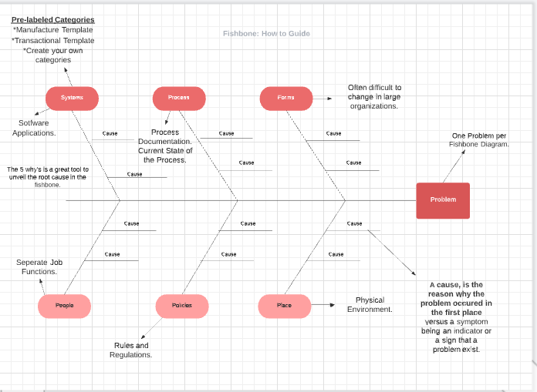
Notes:
Fishbone tool template and how to guide. Add the information to the link and give them instructions how to access.

Slide 8
Discuss the Problem
The HCPF Management Evaluation (ME) Program has identified a trend during ME evaluations pertaining to the HCPF Memo Series.
Eligibility Sites do not know where to access the Memo Series.
Eligibility Sites do not have clear process in disseminating Memo Series information.
Eligibility Sites do not have a clear training plan for Memo Series information.
Notes:
Reasons why the Memo’s are important. 1. These usually tend to include information around State and/or Federal mandates (for example Asset Verification Program (AVP)). 2. You don’t want your sites accuracy rate to be impacted due to missing information. 3. Doing the work ahead will help your site when it’s chosen for an ME review. Many of the Memo’s can end up being an ME finding and then your site may have a lot of findings to cure. If these findings are not cured that can lead to an Improvement Action Plan (IAP) and/or Corrective Action Plan (CAP) and CAP can lead to fiscal sanctions. Your business process will need to be updated regardless so it’s more beneficial to do it at the front end.

Slide 9
Fishbone Tool Activity
Notes:
Problem Statement: HCPF Memo series are not being read and trained on within Eligibility Sites.
Note: Here we would then go to Lucid Chart and conduct Fishbone exercise

Slide 10
Countermeasure Action Plans
Please complete Action Plans based off the countermeasures provided.
How to complete an Action Plan?
Notes:
Ask for a volunteer to create an action plan for their Site.

Slide 11
Questions?

Slide 12
Contact Info
Performance Improvement Team
Hcpf_Performance.Improvement@state.co.us
HCPF - PIT Website
https://hcpf.colorado.gov/compliance-team

Slide 13
Thank you!
Notes:
You should receive a survey once the session closes. We’d really appreciate if you can give us some feedback on how you think today’s workshop went.

