Slide 1
On behalf of HEALTH FIRST COLORADO Durable Medical Equipment Utilization Review

Slide 2
Table of Contents
Early and Periodic Screening Diagnostic Treatment (EPSDT)
About Acentra Health
Scope of Services
Acentra Health Services for Providers
Provider Responsibilities
Prior Authorization Request (PAR) Submission
General Requirements
DME PAR Requirements
Submission Requirements
Continuous and Bilevel Airway Pressure Devices
Disposable Supplies
Diabetic Supplies
Mobility Equipment
Complex Rehabilitation Technology
Documentation Requirements
Modifier Requirements
PAR Determination Process
Turnaround Times
Medicaid Rule for Medical Necessity
PAR Revision
Change of Provider Form
Recap

Slide 3
Early and Periodic Screening Diagnostic Treatment (EPSDT)
Acentra Health follows the EPSDT requirements for all medical necessity reviews for Health First Colorado members.
Medical necessity reviews on treatments, products or services requested or prescribed for all members ages 20 years of age and under are based on compliance with federal EPSDT criteria.
Medical necessity is decided based on an individualized, child specific, clinical review of the requested treatment to ‘correct or ameliorate’ a diagnosed health condition in physical or mental illnesses and conditions.
EPSDT includes both preventive and treatment components as well as those services which may not be covered for other members in the Colorado State Plan.
https://hcpf.colorado.gov/early-and-periodic-screening-diagnostic-and-treatment-epsdt

Slide 4
Our purpose is to accelerate better health outcomes through technology, services, and clinical expertise.
In 2021, Kepro was awarded the Department of Health Care Policy and Financing (HCPF) contract for Utilization Management and Physician Administered Drug (PAD) review.
With over six decades of combined experience, CNSI and Kepro have come together to become:
Our vision is to be the vital partner for healthcare solutions in the public sector.
Our mission is to continually innovate solutions that deliver maximum value and impact to those we serve.

Slide 5
About Acentra Health (cont’d…)
In addition to UM review, Acentra Health will administer or provide support in:
Client Overutilization Program (COUP)
Annual HCPCS code review
Quality Program
Reporting
Review Criteria selection
Customer Service Line
Appeals, Peer-to-Peer, and Reconsiderations
Fraud & False Claims reporting

Slide 6
Scope of Services
Audiology
Diagnostic Imaging
Durable Medical Equipment
Inpatient Hospital Review Program (IHRP 2.0)
Medical Services including, but not limited to, select surgeries such as bariatric, solid organ transplants, transgender services, and elective surgeries
Molecular/Genetic Testing
Out-of-State Inpatient Services
Outpatient Physical and Occupational Therapy
Outpatient Speech Therapy
Pediatric Behavioral Therapy
Private Duty Nursing
Personal Care Services
Physician Administered Drugs

Slide 7
Acentra Health’s Services for Providers
24-hour/365 days provider portal accessed at: https://portal.kepro.com
Provider Communication and Support email: coproviderissue@kepro.com
Provider Education and Outreach, as well as system training materials (including Video recordings and FAQs) are located at: https://hcpf.colorado.gov/par
Prior Authorization Review (PAR)
Retrospective Review (when allowed by CO HCPF)
PAR Reconsiderations & Peer-To-Peer Reviews
PAR Revisions
Access to provider reports and case statuses with Atrezzo Portal
Provider Manual is posted at: https://hcpf.colorado.gov/par

Slide 8
Provider Responsibilities
Providers must request Prior Authorization for services through Acentra's portal, Atrezzo. A Fax Exempt Request form may be completed here if specific criteria is met such as:
The provider is out-of-state or the request is for an out of area service
The provider group submits on average 5 or fewer PARs per month and would prefer to submit a PAR via fax
The provider is visually impaired
Utilization of the Atrezzo portal allows the provider to:
Request prior authorization for services
Upload clinical information to aid in review of prior authorization requests
Submit reconsideration and/or peer-to-peer requests for services denied

Slide 9
Provider Responsibilities (cont’d…)
The system will give warnings if a PAR is not required​
Always verify the Member’s eligibility for Health First Colorado prior to submission by contacting Health First Colorado ​
The generation of a Prior Authorization number does not guarantee payment

Slide 10
Prior Authorization Review Submission
Atrezzo portal is accessible 24/7
PAR requests submitted within business hours: 8:00AM – 5:00PM (MT) will have the same day submission date
After business hours: will have a receipt date of the following business day
Holidays: will have a receipt date of the following business day
Days following state approved closures (i.e., natural disasters): will have a receipt date of the following business day

Slide 11
PAR Submission: General Requirements
PAR submissions will require providers to provide the following:
Member ID
Name
Date Of Birth
CPT or HCPCS codes to be requested
Dates of service(DOS)
ICD10 code for the diagnosis
Servicing provider (billing provider) National Provider Identifier (NPI) if different than the Requesting provider
Number of units requested
Supporting Documentation. It will be necessary to provide supporting documentation with your submission. Supporting documentation may include office visit notes, laboratory results, imaging results, etc.
Requests for additional information will be initiated by Acentra if/when there is not substatntial supporting documentation to complete a review.
https://hcpf.colorado.gov/par​

Slide 12
Covered Durable Medical Equipment, Prosthetics, Orthotics and Supplies (DMEPOS) Benefits
Health First Colorado (Colorado's Medicaid Program), covers Durable Medical Equipment, Prosthetics, Orthotics, and Supplies (DMEPOS).
Durable Medical Equipment (DME) is defined as equipment that can withstand repeated use and that generally would be of no value to the member in the absence of a disability, illness, or injury.
Prosthetics and Orthotics (P&O or O&P) are defined as replacement, corrective, or supportive devices that artificially replace a missing portion of the body, prevent or correct physical deformity or malfunction, or support a weak or deformed portion of the body.
Disposable Medical Supplies (Supplies) are defined as supplies that are specifically related to the active treatment or therapy for an illness or physical condition; they are non-durable, disposable, consumable and/or expendable.
Some supply items and most DME items require prior authorization.
Prior Authorization Requests must be submitted and approved before services are rendered. The service must be rendered by the identified supplier on the approved PAR. Services rendered must match the approved services exactly including any billed modifiers.

Slide 13
Submission Requirements
All PARs must be submitted by the supply provider that intends to submit the claim for the service and have an attached prescription from the prescribing authority and any other required documentation.
Prior Authorization Request dates typically have a date span for one (1) year less one (1) day. Exceptions for decreased span dates less than one (1) year are allowed in certain circumstances such as short-term rental or WIC application period. Dates must not exceed one (1) year and must match the dates on individual line items, or the PAR will be denied.
All submissions must include an order for specific items and quantities with dates that match the dates of the PAR request. All orders must be signed by the MD/NP/PA/DO with either a wet signature or valid CMS compliant E-signature.

Slide 14
Continuous and Bilevel Airway Pressure Devices (CPAP/BiPAP)
Continuous and Bilevel Positive Airway Pressure Devices (CPAP/BiPAP)
CPAPs and BiPAPs require a trial (rental) period of 30-90 days, in which the member must demonstrate compliance, before a purchase request will be approved.
CPAP/BiPAP Replacement and Supplies
If a device is replaced within five (5) years because of loss, theft, or irreparable damage there is no requirement for a new sleep test or trial period.
If a device is replaced after five (5) years, there must be a face-to-face evaluation by the members treating physician (within six (6) months of the request) that documents that the beneficiary continues to use and benefit from the device. There is no requirement for a new sleep test or trial period.
When supplies are needed for a member-owned device, the PAR must include either a download from the device that demonstrates compliance or a face-to-face evaluation by the members treating physician (within six (6) months of the request) that documents that the beneficiary continues to use and benefit from the device.
Compliance is defined as usage that is 4 hours per night on 70% of nights during a consecutive thirty (30) day period anytime during the approved trial/rental period.
If a member received a device prior to enrollment with Health First Colorado and needs a new device or supplies, then documentation that the beneficiary had a sleep test must be provided with the initial PAR. There is no requirement for a new sleep test unless the documentation from the prior test cannot be provided.

Slide 15
Disposable Supplies
Disposable Supplies
Disposable supplies are a benefit of Health First Colorado for use by the member in his/her home. With the exception of gloves, the Home Health agency is responsible for providing all supplies necessary to meet the universal precaution requirement during a visit.

Slide 16
Diabetic Supplies
Diabetic Supplies
Most diabetic supplies, such as glucose testing meters, test strips and other related supplies are a benefit with a prescription from a physician, physician assistant or nurse practitioner. Diabetic supplies are available for insulin, and non-insulin dependent members. Diabetic supplies MUST be billed as DMEPOS. Pharmacies billing supplies must follow Supply billing procedures and will not be reimbursed if billed as a pharmacy claim using NDC codes.
Continuous Glucose Monitor (CGM) Benefit Coverage
PARs, including requests for CGM supplies, will be limited to a 6-month period.
When requesting a CGM in the online PAR portal, providers will be asked whether the member has received or if there is documented plan to receive diabetes education specifically related to CGMs.
CGM replacement policy per 8.590.2.J. Repairs and replacement parts are covered under the following conditions:
The item was purchased by Medicaid; or
The item is owned by the member, member’s family or guardian; and
The item is used exclusively by the member; and
The item’s need for repair was not caused by member misuse or abuse; and
The item is no longer under the manufacturer warranty

Slide 17
Mobility Equipment
Mobility Equipment (Manual Wheelchairs, Power Wheelchairs and Scooters)
All mobility equipment purchases require a PAR and must be accompanied by a signed letter of medical necessity from a physician, physician assistant or nurse practitioner
Members who meet medical criteria guidelines may receive one (1) primary device and, when deemed necessary, one (1) secondary device within a five (5)-year time period. Replacement of stolen equipment requires a police report that conforms to criteria outlined in the Colorado Revised Statutes. Primary and secondary equipment cannot be duplicates.

Slide 18
Mobility Equipment Con’t
Prior Authorization for Repairs and Modifications
PARs submitted with multiple pieces of equipment on the same request will be denied; each wheelchair or scooter that requires PAR must be submitted on separate requests.
The following information must be included in the request; requests lacking any of the following information will result in a denial or will be returned to the provider for the missing information:
Equipment type indication: manual, power; or scooter and
Manufacturer, make, and model; and
Serial number: PARs for repair and modification must identify the serial number of the base equipment in field 16 (paper) or field 12 (electronic) on the PAR form; and
If available, the original wheelchair purchase date or PAR number; and
Beginning July 1, 2017, the PAR must contain the RA or RB modifier depending on the request.
Note: Repairs for members residing in a nursing facility may be covered if the wheelchair was owned by the member prior to entering the facility. In this instance, the PAR must indicate that the member is residing in the nursing facility by checking "yes" in the appropriate field on the PA request. The PAR will not be processed without this disclosure

Slide 19
Complex Rehabilitation Technology (CRT) PARs
Understanding CRT
Complex Rehabilitation Technology (CRT) includes individually configured manual wheelchair systems, power wheelchair systems, adaptive seating systems, alternative positioning systems, standing frames, gait trainers, and specifically designed options and accessories classified as DME. Only qualified CRT suppliers may bill CRT procedure codes.
Prior Authorization Requests (PARs)
There are two (2) levels of documentation requirements associated with PARs for CRT:
Basic Documentation
This level of documentation does not require a specialty evaluation. Basic documentation requirements apply to all CRT wheelchairs and wheelchair-related items that require a PAR.
Specialty Evaluation Documentation
This level of documentation provides further details in order to establish medical necessity. A specialty evaluation is an assessment performed by a licensed/certified medical professional (such as a Physical Therapist, Occupational Therapist, or physician) who has no financial relationship with the DME supplier and who has specific training and experience in complex rehab technology wheelchair evaluations. NOTE: Specialty evaluation is not required for CRT repair.
Specialty evaluation is required for:
A new CRT wheelchair or a replacement CRT wheelchair after the 5th year mark for adults and 3rd year mark for children.
A new custom contoured seating system or modification.
An addition of power seating or alternative drive control to a wheelchair.

Slide 20
DME PAR Requirements - Documentation
Overlapping PAR request dates for same items will not be accepted
PAR requests require physician’s order that includes the items being requested
Questionnaires will be required as appropriate
Specialty evaluations will be required as appropriate
Documentation to support medical necessity should be included with every review
Please refer to the billing manual under PAR requirements to find the full list of required documentation:
https://hcpf.colorado.gov/DMEPOS-manual

Slide 21
Submission Requirements At a Glance
*When a member's eligibility is determined after the date of service, the member is issued a Load Letter. The Load Letter must be submitted with the supporting clinical documentation for the PAR for a retroactive request to be processed.
Duration | PAR limited to 365 days
Provider Timely Submission Requirement | Allowed 90 calendar days from date of delivery
Retroactive Authorization (Member not eligible at time of service) | Not accepted by Acentra *Exceptions may be made by HCPF
Servicing Provider / Billing Provider | Supply provider, some pharmacies, Prosthetic/Orthotic only suppliers
Requesting Provider | Physician, Physician Assistant, Nurse Practitioner
Billing Manual Link | https://hcpf.colorado.gov/DMEPOS-manual

Slide 22
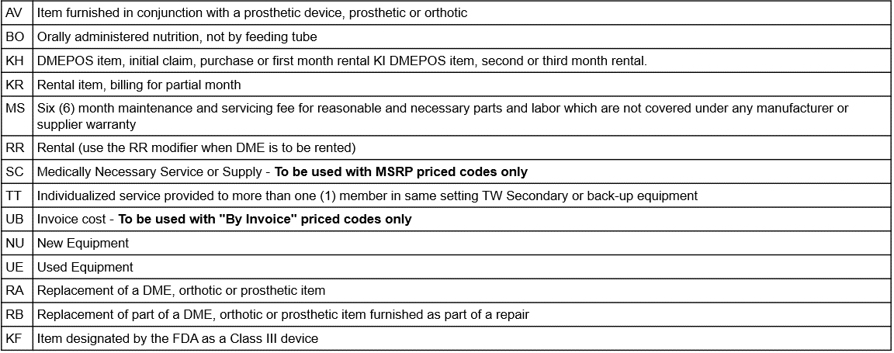
Modifier Requirements
Modifier codes must be included as appropriate for all DMEPOS requests. The same modifiers used on the PAR must be used on the claim, in the same order

Slide 23
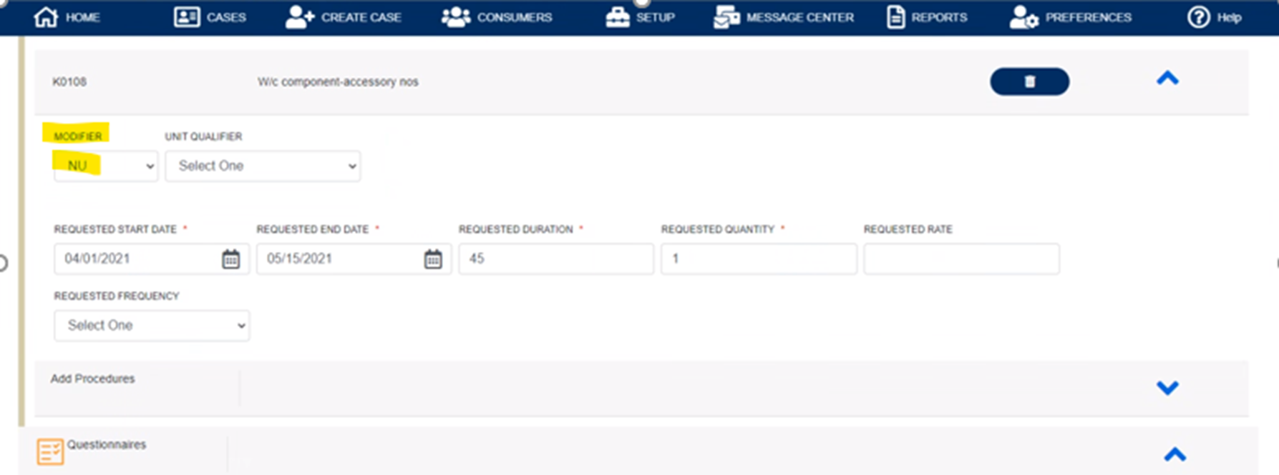
Modifier Placement
Below is an example of placement for modifiers within the review

Slide 24
PAR Determination Process
After submission of a request, you will see one of the following actions occur:​
Approval: Met criteria/Code of Colorado Regulations applied for the service requested at first level review or was approved at physician level.
Request for additional information: Information for determination is not included and vendor requests this to be submitted to complete the review. ​
Technical Denial: Health First Colorado Policy is not met for reasons including, but not limited to, the following reasons:
Untimely Request
Requested information not received or Lack of Information (LOI)​
Duplicate to another request approved for the same provider​
Service is previously approved with another provider​
​Medical Necessity Denial: Physician level reviewer determines that medical necessity has not been met and has been reviewed under appropriate guidelines. The Physician may fully or partially deny a request.​

Slide 25
PAR Determination Process (cont’d…)
Denials
If a technical denial is determined, the provider can request a reconsideration.
If a medical necessity denial was determined, it was determined by a Medical Director. The Medical Director may fully or partially deny a request. For a medical necessity denial, the provider may request a reconsideration and/or a Peer-to-Peer.
Steps to consider after a denial is determined:​
Reconsideration Request: the servicing provider may request a reconsideration to Acentra Health within 10 business days of the initial denial. If the reconsideration is not overturned, the next option is a Peer-to-Peer (Physician to Physician).
Peer to Peer Request: an ordering provider may request a Peer-to-Peer review within 10 business days from the date of the medical necessity adverse determination.
Place the request in the case notes, providing the physician’s full name, phone number, and three dates and times of availability.
The peer-to-peer will be arranged on one of the provided dates and times for the conversation to be conducted. You may also call Customer Service at 720-689-6340 to request the peer-to-peer. ​

Slide 26
Turnaround Times (TAT) – Part 1
Turnaround Time: the turnaround time for completion of a PAR review ensures: ​
​A thorough and quality review of all PARs by reviewing all necessary & required documentation when it is received
​
Decreases the number of unnecessary pends to request additional documentation or information ​
Improves care coordination and data sharing between Acentra Health and the Department’s partners (i.e., Regional Accountable Entities, Case Management Agencies, etc.)
​*For additional information pends: the provider will have 10 business days to respond. If there is no response or there is an insufficient response to the request, Acentra will complete the review and technically deny for Lack of Information (LOI), if appropriate.

Slide 27
Turnaround Times – Part 2
Expedited review : a PAR that is expedited is because a delay could:
• Jeopardize Life/Health of member,
• Jeopardize ability to regain maximum function
• and/or subject to severe pain.
These requests will be completed in no more than 4 business hours.
Rapid review: a PAR that is requested because a longer turnaround time could result in a delay in the Health First Colorado member receiving care or services that would be detrimental to their ongoing, long-term care.
A Rapid review may be requested by the Provider in very specific circumstances including:
• A service or benefit that requires a PAR and is needed prior to a Health First Colorado member’s inpatient hospital discharge.
Same Day Diagnostic studies required for cancer treatments.
Genetic or Molecular testing requiring amniocentesis
These requests will be completed in no more than 1 business day.
Standard review: the majority of cases would fall under this category as a Prior Authorization Request is needed. These requests will be completed in no more than 10 business days.

Slide 28
Definition of Medical Necessity
10 CCR 2505-10; 8.076.1.8
Medical necessity means a Medical Assistance program good or service:​
Will, or is reasonably expected to prevent, diagnose, cure, correct, reduce, or ameliorate the pain and suffering, or the physical, mental, cognitive, or developmental effects of an illness, condition, injury, or disability.
This may​ include a course of treatment that includes mere observation or no treatment at all;​
b. Is provided in accordance with generally accepted professional standards for health care in the United States;​
c. Is clinically appropriate in terms of type, frequency, extent, site, and duration;​
d. Is not primarily for the economic benefit of the provider or primarily for the convenience of the client, caretaker, or provider;​
e. Is delivered in the most appropriate setting(s) required by the client's condition;​
f. Is not experimental or investigational; and​
g. Is not more costly than other equally effective treatment options.​
For EPSDT, medical necessity includes a good or service that will or is reasonably expected to, assist the member to achieve or maintain maximum functional capacity in performing one or more Activities of Daily Living, and meets the criteria, Code of Colorado Regulations, Program Rules (10 CCR 2505-10.8.280.4.E.2).​

Slide 29
PAR Revision
If the number of approved units needs to be amended or reallocated, the provider must submit a request for a PAR revision prior to the PAR end date.
Acentra Health cannot make modifications to an expired PAR or a previously billed PAR.​

Slide 30
PAR Revision
To make a revision:
Select “Request Revision” under the “Actions” drop-down
Select the Request number and enter a note in the existing approved case of what revisions you are requesting
Upload additional documentation to support the request as appropriate

Slide 31
Change of Provider Form
When a member receiving services, changes providers during an active PAR certification, the receiving provider will need to complete a Change of Provider Form (COP) to transfer the member’s care from the previous provider to the receiving agency.
This form is located on the Provider Forms webpage under the Prior authorization Request (PAR) Forms, drop-down menu, along with “How to Complete Change of Provider Form. "

Slide 32
Acentra Health Services for Providers - Recap
24-hour/365 days provider Atrezzo Portal may be accessed at: https://portal.kepro.com​
System Training materials (including Video recordings and FAQs) and the Provider Manual are located at: https://hcpf.colorado.gov/par
Provider Communication and Support email: coproviderissue@kepro.com ​

Slide 33
Thank you for your time and participation!
For Escalated Concerns please contact: hcpf_um@state.co.us
Acentra Health Customer Service: (720) 689-6340
PAR Related Questions: coproviderissue@kepro.com

