Slide 1
Who are DCWs?
An overview of the Colorado Department of Health Care Policy and Financing (HCPF) campaign to raise awareness of the vital role of Direct Care Workers in Colorado. Learn more about the campaign and how you can support it.

Slide 2
Campaign Objectives
Goal:
To raise awareness about the invaluable role of Direct Care Workers, encourage community members to join this essential workforce, and magnify how DCWs provide compassionate care and companionship to the members they support.

Slide 3
Campaign Objectives
Target Audience:
Prospective DCWs and job seekers looking either passively or actively for work in direct care.
Call to Action:
Learn more about how DCWs make a difference
and how you can be one too.

Slide 4
Who are DCWs?
DCWs are workers who provide care services, such as certified nursing assistants, home health aides, personal care aides, caregivers, and companions. U.S. Department of Labor
Direct Care Workers are:
Personal Care Worker/Home Health Aides - Provide non-medical support with daily tasks in member’s homes.
  Examples: cooking meals, assisting with hygiene needs, cleaning, and running errands
Nursing Aides - Provide skilled care with activities of daily living.
  Examples: Monitor member’s health status, assistance with transfers, hygiene, and meal preparation
Direct Support Professionals - Provide support, mentorship, and companionship to members.
  Examples: administer medication, support daily living needs, and provide transportation.
Job Coaches - Provide on-the-job training and support for members.
  Examples: Helping members learn and perform job tasks and build positive relationships.
Caregivers - Provide supervision, behavior supports, and assistance with activities of daily living.
  Examples: medication reminders, and food preparation.

Slide 5
DCWs, providing support that improves lives
The Department of Health Care Policy and Financing (the Department) obtained funding via the Home and Community Based Services (HCBS) American Rescue Plan Act (ARPA) program to launch a public awareness campaign about the value and importance of the Direct Care Workforce (DCW).
The campaign — “Who is a DCW?” — showcases and highlights the value and importance of the DCW and the impact individual DCWs can make in their community. Additionally, the campaign seeks to recruit the next generation of DCWs into this critical field.

Slide 6
Why Now?
There is a state-wide shortage of direct care workers in Colorado.
Members or individuals requiring assistance due to disability, age, or illness rely on the direct care workforce to remain in home and community-based settings. Therefore, increasing the DCW population positively affects the entire State.
According to a 2022 PHI study, the population of older adults (age 65+) in the U.S. is projected to nearly double from 49.2 million to 94.7 million. This rapid demographic growth is “the primary driver of job growth in the direct care workforce.” The growth will also impact future demand for direct care workers. This doesn’t include the number of residents with disabilities and/or illnesses that require direct care.

Slide 7
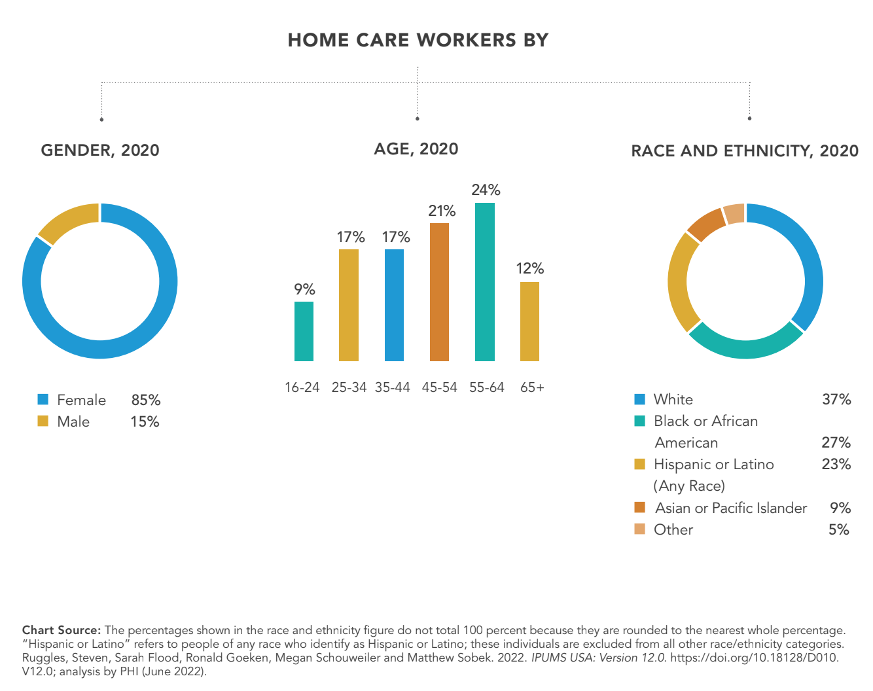

Slide 8
Partnerships
The campaign has partnered with the following outlets to distribute key messages and advertising across the state of Colorado. The benefit for these partnerships is that each respective outlet can boost the campaign messaging throughout their niche communities and raise awareness about who DCWs are and why the work is important.
Kool105
Kroenke Sports & Entertainment
Telemundo
El Comercio de Colorado
Peacock & NBC+
MIX 100
CBS
The Colorado Sun
Outfront Magazine
Lamar Advertising
Westword
9News

Slide 9
Learn more about how DCWs make a difference and how you can be one too at:
hcpf.colorado.gov/Direct-Care-Spotlight
To support this campaign, please reach out to: JWolford@circuitmedia.com

