Slide 1
Safety Net Provider Forum
August 30, 2024
Presented by:
Mel Tyler, Safety Net Unit Manager - BHA
Meghan Morrissey, Safety Net and Acute Care Unit Supervisor - HCPF
Angie Bergefurd, Health Management Associates - HMA

Slide 2
Meeting Purpose
Behavioral health safety net providers serve priority populations and comply with the safety net no refusal requirements, ensuring that priority populations receive access to the care that they need to achieve whole person health through care and coordination. Safety Net Fact Sheet December 2023
The purpose of this meeting is to:
Review current state behavioral health safety net system
Support Safety Net Providers with information and resources to participate in the Safety Net system successfully
Facilitate information sharing and discussion between CO state staff and stakeholders

Slide 3
Behavioral Health Safety Net Providers
Essential Provider
Provides care coordination and one or more of the following:
Emergency/Crisis
Outpatient
Intensive Outpatient
Residential
Withdrawal Management
Inpatient
Integrated Care
Hospital Alternatives
Comprehensive Provider
Provides care coordination and all of the following:
Emergency/Crisis
Outpatient
Intensive Outpatient
Care Management
Outreach, Engagement, Education
Recovery Supports
Outpatient Competency Restoration

Slide 4
Meeting Agenda
BHA Updates:
Safety Net Applications
Policy and Procedure Updates
Spotlight: Crisis Services
HCPF Updates:
Comprehensive Providers
Essential Providers
Known Issues
HMA Provider TTA Updates:
Training Library
Office Hours

Slide 5
BHA

Slide 6
Update on Safety Net Approvals
As of 08/30:
Received 361 total applications
Issued 18 Comprehensive approvals
Issued 94 Essential approvals

Slide 7
Safety Net BHA Application
Application for Safety Net Approval is still available.
First step is to submit a Letter of Intent to BHA.
This can be done along with renewal/application for another license (e.g. BHE) or separate.
Policies and Procedures for Safety Net Approval required to process the application.
Need help? Technical assistance appointments available!
Notes:
https://bha.colorado.gov/behavioral-health/designation-and-licensing

Slide 8
BHA Policies & Procedures (P&Ps) Processes Changes (Trial Basis)
Agencies seeking Safety Net approval will not (for now):
Have P&Ps “approved” by their Licensing Manager
Paste P&Ps into LADDERS
Agencies are expected to:
Actively practice in compliance with all relevant regulations found in 2 CCR 502-1, and
Be able to promptly provide your agency’s P&Ps to BHA upon request, such as in the case of an investigation or a site visit. Please be aware that if your agency is unable to meet this timely submission request, or submits timely P&Ps that are not compliant with regulations, violations and/or adverse action may be taken as necessary.
Notes:
https://bha.colorado.gov/behavioral-health/designation-and-licensing

Slide 9
Questions
SNP regulation resources, licensing and safety net approval info, book a support session
General questions: cdhs_bharulefeedback@state.co.us
Individual support: book a support session or contact your safety net licensing manager

Slide 10
Crisis & Safety Net

Slide 11
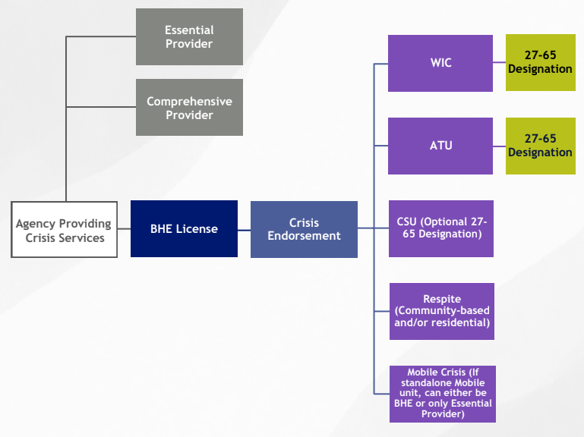
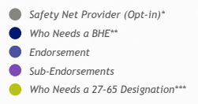
Agency Providing Crisis Services - BHA Licensing

Slide 12
MCR is part of the Safety Net
The MCR services codes:
90839 with ET modifier
H2011 with ET modifier
may be provided by:
Crisis Services PT 95, Speciality 772 MCR
with essential approval
without essential approval
Comprehensive Safety Net PT 78, Specialty 887

Slide 13
HCPF

Slide 14
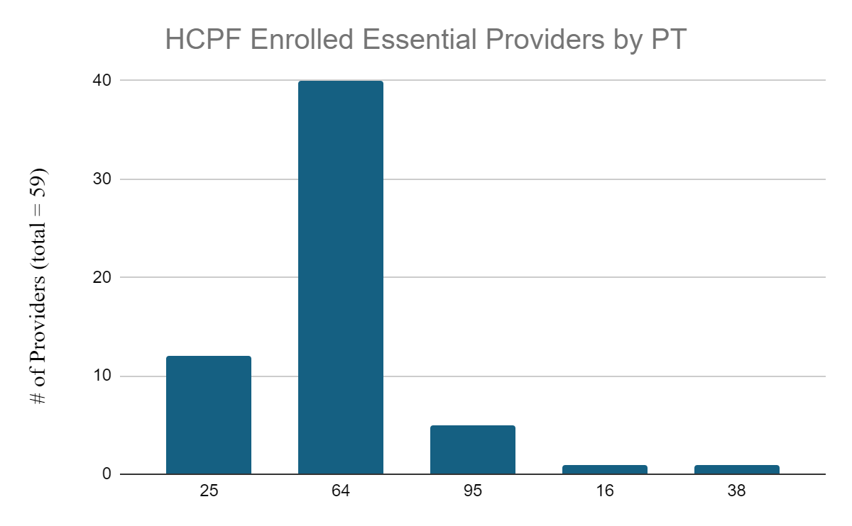
Notes:
PT 25: 12 providers
PT 64: 40 providers
PT 95: 5 providers
PT 16: 1 provider
PT 38: 1 provider

Slide 15
PTs Eligible for Essential Approval
State Behavioral Health Services Billing Manual Appendix L (page 215-216)
Provider Type | Code
Hospital - Mental | 2
Physician | 5
Clinic - Practitioner | 16
Non-Physician Practitioner - Individual | 24
Non-Physician Practitioner - Group | 25
Osteopath | 26
Psychiatric Residential Treatment Facility | 30
Licensed Psychologist | 37
Licensed Behavioral Health Clinician | 38
Physician Assistant | 39
Nurse Practitioner | 41
Rural Health Clinic | 45
Residential Childcare Facility | 52
Substance Use Continuum | 64
Qualified Residential Treatment Program | 68
Behavioral Health Group | 77
Crisis Provider | 95
Adult Mental Health Residential | 96

Slide 16
Comprehensive Providers
Anticipated Comprehensive Providers w/Published Rates
A.R.T.S.
AllHealth Network
Aurora
Centennial
Community Reach Center
Crossroads
Diversus Health - AspenPointe
Eagle Valley
Health Solutions
Jefferson Center for Mental Health
Mental Health Partners
Mile High Behavioral Health
Mind Springs
North Range Behavioral Health
Paragon Behavioral Health Connections
San Luis
Sobriety House
Solvista Health
Southwest CO Mental Health Center - Axis
SummitStone Health Partners
WellPower
Congratulations!
5 Comprehensive Provider Type 78 HCPF completed enrollments across 28 locations
Aurora
North Range Behavioral Health
Paragon Behavioral Health Connections
Solvista Health
SummitStone Health Partners
*Comprehensive Providers are expected to complete their HCPF PT 78 enrollment by 12/31/24

Slide 17
Essential Providers
A Provider gets BHA Approval as an Essential Provider
A Provider enrolls (or updates enrollment) with HCPF
There is not a distinct Provider Type or Specialty Type for this - it will be a “box” you select in the enrollment portal under the appropriate existing provider types
New Providers - Enroll as the appropriate provider type and then submit a maintenance request and select “Essential” in the enrollment portal. Must upload BHA Approval Letter
Current Providers - Submit a maintenance request and select “Essential” in the enrollment portal. Must upload BHA Approval Letter
*BHA Essential Approval services must align with your HCPF provider type.
A Provider must be contracted with an MCE as a safety net provider to receive the enhanced payment.
MCEs are required to re-contract with existing providers who have secured Essential status.
MCEs may choose not to contract with new providers based on network needs.
A Provider will receive the Essential enhanced payment rate based on the effective date of the MCE contract.
HCPF sends a weekly provider file to the MCEs. The weekly file includes any changes that were made from the previous weekly file.

Slide 18
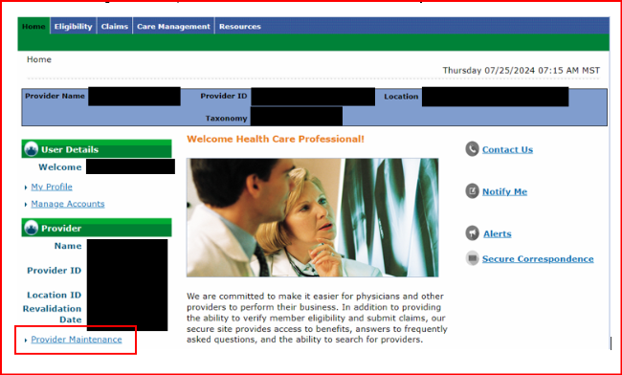
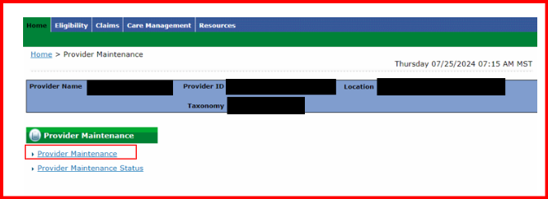
Essential Providers

Slide 19
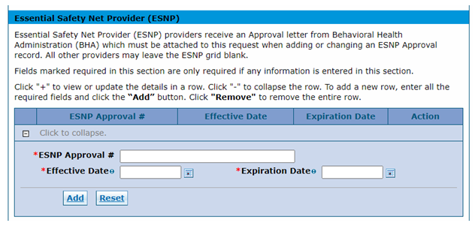
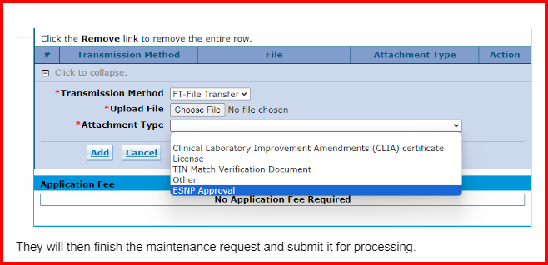
Essential Providers

Slide 20
Known Issues
BHA will include your legal name and DBA on Essential Approval and Comprehensive Approval. One of these names must match the name you are enrolled with HCPF as to be approved in HCPFs system.
“Telehealth Only” on BHA Approval Letter means the provider has no brick and mortar location, will not need to match location in HCPF enrollment
Issue with Application fee for PT 78 has been resolved

Slide 21
PT 64 SUD Continuum
Effective August 1, 2024, no new enrollments are allowed for Substance Use Disorder-Clinics PT 64/477
Existing PT 64/477 can upload their essential approval letters, but HCPF will be discontinuing PT 64/477 in FY 24-25 to ensure all providers are enrolled with appropriate specialty types.
Known Issue: PT 64 unable to add an “unique taxonomy” when they are adding “additional specialties” to a provider profile.
WORKAROUND
Enter a Maintenance request that includes the following attachments:
A document that lists the specialties they would like to add. Add the document as an “Other Attachment.”
All required attachments for the new specialty.
Provider does not need to add a new specialty to the Maintenance request.
Submit the ATN, then provide the ATN number to your department contact.
You will receive a letter of acceptance or denial after the ATN review is concluded.

Slide 22
Essential Provider Rates
Q: As an Essential Safety Net Provider, when will I be able to begin receiving the Essential reimbursement rate?
A: A provider will receive the Essential reimbursement rate based on the effective date of the MCE contract.
Q: My provider organization is seeking approval as an Essential Safety Net Provider. Must I contract with a Managed Care Entity (MCE) to bill and receive payment under the Essential Fee Schedule?
A: Yes. A provider must be contracted with a MCE to be reimbursed the Essential Fee Schedule rates. MCEs are required to re-contract with existing providers who are approved as Essential Safety Net Providers. MCEs may choose not to contract with new provider even if they are approved Essential safety net provider based on network needs.

Slide 23
Provider Enrollment
Provider Services Call Center
1-844-235-2387
Provider Enrollment Support https://hcpf.colorado.gov/regional-provider-support
Colorado NPI Law Fact Sheet
NPI Law FAQs

Slide 24
Questions
HCPF SNP Webpage
SNP forum archive and training resources
HCPF Enrollment/Billing Questions - hcpf_safetynetforum@state.co.us or contact your field representative
Training or technical assistance questions - safetynettta@healthmanagement.com

Slide 25
HMA

Slide 26
BH Provider TTA Updates
Training & Technical Assistance Program: Webpage Highlights
Trainings
30+ live virtual & pre-recorded trainings focused on expanding benefits and services, improving access to care, and elevating quality
FAQs
45 answers to questions commonly asked by providers with more continually being added
hcpf.colorado.gov/safetynetproviders
Notes:
10 new FAQs have been posted on topics related to enrollment, payment and licensure.
https://hcpf.colorado.gov/safetynetproviders

Slide 27
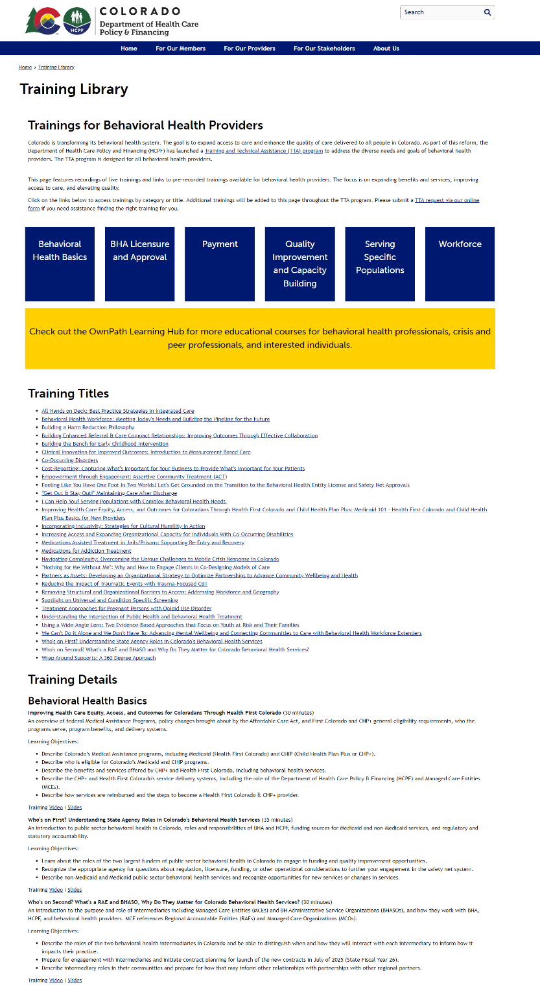
BH Provider TTA Updates
Training Library Updates
New training library page organizing the 30+ trainings by category:
Behavioral Health Basics
BHA Licensure & Approval
Payment
Quality Improvement & Capacity Building
Serving Specific Populations
Workforce
The new page makes it easier for providers to find trainings that meet their needs! Details include training description, learning objectives, and links to the YouTube recording and slides.
http://hcpf.colorado.gov/training-library
Notes:
https://hcpf.colorado.gov/safetynetproviders

Slide 28
BH Provider TTA Updates
Newly added pre-recorded & recordings of live trainings are available now under the Training Library on the HCPF Safety Net Providers landing page include:
Digital Technology Tools: Considerations for Achieving the Colorado “North Stars”
Incorporating Inclusivity: Strategies for Cultural Humility in Action
Coming Soon:
Introduction to Value-Base Payment for Behavioral Health Providers
Introduction to Alternative Payment Models for Behavioral Health Providers
Paying Differently in Colorado - Introducing APMs in Colorado Behavioral Health
BHA Provider Rules
Introduction to Behavioral Health Entities
Notes:
https://hcpf.colorado.gov/safetynetproviders

Slide 29
BH Provider TTA Updates
Frequently Asked Questions
Most commonly asked questions from providers, categorized by topic:
BHA Licensure/Approval
HCPF Enrollment
Safety Net Provider Types
National Provider Identifier
Billing and Reimbursement
FAQs are based on questions shared during trainings, office hours, the online feedback form, etc. Have a question? Email info@safetynetproviders.com.
hcpf.colorado.gov/safetynetproviders
Notes:
https://hcpf.colorado.gov/safetynetproviders

Slide 30
August TTA Office Hours
AUGUST OFFICE HOURS ARE TODAY AT NOON - IT IS NOT TOO LATE TO REGISTER!
August Office Hours will:
Focus on Essential Providers and Comprehensive Providers
Include topics such as the HCPF enrollment portal, the Essential Fee Schedule, the Prospective Payment System, and other reform topics
Address implementation questions
Include BHA and HCPF representatives
Use the QR Code below to register now

Slide 31
FINAL TTA Office Hours Session
September 27, 2024 - Noon MST
Register Here
September Office Hours will continue the discussion around Comprehensive Safety Net Providers, as well as addressing questions related to the Prospective Payment System (PPS) and other reform topics.

Slide 32
Resources
Next meeting: June 28 10:00am-11:00am Register in advance
BHA Laws and Rules Webpage
SNP regulation resources, licensing and safety net approval info, book a support session
General questions: cdhs_bharulefeedback@state.co.us
Individual support: book a support session or contact your safety net licensing manager
HCPF SNP Webpage
SNP forum archive and training resources
HCPF Enrollment/Billing Questions - hcpf_safetynetforum@state.co.us or contact your field representative
Training or technical assistance questions - safetynettta@healthmanagement.com

