Slide 1
Welcome
We are Recording
Use Chat
Please ask questions
Slides
Will be Shared to webpage and via newsletter
Avoid sharing protected health information
Listening by Phone
Press *6 to unmute your line or *9 to raise hand
Closed Captioning
Click the Live Transcript icon at the bottom of your screen
Notes:
Remove this slide before posting to website

Slide 2
HCPF/BHA/CDPHE
Crisis Services Bi-Monthly Technical Assistance Collaborative Meeting
October 24, 2024
11-12:30pm

Slide 3
Agenda
Welcome and Introductions
System Updates
ASAM 4 Changes
Region Updates
BHASO
RAE
BHA Updates
988 Vendor Transition
OwnPath Learning Hub
HCPF Updates
CDPHE Updates
Opportunities for Engagement - This meeting series is ending!

Slide 4
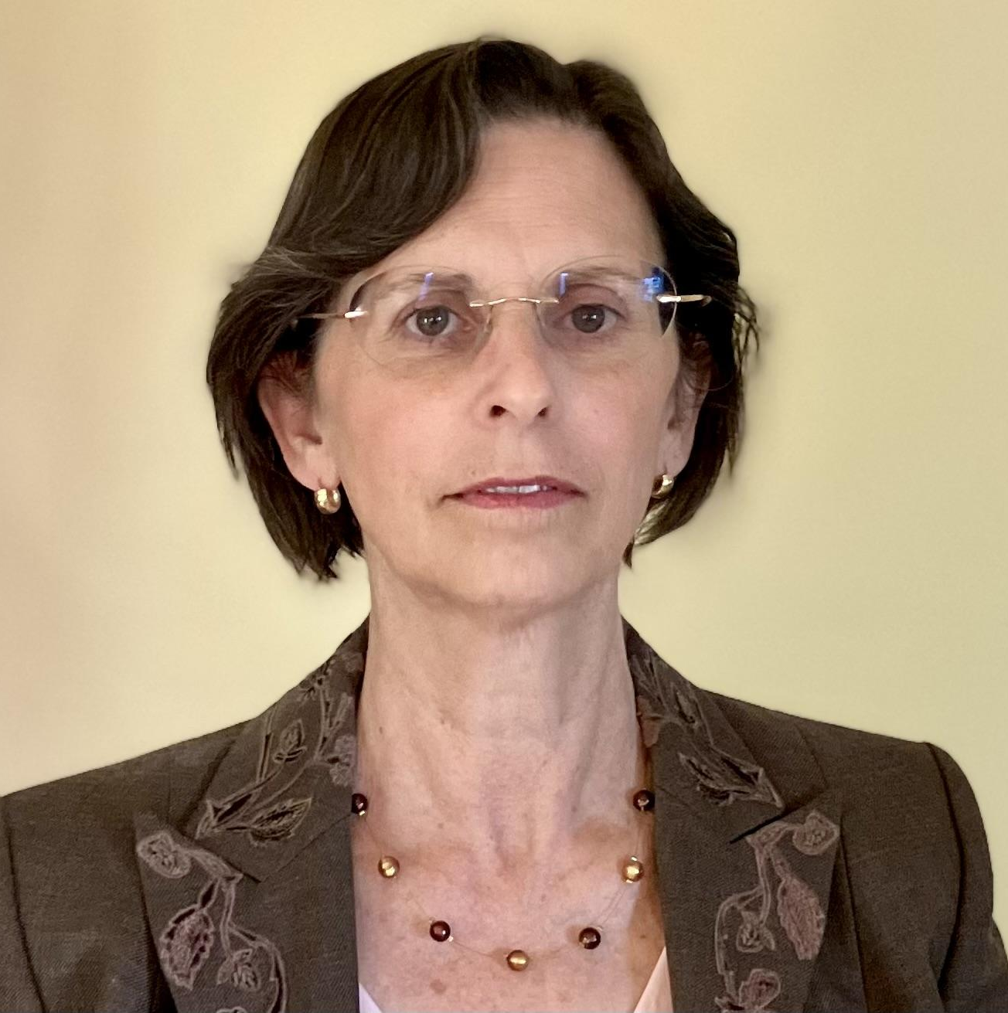
Introductions
Meghan Morrissey
Safety Net and Acute Care Unit Supervisor, HCPF
Jennifer Holcomb
Behavioral Health Benefits Section Manager & SUD Senior Staff Authority, HCPF
Alexandra Haas
Policy Supervisor of Health Facilities & EMS Division, CDPHE
Marc Condojani
Statewide Program Division Director, BHA
Carey Boelter
Associate Director Crisis Services, BHA
Steven Wells​
Crisis Program Manager, BHA
Kelly Bowman
988 Enterprise & Crisis Line Program Manager, BHA

Slide 5
ASAM 4th Edition Changes

Slide 6
ASAM 4
What’s happening?
The American Society of Addiction Medicine (ASAM) released an updated version of national guideline in the Fall of 2023. Colorado is positioning to move into alignment with these guidelines in 2026.
Why is it happening?
Required (by statute and for federal funding)
Best practice for the people of Colorado

Slide 7
ASAM 4
Who is it effecting?
All BHA-licensed providers with varied levels of impact
Outpatient: less substantial changes
Residential & withdrawal management (WM): more substantial changes
ex: WM embedded within other levels of care, no longer standalone
May include discussions with CSU and WIC providers in the future
When is it happening?
The work is currently underway (cdhs_bharulefeedback@state.co.us)
Save the dates: 11/26 and 12/17 from 12:00pm-1:30pm
Prioritizing WM, residential, crisis system impact
Spring 2025: majority of larger stakeholder events
Fall 2025: State Board for formal rule promulgation process
Anticipated effective date: Jan 1, 2026 with delayed enforcement process
Full alignment date: July 1, 2026

Slide 8
BHASO

Slide 9
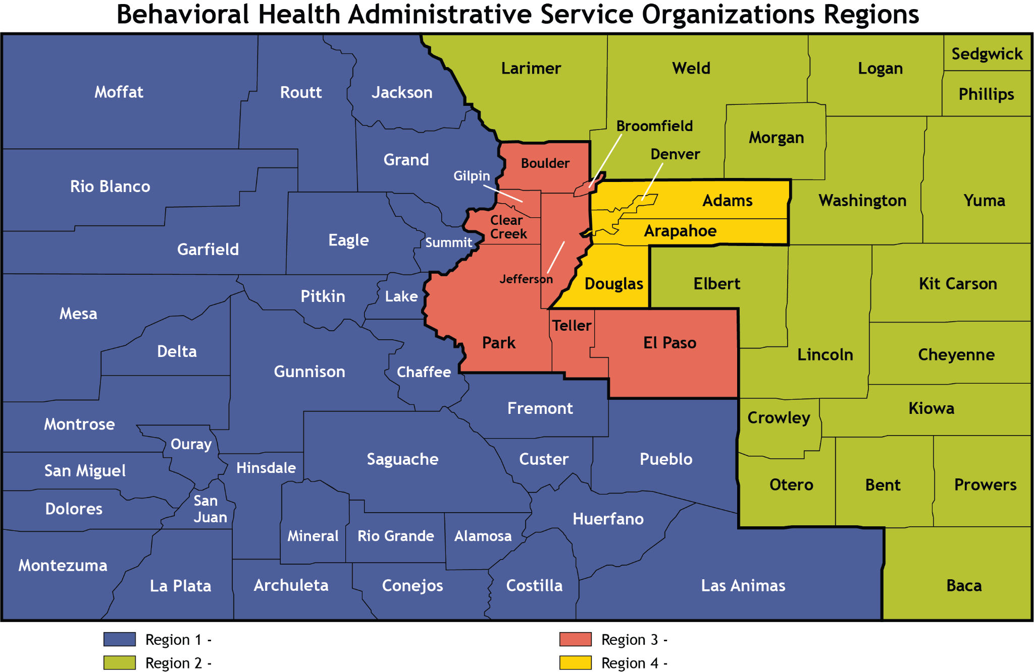
BHASO

Slide 10
RAE

Slide 11
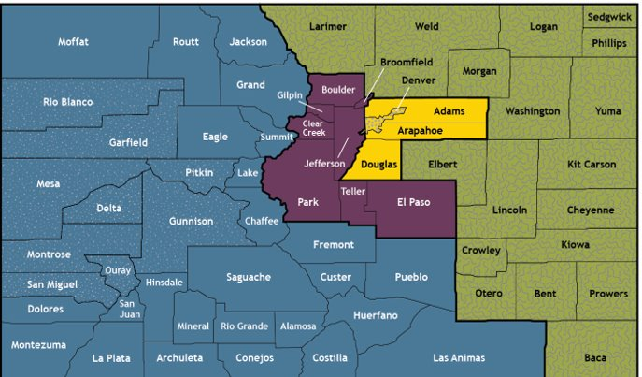
RAE Regions
These regions align with Behavioral Health Administrative Service Organizations (BHASOs)​
New regions/RAEs begin July 1, 2025

Slide 12
988 Vendor Transition

Slide 13
988 Colorado Mental Health Line
988colorado.com

Slide 14
BHA OwnPath Learning Hub

Slide 15
Crisis Professional Curriculum
To get started go to the OwnPath Learning Hub then select The CPC. From there, you can click ENROLL and then register an account. Once registered, you will be able to access the initial modules of the CPC.

Slide 16
BHA LMS
Crisis Professional Curriculum (CPC)
Training is free
All 32 Courses/45 hrs have been released as of 07/15/24
23 courses currently approved for CEUs by the APA, 8 additional courses under review
Crisis Assessment
The Colorado Crisis Assessment was released on 07/15/24 with the final CPC courses. The Colorado Crisis Assessment fillable form and instructions can be found here
Providers are encouraged to work with their ASO to complete a BHA waiver if believe they are not going to be compliant with Rule (2 CCR 502-1) either for the crisis professional staffing requirements related to MCR, WIC and CSU and/or implementation of the Colorado Crisis Assessment

Slide 17
HCPF Updates

Slide 18
MCR is part of the Safety Net
The MCR services codes:
90839 with ET modifier
H2011 with ET modifier
may be provided by:
Crisis Services PT 95, Speciality 772 MCR
with essential approval
without essential approval
Comprehensive Safety Net PT 78, Specialty 887
Be sure to use ET modifier to show that follow up was completed per MCR definition and scope

Slide 19
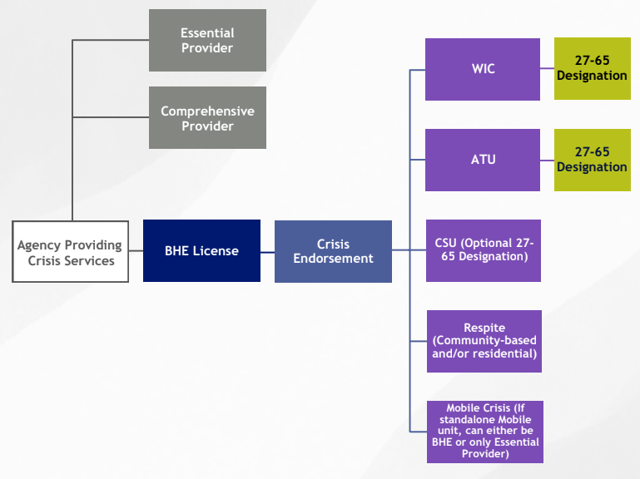
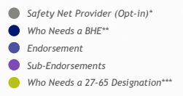
Agency Providing Crisis Services - BHA Licensing

Slide 20
Behavioral Health Safety Net Providers
Essential Behavioral Health Safety Net Provider
Provides care coordination and one or more of the following:
Emergency/Crisis
Outpatient
Intensive Outpatient
Residential
Withdrawal Management
Inpatient
Integrated Care
Hospital Alternatives
Comprehensive Community Behavioral Health Provider
Provides care coordination and all of the following:
Emergency/Crisis
Outpatient
Intensive Outpatient
Care Management
Outreach, Engagement, Education
Recovery Supports
Outpatient Competency Restoration
Notes:
Safety net is made up of comprehensive and essential providers
Care coordination is requirement for all
Many providers may provide these services and even to medicaid or priority populations - being a safety net provider comes with enhanced payment for those services because the provider is meeting additional standards in accordance with the safety net system competencies

Slide 21
HCPF Enrollments
MCR
Aspen Hope Center
Axis Health System
Centennial Mental Health Center*
Denver Health and Hospital Authority
Diversus Health*
Gunnison Valley Health
Health Solutions*
Jefferson Center for Mental Health*
Mind Springs Health*
North Range Behavioral Health*
Paragon*
San Luis Valley Behavioral Health*
Solvista*
Specialized Alternatives for Families and Youth
SummitStone Health Partners*
Valley-Wide Health Systems*
Your Hope Center
Vail Health*
BHST
Adlan Transportation (720-477-9758)
Aspen Ride, LLC (720-220-5703)
Centennial Mental Health Center (833-591-0454)
Citadel Security (970-216-4384)
Colorado Secure Transportation, LLC (877-743-3988)
Delta County Ambulance District (970-250-3531)
Diversus Health Services (719-635-7000)
Eagle County Paramedic Service (970-479-2201)
First Response K-9 (719-849-3994)
Guardian Transport & Security LLC (970-640-5957)
Legacy EMS, Inc (844-886-3339)
Met Transport LLC
Mind Springs Health (970-783-7778)
North Range Behavioral Health
Poudre Valley Health Care, Inc. (970-237-7919)
SkyRide LLC (720-957-2024)
UTE Pass Regional Ambulance District (719-687-9262)
Zin Transportation, LLC

Slide 22
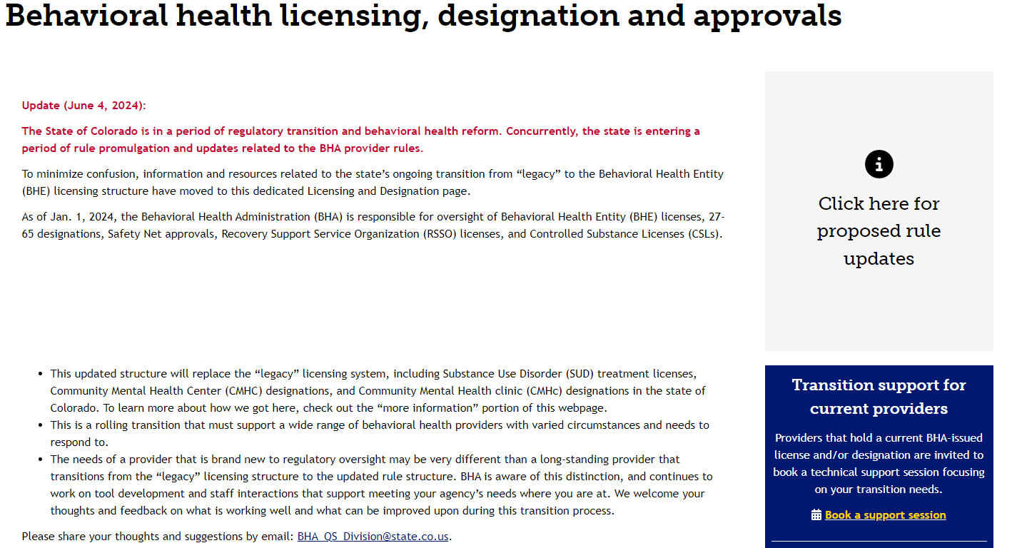
Schedule a Support Session
Notes:
https://bha.colorado.gov/behavioral-health/designation-and-licensing

Slide 23
Essential Providers
A Provider gets BHA Approval as an Essential Provider
A Provider enrolls (or updates enrollment) with HCPF
There is not a distinct Provider Type or Specialty Type for this - it will be a “box” you select in the enrollment portal under the appropriate existing provider types
New Providers - Enroll as the appropriate provider type and then submit a maintenance request and select “Essential” in the enrollment portal. Must upload BHA Approval Letter
Current Providers - Submit a maintenance request and select “Essential” in the enrollment portal. Must upload BHA Approval Letter
*BHA Essential Approval services must align with your HCPF provider type.
A Provider must be contracted with an MCE as a safety net provider to receive the enhanced payment.
MCEs are required to re-contract with existing providers who have secured Essential status.
MCEs may choose not to contract with new providers based on network needs.
A Provider will receive the Essential enhanced payment rate based on the effective date of the MCE contract.
HCPF sends a weekly provider file to the MCEs. The weekly file includes any changes that were made from the previous weekly file.

Slide 24
BHST Billing Updates
BHST Billing Manual
Procedure Codes and Rates
The Provider Rates and Fee Schedules outline the current BHST rates and available procedure codes. The Rate and Fee Schedule is updated annually around July 1 with the new rates implemented by the legislature for the new State Fiscal Year.
*When submitting a claim, providers must use modifier ET in order to get reimbursed.
Enter whole numbers only. Do not enter fractions or decimals.
Trips over 250 Miles
For BHST trips over 250 miles one-way, BHST providers must submit the BHST 250+ Mileage Verification form with their claim. The form must be filled out by the Behavioral Health provider who requested the BHST trip. The Behavioral Health provider can be the same professional types who establish member eligibility.
Multiple Trips in the Same Day
When billing for one member taking multiple trips in the same day with the same rendering provider, modifier 76 must be used.
When billing for one member taking multiple trips in the same day with different rendering providers, modifier 77 must be used.
Code | Modifier* | Unit | Description | Rate
A0999 | ET | One Way Trip | Behavioral Health Secure Transport | $267.91
A0425 | ET | Mile | Ground mileage, per statute mile | $6.41

Slide 25
Funding Opportunities
BHA Funding Opportunities
EMS Funding Opportunities
National Aging and Disability Transportation Center
Transportation Safety Foundation Grant Application
SAFECOM
US Dept of Transportation SMART Grant

Slide 26
CDPHE & BHST

Slide 27
BHST Provider
If you are interested in providing transportation to people in BH Crisis,
STEP 1: Obtain the appropriate licenses and permits from the counties of operation:
Secure Transport web page to find county contacts
Register a profile with CDPHE
STEP 2: If you would like to receive HCPF funding:
Complete provider enrollment
Learn more via the Behavioral Health Secure Billing Manual

Slide 28
Submission Process & Data Privacy
To protect client information, data submission must be encrypted prior to sending to the department. To do that, you must complete the following steps:
There is a button at the bottom of https://cdphe.colorado.gov/emergency-care/air-and-ground-ambulance/behavioral-health-secure-transport entitled “Submit encrypted data”
Create a password for your email encryption account
Click ‘New Message’ and complete the email as you typically would.
Attach the Secure Transportation Spreadsheet from your agency, address email to cdphe_securetransportationdata@state.co.us and click ‘Send’.

Slide 29
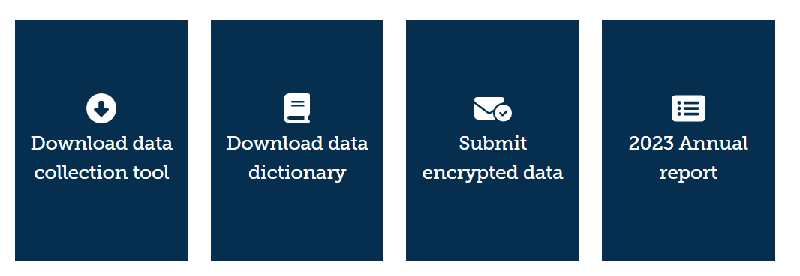
CDPHE Data Report

Slide 30
Secure Transportation Spreadsheet
CDPHE has a downloadable spreadsheet that can be accessed at https://cdphe.colorado.gov/emergency-care/air-and-ground-ambulance/behavioral-health-secure-transport
This is also the website to access Profiles, the data dictionary, and submit the completed spreadsheet

Slide 31
Keep in Touch

Slide 32
Opportunities for Engagement
BHA Forums:
988 Enterprise Board Meeting - Second Thursday of the Month. Zoom link on webpage
BHA Provider Convening. Register in advance for December.
BHA Rule Feedback. Register for various times in-person and virtual or provide direct feedback via 2024 Rules Feedback Google Form
ASAM Workgroup: email cdhs_bharulefeedback@state.co.us with your interest
Check out the BHA Meetings and Events Calendar
BHA Newsletter: Sign up here
HCPF Forums: Designed to be a space for presentation of information and discussion:
Independent Provider Network Forum - Quarterly First Friday 1:00 – 2:00 PM. Register in advance.
SUD Forum – Quarterly First Wednesday 2:00 – 3:00 PM. Register in advance.
Peer Support Workforce Collaborative Meetings led by BHA – Quarterly First Thursday 12-1:30 PM. Register in advance through the BHA’s Stakeholder Calendar.
Behavioral Health Hospital Engagement Forum – Quarterly Second Friday 10:00 -11:00 AM. Register in advance.
Office Hours and Technical Assistance: Designed to be a “drop in” space for quick answers to issues best addressed by a brief discussion:
Crisis Office Hours – Monthly Second Tuesday 11:00 AM - noon. Register in advance.
Safety Net Provider Office Hours – Monthly Last Friday 10:00 – 11:00 AM. Register in advance.
SUD Provider Office Hours - Monthly on the 1st Wednesday 2:00 – 3:00 PM. Register in advance.
Housing Provider TA - Monthly on the last Thursday 2:00 – 3:00 PM. Register in advance.
Peer Providers TA - Monthly on the 4th Thursday 12:00 – 1:00 PM. Register in advance.
HCPF Newsletters: Health First Colorado Behavioral Health Updates: Sign up here
CDPHE Newsletter: ETMS on the Go. Sign up here.

Slide 33
Thank You and Questions
BHA Mission:
To co-create a people-first behavioral health system that meets the needs of all people in Colorado
Marc Condojani
Statewide Program Division Director, BHA
marc.condojani@state.co.us
Carey Boelter
Associate Director Crisis Services, BHA
carey.boelter@state.co.us
Kelly Bowman
988 Enterprise & Crisis Line Program Manager
kelly.bowman@state.co.us
Steven Wells
Crisis Program Manager, BHA
steven.wells@state.co.us
HCPF Mission:
To improve health care equity, access and outcomes for the people we serve while saving Coloradans money on health care and driving value for Colorado
hcpf_crisisservices@state.co.us
CDPHE Mission:
Advancing Colorado’s health and protecting the places where we live, learn, work, and play.
Alexandra Haas
Policy Supervisor of Health Facilities & EMS Division, CDPHE
alexandra.haas@state.co.us

