Slide 1
Welcome
We are Recording
Use Chat
Please ask questions
Slides
Will be Shared to webpage and via newsletter
Avoid sharing protected health information
Listening by Phone
Press *6 to unmute your line or *9 to raise hand
Closed Captioning
Click the Live Transcript icon at the bottom of your screen
ASL Interpretation
Please keep your video on only when talking
Notes:
Remove this slide before posting to website

Slide 2
HCPF/BHA/CDPHE
Behavioral Health Crisis Services Collaborative Technical Assistance Meeting
October 26, 2023
11-12:30pm

Slide 3
Agenda
Welcome and Introductions
Communications
988 Update
BHA Learning Management System Crisis Curriculum Update
HCPF Enrollment Clarification

Slide 4
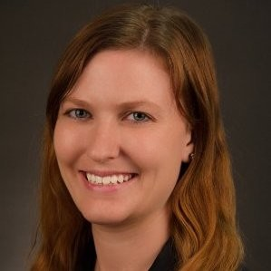
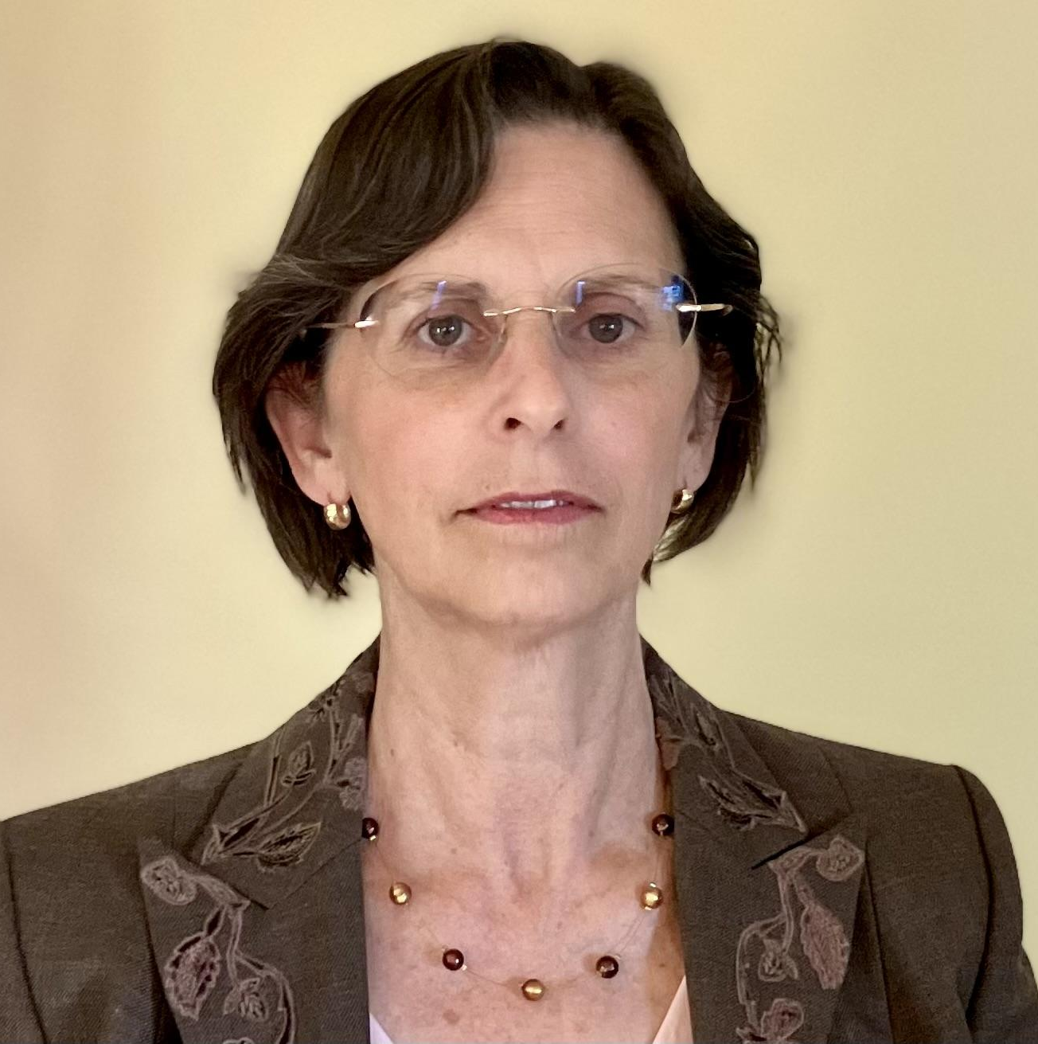
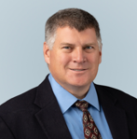
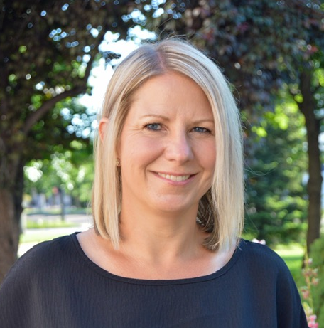
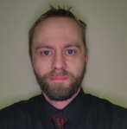
Introductions
Meghan Morrissey
Crisis Services Policy Advisor, HCPF
Jennifer Holcomb
Behavioral Health Managed Care Section Manager & SUD Senior Staff Authority, HCPF
Alexandra Haas
Policy Supervisor of Health Facilities & EMS Division, CDPHE
Marc Condojani
Manager of Crisis Services Colorado, BHA
Carey Boelter
Associate Director Crisis Services, BHA
Steven Wells​
Crisis Program Manager, BHA
Kelly Bowman
988 Enterprise & Crisis Line Program Manager, BHA

Slide 5
Communications

Slide 6
BHA Communications
Marc Condojani, LCSW, CAS
Manager of Crisis Services Colorado, BHA
marc.condojani@state.co.us
Carey Boelter, MA, LPC
Associate Director Crisis Services, BHA
carey.boelter@state.co.us
Steven Wells, MSW, AS​
Crisis Program Manager, BHA
steven.wells@state.co.us
oversees colorado crisis services contract
Kelly Bowman, BA
988 Enterprise & Crisis Line Program Manager, BHA
kelly.bowman@state.co.us

Slide 7
BHA Websites
BHA Crisis Services
Find Behavioral Health Help
BHA 988
Colorado Crisis Services Data Dashboard

Slide 8
HCPF Communications
Meghan Morrissey, LCSW, LAC
Crisis Services Policy Advisor, HCPF
meghan.morrissey@state.co.us
HCPF Crisis Services: Monthly Open Office Hours
informal
ask questions
clarifying updates
Crisis Services Bi-Monthly Technical Assistance
collaborative (HCPF, BHA, CDPHE, etc.)
recorded
presentations and updates
Crisis Services Newsletter
Websites
HCPF_CrisisServices@state.co.us
PLEASE DIRECT ALL CLAIMS and PORTAL QUESTIONS TO GAINWELL TECHNOLOGIES (formerly DXC) at 1-844-235-2387. If you have contacted Gainwell and your question is still unresolved, you must have the call center agent’s name and the call tracking number in order for me to escalate your inquiry internally.
contact your field representative

Slide 9
HCPF Websites
Crisis Services
https://hcpf.colorado.gov/crisisservices
Provides overview
Links to engagement forums
Crisis Services Provider Page
https://hcpf.colorado.gov/bhcrisisservicesproviders
Lists various crisis services by community-based, facility-based, and transportation options
HCPF Crisis Services Hospital Billing Guidance Aug. 2023
Link to NEMT Providers (for transportation after discharge)
MCR
https://hcpf.colorado.gov/mobilecrisisresponse
Lists HCPF enrolled MCR providers
BHST
https://hcpf.colorado.gov/securetransport
Lists HCPF enrolled BHST providers

Slide 10
CDPHE Communications
Alexandra Haas, JD, LLM, Policy Supervisor of Health Facilities & EMS Division, CDPHE alexandra.haas@state.co.us
Along the crisis continuum, health transportation services continue to be regulated by CDPHE.
EMS rule is in process to have CDPHE oversight
Engage with the ground ambulance licensing task force
BHST service is regulated by individual counties.
List of BHST County Contacts

Slide 11
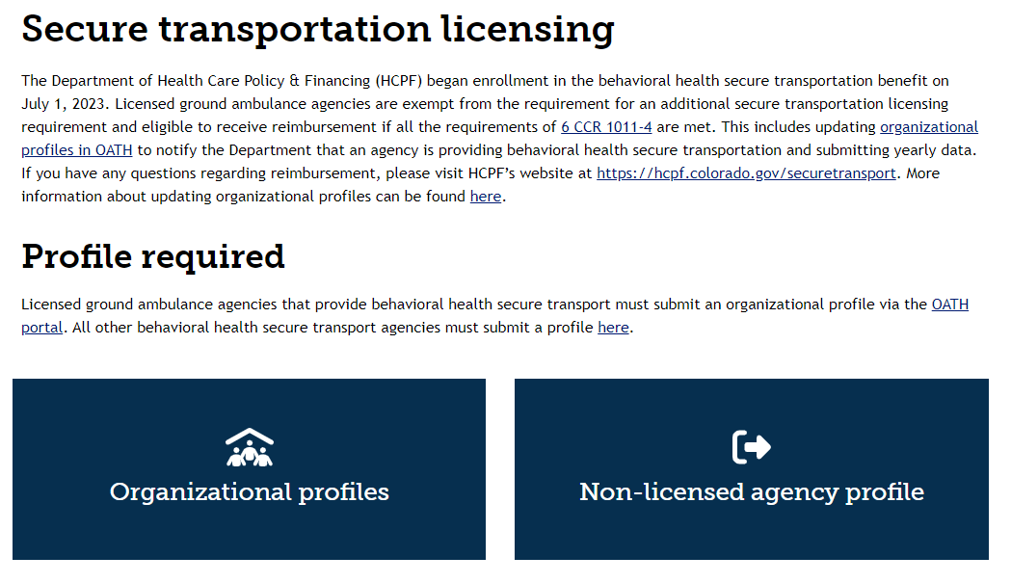
CDPHE Website
Update Your Profile
Funding opportunities
Data template forthcoming
Ground Ambulance Profile
BHST Profile

Slide 12
988

Slide 13
988 Updates
Both 988 and 911 have been made aware of MCR and BHST providers list availability on HCPF web pages

Slide 14
Order Free 988 Materials
informed by feedback from the people of Colorado
designed in collaboration with a workgroup of community partners.
Order free print materials
Download digital materials
If you have any questions, please email cdhs_bha_outreach@state.co.us

Slide 15
BHA Learning Management System Crisis Curriculum Update

Slide 16
BHA LMS
Crisis Professional Curriculum
Slide decks are moving along, thanks to all who have reviewed and provided feedback!
Launch date: January 1, 2024
Crisis Professional Scope of Practice
Currently in drafting stage
Crisis Assessment
Working with a contractor to have ready by Jan 1, 2024.

Slide 17
HPCF Enrollment Clarification

Slide 18
MCR vs BHST Enrollment
MCR
Group
PT 95
Need BHA endorsement letter
BHST
Atypical
PT 97
Need county licenses and vehicle permits
*PT 13 (124 or 324) may use BHST codes

Slide 19
BHST Reciprocity Agreements
BHST provider enrollment requires license & permits. If you are using a reciprocity agreement to operate in another county, we do not need you to include your reciprocity agreement in your enrollment.
keep your records up to date on all licenses/permits that allow you to operate in your service area.
keep your CDPHE profile up-to-date

Slide 20
Current HCPF Enrollments
MCR (12)
Axis Health System
Centennial Mental Health Center
Denver Health and Hospital Authority
Health Solutions
Integrated Insight Therapy
Jefferson Center for Mental Health
North Range Behavioral Health
San Luis Valley Behavioral Health
Solvista
SummitStone Health Partners
Valley-Wide Health Systems
Your Hope Center
BHST (8)
Centennial Mental Health Center (833-591-0454)
Citadel Security
Delta County Ambulance District
Diversus Health Services (719-635-7000)
First Response K-9 (719-849-3994)
North Range Behavioral Health (970-347-2120 option 2)
Poudre Valley Health Care, Inc. (970-237-7919)
Ute Pass Regional Ambulance District
*291 claims paid thus far!

Slide 21
Medicaid Transportation Spectrum
Scheduled
Unscheduled
Non-Medical Transport
Non-Emergent Medical Transport
Behavioral Health Secure Transport
Emergency Transport
Scheduled trips to non-medical places that support member health and community integration
*eligible to Medicaid waiver members only
Scheduled trips to provide continuity of care to members, including planned outpatient or inpatient appointments
Urgent transportation to members in behavioral health crisis
Urgent and emergent transportation due to medical emergency to highest level of care

Slide 22
NEMT Enrollment Moratorium
ATTENTION: The state has imposed a moratorium on new enrollments for Non-Emergent Medical Transportation (NEMT) due to a significant potential for fraud, waste, or abuse to the Medicaid program. The moratorium will be in place for a minimum of 6 months and may extend beyond that. Additional information will be announced as it becomes available.

Slide 23
Troubleshooting HCPF Enrollment
For enrollment support: https://hcpf.colorado.gov/provider-help
Contact Gainwell 7:00 a.m. - 5:00 p.m. MT Monday - Friday at: 1-844-235-2387
https://hcpf.colorado.gov/virtualagent
note your call tracking number (CTN)
Field representatives for locally assigned support

Slide 24
BHA Reimbursement Option
General Accounting Encumbrance (GAE)
Available to Administrative Service Organizations (ASO) and Community Mental Health Centers (CMHC) only
Contact BHA
marc.condojani@state.co.us
carey.boelter@state.co.us
steven.wells@state.co.us

Slide 25
Funding Opportunities
EMS Funding Opportunities
BHA Funding Opportunities
National Aging and Disability Transportation Center

Slide 26
Next Meeting
December 21, 2023: 11-12:30pm
https://us06web.zoom.us/meeting/register/tZwtcu-uqjgrG9YQrMiVQqDP6e3FjVJY_h9i

Slide 27
Thank You and Questions
BHA Mission:
To co-create a people-first behavioral health system that meets the needs of all people in Colorado
Carey Boelter
Associate Director Crisis Services, BHA
carey.boelter@state.co.us
Marc Condojani
Manager of Crisis Services Colorado, BHA
marc.condojani@state.co.us
Steven Wells
Crisis Program Manager, BHA
steven.wells@state.co.us
HCPF Mission:
To improve health care equity, access and outcomes for the people we serve while saving Coloradans money on health care and driving value for Colorado
Jennifer Holcomb
Behavioral Health Managed Care Section Manager
& SUD Senior Staff Authority, HCPF
jennifer.holcomb@state.co.us
Meghan Morrissey
Crisis Services Policy Advisor, HCPF
meghan.morrissey@state.co.us
CDPHE Mission:
Advancing Colorado’s health and protecting the places where we live, learn, work, and play.
Alexandra Haas
Policy Supervisor of Health Facilities & EMS Division, CDPHE
alexandra.haas@state.co.us

