Slide 1
Department of Health Care Policy and Financing (HCPF) DOULA STAKEHOLDER ENGAGEMENT KICK-OFF!
October 18th, 2023
Brooke Greenky ∙ Susanna Snyder ∙ Sarabeth Upson
Notes:
Thanks for joining us!
Welcome
Reminders:
- Spanish Live Interpretation: Linda is here!
- This meeting will be recorded and posted, slides as well.

Slide 4
Today’s Agenda
Intro/Welcome (5 minutes)
Background and Level Setting – How did we get here? (20 minutes)
Medicaid 101 Background
Doula Benefit Background
Discuss Expectations/Groups Norms/Commitments (15 minutes)
Collect feedback on stakeholder engagement logistics and scholarship structure (40 minutes)
Next Steps (10 minutes)
Notes:
Understand doula benefit and how we got here
The dept will receive feedback from the community on stakeholder logistics etc

Slide 5
Meeting Objectives
Welcome everyone to this new stakeholder space and celebrate the work toward implementation of this new benefit!
Understand Medicaid Basics, the Doula Benefit, and how we got here
Talk through the Departments’ commitment(s) around this work
Receive feedback from the community on the upcoming stakeholder process opportunities

Slide 6
Welcome!
THANK YOU FOR JOINING US!
This meeting is being recorded for transparency and to keep track of next steps. It will be posted to our website ASAP along with these slides.
Department Staff:
Susanna Snyder, Child and Family Health Division Director
Brooke Greenky, Reproductive Health Unit Supervisor
Sarabeth Upson, Maternal Child Health Implementation Specialist
There are a lot of people here today! Please put your name, pronouns and any organization or title you may want to share in the chat!
Notes:
What a diversity of voices who are showing up to the table who are excited with great perspectives.
Celebrate the exciting place.

Slide 7
Thank you to Lauren Smith and Pia Long (and your organizations) for your leadership and partnership in Phase I of Doula Stakeholdering. Thank you to those who attended those sessions and thank you to those attending today!

Slide 8
Background and Level Setting

Slide 9
Who is HCPF?
HCPF = Colorado Department of Health Care Policy and Financing​
Designated as Colorado’s single state Medicaid agency​
Responsible for supervision and oversight of Colorado’s public insurance programs​
Visit our website: https://hcpf.colorado.gov/
Notes:
For our Members
For our Providers
For our Stakeholders

Slide 10
What is Medicaid?
Medicaid provides health coverage to millions of Americans, including eligible low-income adults, children, pregnant people, elderly adults and people with disabilities.
Medicaid is federal – state partnership

Slide 11
Who We Serve
February 2023:
1,702,359 Coloradans received
Health First Colorado
47,367 enrolled in
Child Health Plan Plus

Slide 12
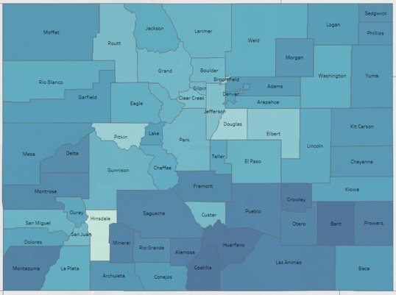
Medicaid covers 42% of all Colorado Births
Notes:
WHY WE ARE HERE.

Slide 13
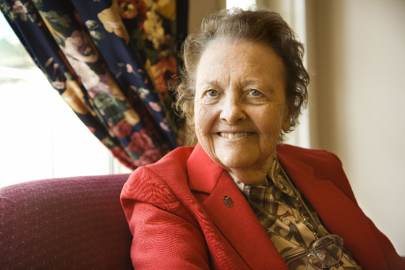
What is Health First Colorado?
Free or low-cost public health care coverage for Coloradans who qualify
Comprehensive benefits and services
Care coordination
More adults and parents who qualify
Apply at any time
https://www.colorado.gov/pacific/hcpf/colorado-medicaid
Notes:
No monthly or annual enrollment fee
Members pay no or very low co-pay amounts depending on the population
For example, children, pregnant people, populations who do not pay co-pays

Slide 14
Health First Colorado Benefits
Dental services
Emergency & urgent care
Hospitalization
Behavioral health
Prescription drugs
Maternity care (Prenatal, delivery, postpartum)
Immunizations
Primary care
Laboratory Services
Rehabilitative
Services
https://hcpf.colorado.gov/program-list

Slide 15
Maternal Health Data
Notes:
Programming/data

Slide 16
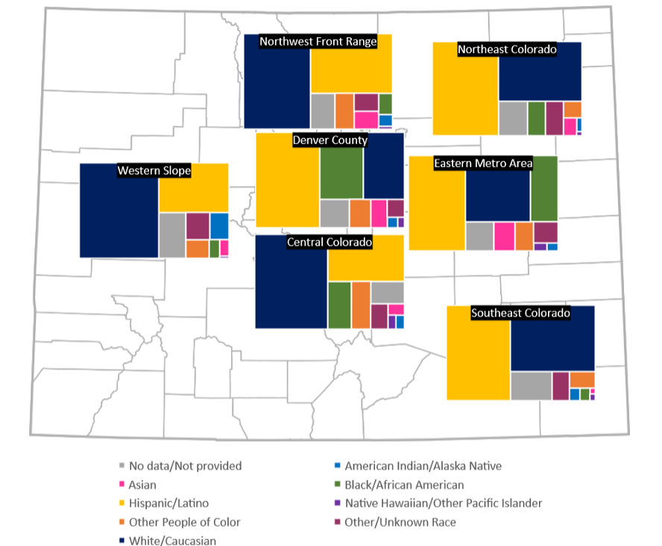

Slide 17
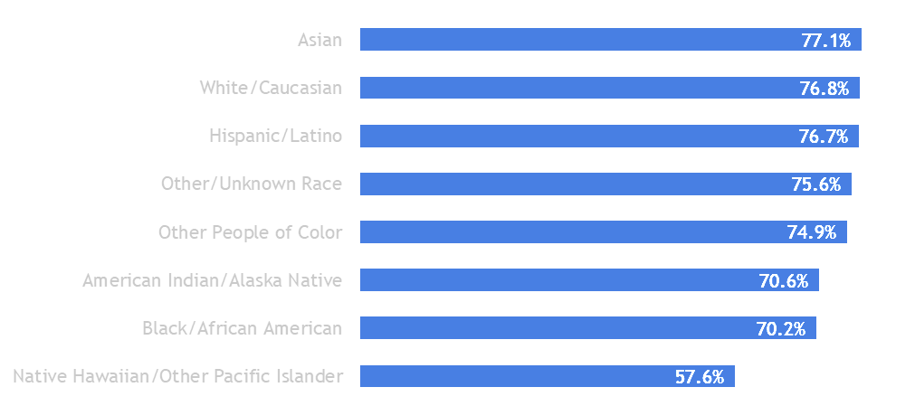
Prenatal Care in First Trimester, Race/Ethnicity
Takeaway: Over 70% have first trimester prenatal care in most groups, but among AI/AN, Black, and especially NHOPI, the rate of visits is lower.

Slide 18
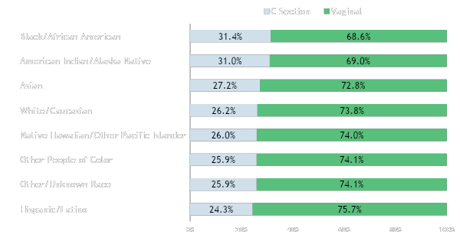
Vaginal or C-section Births: Race/Ethnicity
Takeaway: Black/African American and AI/AN birthing parents have higher rates of C-section births; 7 percentage points higher than Hispanic parents.

Slide 19
Medicaid/Health First Colorado
Temperature Check
In the chat:
Did you learn anything new? Yes/No
If you feel comfortable sharing, what did you learn or what surprised you?

Slide 20
Doulas for Medicaid Members

Slide 21
How did we get here?
Historically and Ongoing: Doula Community-Led Work
2021-22 | HPCF work nationally and internally on opportunity
2022 | Governor’s Budget Released (11/1/22)
 | Targeted Stakeholder Discussions Begin
2023 | Partner stakeholder work
 | Budget approval through legislature
 | SB23-288 Complements (Stakeholder work, Scholarship, Authority)
 | Kickoff!
Notes:
SenatorRhonda Fields
SenatorJanet Buckner
RepresentativeRegina English
RepresentativeJunie Joseph

Slide 22
What does this include?
Historically and Ongoing: Doula Community-Led Work
$1500 | Doula Rate – TBD on how those funds are distributed across services
$150k | Stakeholder Work
$100k | Scholarship Fund (SB23-288)
$30k | Outreach to members about doulas
$1.1m | Doula “Hub”
 | [training, support, member materials, infrastructure for scholarship program and more!]
Notes:
Doula Hub:
A place for existing doulas to access on-demand trainings and resources on how to obtain an NPI, enroll in Medicaid and bill for services
Training opportunities available on topics including (but not limited to) “Continuing cultural competence, providing care coordination and connection to community resources, and helping members receive their prenatal and postpartum care.
An ongoing supportive doula community infrastructure to support doula retention that includes mentorship and group meetups for doulas to share best practices and process vicarious trauma from attending births
A Medicaid enrolled doula provider list for members to find and contact doulas serving Medicaid members in their area
Member facing materials on doula services, benefits and eligibility
Translation

Slide 23
Enrollment and Billing
Medicaid Enrolled Providers
-Need NPI & Other Enrollment Criteria
Submit Claims through online Portal
-Billing Details (who, what, when, where, why?)
Reimbursement or Denial
-Based on accuracy of claim submission
Funding for training and troubleshooting to support providers in this process

Slide 24
Provider Enrollment
Temperature Check
In the chat, please input where you feel you are in terms of familiarity with Medicaid billing/structure
1-10 with 10 being “expert”

Slide 25
Resources for Further Reading:
National Health Law Doula Medicaid Project
SB23-288 Coverage for Doula Services
NASHP: State Medicaid Approaches to Doula Service Benefits
Budget Request: Advancing Birthing Equity

Slide 26
Timeline Updates
Notes:
…

Slide 27
Project Timeline
Fall 2023
Fall 2023
Jan - July 2024
Implementation:
July 2024
Stakeholder contract released and vendor onboarded
Stakeholder meetings,
Doula Advisory Committee (DAC) formation
Doula Advisory Committee (DAC) meetings
DAC meetings continue
Doula provider enrollment opens
HCPF creates fee schedule and provider manual
SPA submitted to CMS
Doulas can be reimbursed
Anticipated CMS Approval of benefit
Implementation Date: July 1, 2024
Notes:
Let’s walk through this above

Slide 28
What is in the queue?
Documented Quote
We are in the final stages of posting a stakeholder engagement procurement contract which will be posted here when finalized. This will give interested organizations the opportunity to apply to lead our robust stakeholder engagement efforts.
We will send out another email when the solicitation goes live and include detailed instructions to view the solicitation as well.
Interested organizations will need to make an account on the Colorado VSS website to view/respond to the solicitation.

Slide 29
More queue
Upcoming Stakeholder Engagement Meetings
Doula Hub Details
State Plan Amendment (SPA) Submission

Slide 30
What is a State Plan Amendment (SPA)?
“A Medicaid and CHIP state plan is an agreement between a state and the Federal government describing how that state administers its Medicaid and CHIP programs. It gives an assurance that a state will abide by Federal rules and may claim Federal matching funds for its program activities. The state plan sets out groups of individuals to be covered, services to be provided, methodologies for providers to be reimbursed and the administrative activities that are underway in the state.” (Medicaid.gov)
Context/Homework
Other states who have implemented this benefit already submitted these SPAs:
Oklahoma SPA California SPA
District of Columbia SPA Michigan SPA
Maryland SPA

Slide 31
Stakeholdering Transition
Our Commitment + Values
Group Commitments
Discussion:
Stakeholder Engagement Processes
Doula Scholarship

Slide 32
Our Commitment + Values:

Slide 33
HCPF (that’s us) is committed to…
Transparency
Communication
Solutions
Creativity
Partnership/Co-Leading
Respect

Slide 34
Let’s Get Chatting! Topic 1: Stakeholder Engagement Structure Topic 2: Scholarship Development

Slide 35
Stakeholder Engagement Level Setting
Why are we talking about this?
How are we going to do this today?
What will it look like in the future?

Slide 36
Stakeholder Engagement
What are some qualities of stakeholder processes that you’ve participated in and that you’ve seen succeed?
What are some common pitfalls you’d like to see this process avoid?
Meeting Times/Formatting
Language Access – what does this look like?
What else would you like to add to this list?

Slide 37
Stakeholder Engagement Level Setting
What are some qualities of stakeholder processes that you’ve participated in and that you’ve seen succeed?
What are some common pitfalls you’d like to see this process avoid?

Slide 38
Stakeholder Engagement Level Setting
3. What meeting times and meeting format would work best for you?
AM/PM
In Person/Hybrid
Alternating time slots

Slide 39
Stakeholder Engagement Level Setting
4. Language Access – what should this look like?
Translation
Interpretation
Materials
Request(s)

Slide 40
Stakeholder Engagement Level Setting
5. What else should we be discussing in terms of stakeholder engagement structure?

Slide 41
Doula Scholarship Level Setting
Why are we talking about this?
How are we going to do this today?
What will this look like in the future?

Slide 42
SB23 – 288: Coverage For Doula Services
The act provides $100,000 to create a doula scholarship program to provide financial support to eligible individuals to pursue doula training and certification. To be eligible for a scholarship, individuals must agree to enroll as a doula provider and provide doula services to recipients.
Notes:
288 Fiscal Note: https://leg.colorado.gov/sites/default/files/documents/2023A/bills/fn/2023a_sb288_f1.pdf

Slide 43
Doula Scholarship Discussion
What are your top 3 priorities for making sure the doula scholarship is distributed equitably?
What else should we be discussing in terms of Doula Scholarships?

Slide 44
Wrap-Up and Next Steps

Slide 45
Next Steps:
THANK YOU for your time today
Please fill out this form for reimbursement*
- for those not otherwise paid to participate today
Homework: SPAs and Resources
Stay tuned for details on next meeting
Sign up for MCH Newsletter/Tell your Friends!
Check out our Vendor Self Service Page for the Documented Quote in the next few weeks.
Register to be a vendor so you can access the solicitation
Notes:
Lots of next steps!

Slide 46
Next Steps:
7. Meeting Evaluation: Doula Stakeholder Engagement Evaluation
8. Slides and Recording will be Posted!
9. Contact Brooke.Greenky@state.co.us with any questions
Notes:
Reimbursement Form Link: https://forms.gle/wwhE9C2ptW3pEaeu6

Slide 47
Questions?

Slide 48
Thank You!
CONTACT US:
Brooke.Greenky@state.co.us
Sarabeth.Upson@state.co.us
Susanna.Snyder@state.co.us

