Slide 1
Medical Services Board
October 9, 2020
Kim Bimestefer, Executive Director

Slide 2
Agenda
COVID-19 Trend Updates
Unemployment trends
Medicaid enrollment increases
Service metrics and new member app
State budget challenges
COVID19 Strike Force, Alternate Care Sites
Utilization Trends
Q&A

Slide 3
COVID-19 Status as of 10/07 CDPHE updates: https://covid19.colorado.gov/
Please be a leader in your community and in your role by setting the example:
Wear a mask
Practice social distancing
Wash your hands.
Positive Cases | 74,191
People Tested | 1,459,332
Deaths Among Cases | 2,081
Deaths due to COVID-19 | 1,983
Updated Oct 7 4pm

Slide 4
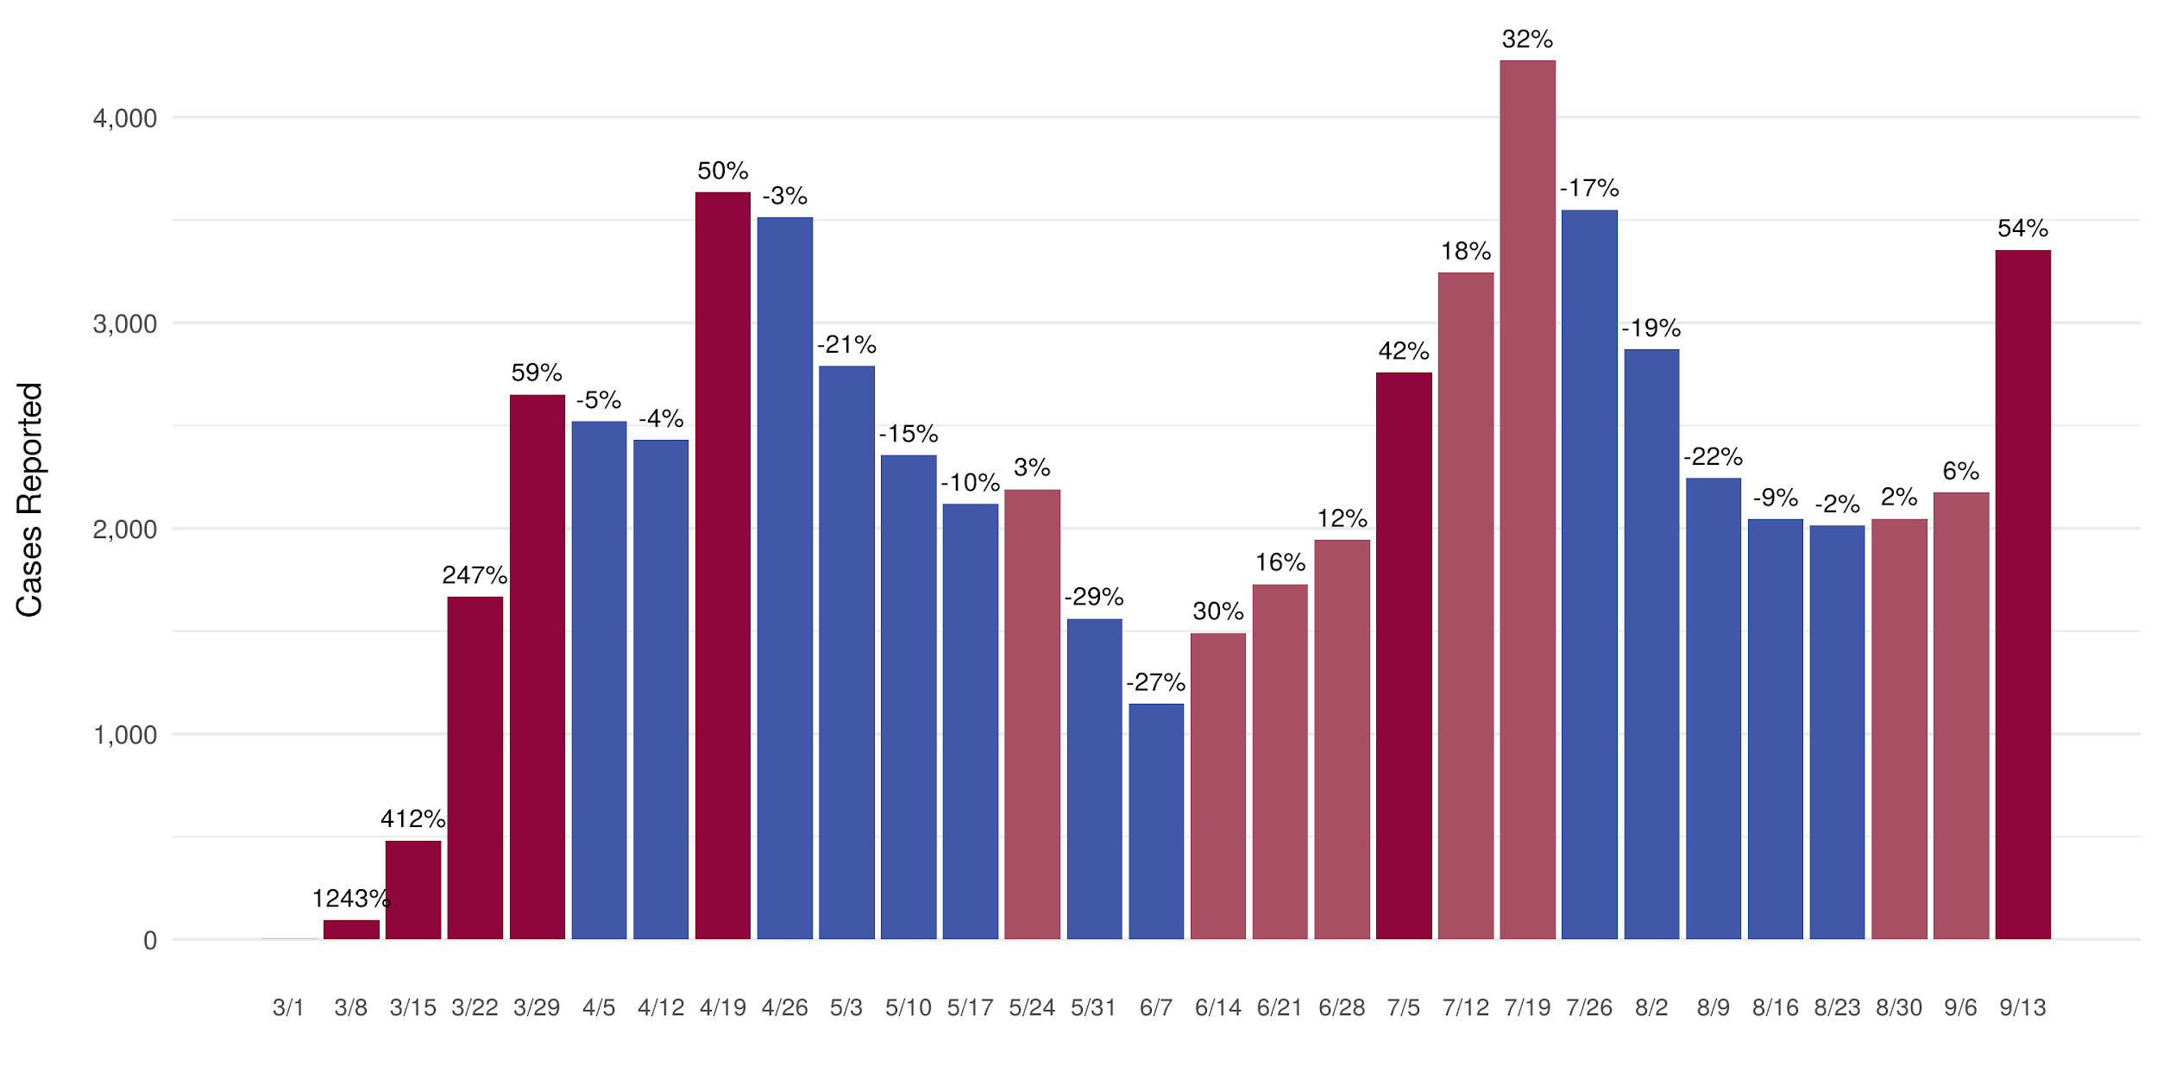
WEEKLY CASE TREND

Slide 5
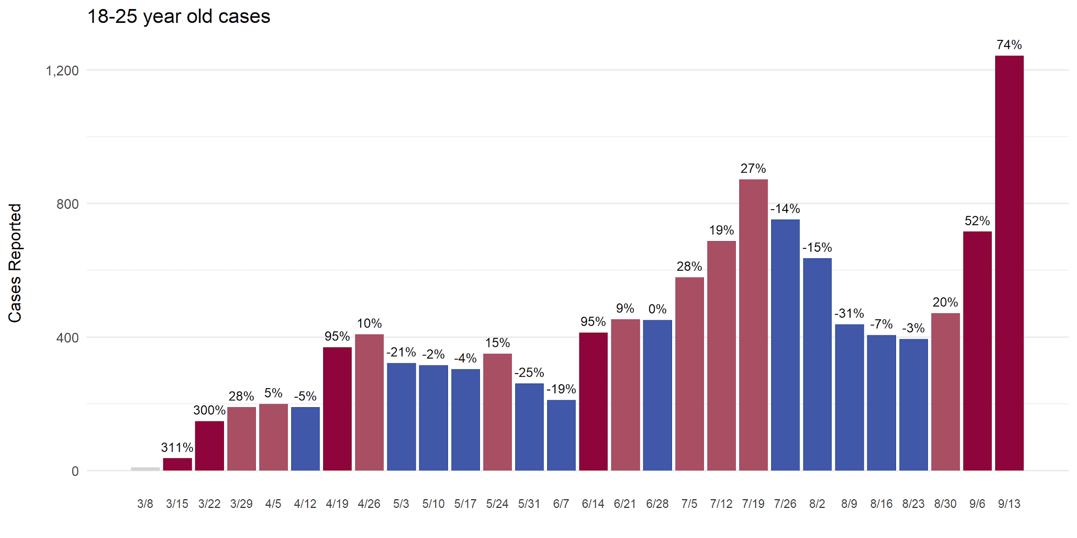
WEEKLY CASE TREND- 18-25 YEAR OLD CASES

Slide 6
Colorado’s Unemployment Rates
Feb Mar Apr May Jun Jul Aug
2.5% 5.2% 12.2%* 10.2% 10.6% 7.4% 6.7%
*highest since 1976; prior record was 8.9% for CO, during the great recession
466,645 Coloradans filed initial unemployment claims since mid-March
Source: Unemployment Data from Colorado Department of Labor and Employment. Chart for the OSPB September 18, 2020 Revenue Forecast available at available at https://www.colorado.gov/governor/office-state-planning-budgeting
Notes:
February: 2.5%
March: 5.2%
April: 11.3%
Highest since state began tracking in 1976
Prior record was 8.9% during Great Recession in Fall 2010
Compares to 14.7% nationally - highest since U.S began tracking in 1948
517,000 Coloradans filed initial unemployment claims since mid-March
Source: Colorado Department of Labor and Employment

Slide 7
September Revenue Forecast: Better than June, but Budget Challenges Remain
Source: Office of State Planning and Budgeting, Revenue and Economic Forecast Presentation to the JBC, Slides 10 & 15. September 18, 2020 available at https://www.colorado.gov/governor/office-state-planning-budgeting

Slide 8
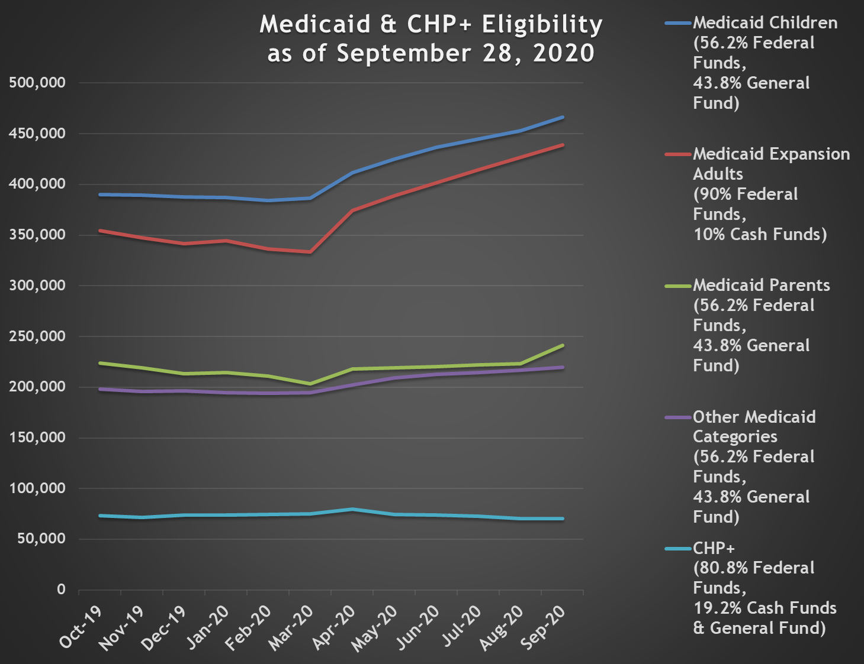
Medicaid Category Enrollment
Count of Clients enrolled by aid code.
Chart shows total enrollments by time periods
and the changes in its composition over time.
The two populations which have seen the greatest increase in enrollment are Medicaid Children and Expansion Adults.
Notes:
For External use

Slide 9
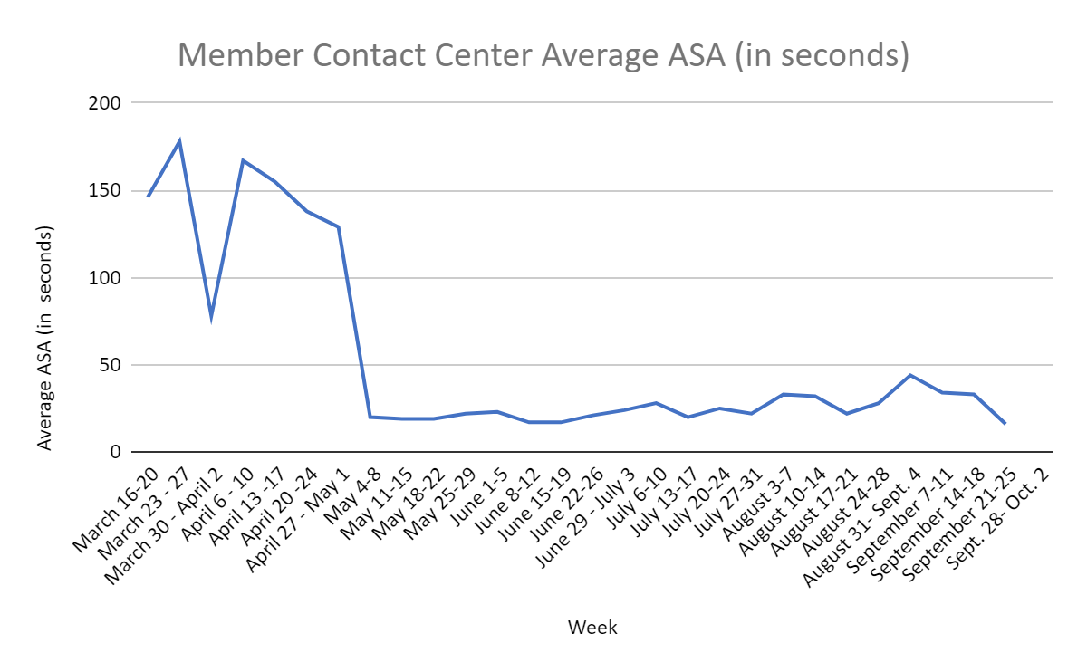
Provider & Member Services

Slide 10
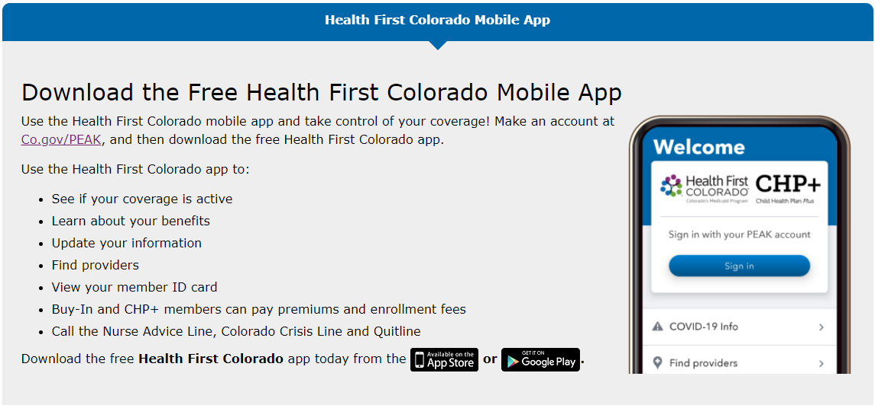
Health First Colorado Mobile App
https://www.healthfirstcolorado.com/mobileapp/

Slide 11
HCPF-CDLE Survey: Where are you getting your health insurance coverage currently?
8.97% - employer extended health care benefits
4.73% - employer’s COBRA option
15.94% - spouse's health insurance
2.18% - under age 26, on my parent’s health insurance policy
10.70% - coverage through Connect for Health Colorado
22.47% - Health First Colorado (Colorado’s Medicaid Program)
.21% - covered by Child Health Plan Plus (CHP+)
15.47% - have healthcare coverage, but not through any of the above*
19.33% - I don't have health insurance coverage

Slide 12
If you are currently uninsured, or anticipate being uninsured, do you plan to:
8.92% - Purchase coverage through Connect for Health Colorado
2.70% - Purchase coverage directly from a health insurance company
20.0% - Apply for coverage with Health First Colorado (CO Medicaid)
.99% - Apply for coverage with Child Health Plan Plus (CHP+)
1.71% - Get covered through my spouse's health insurance
0.09% - Under 26, get covered through my parent’s health insurance
4.95% - Get covered, but not through any of the above
14.50% - Other
46.13% - Go without health insurance coverage

Slide 13
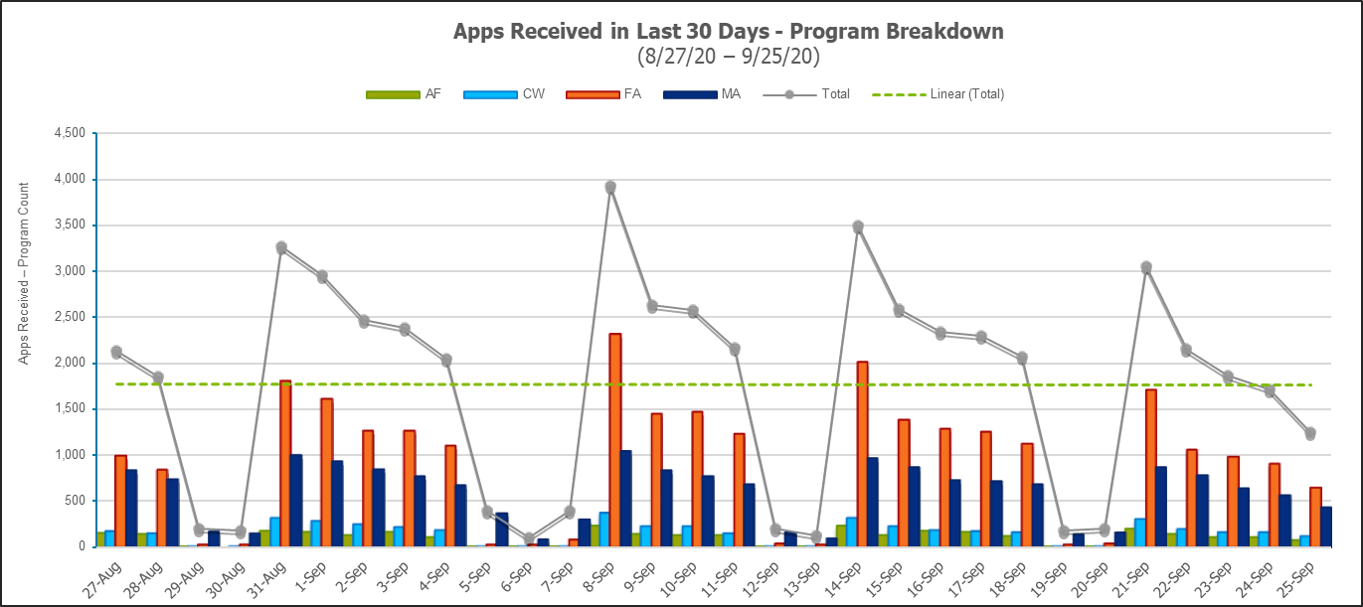
Applications Received Daily broken out by Program
AF = Adult Financial
CW = Colorado Works
FA = Expedited & Non-Expedited Food Assistance
MA = Medical Assistance
This shows what assistance Coloradans are seeking. Over the last 30 days, 52% of applications received were for a Food Assistance program. The second largest category was for Medical Assistance, at 33%. Adult Financial and Colorado Works account for 14% combined.
Notes:
For Internal Use

Slide 14
Help Us Reach Coloradans Who Need Coverage!
HCPF Contact: Sabrina.Allie@state.co.us
Public Service Announcement example:
Tools for partners to help us reach Coloradans available at
CO.gov/hcpf/HereForYou
Enrollment tool/flyer
Newsletter articles, blurbs
Social media posts
Public Service Announcements
Website content
Email content
Images
Notes:
It’s critical that Coloradans know they can apply for health coverage at any time and it’s easy to do.
HCPF is working to spread the word; and we need your help.
We have created an enrollment tool available on our website that provides the critical information I will go over with you next.
Tools are available at CO.gov/hcpf/HereForYou

Slide 15
Department Actions To Date to Connect Coloradans to Coverage to reduce uninsured risk
About 100 stakeholder meetings
New Websites, Brochures, Communications Content
Multiple panels, speaking engagements
Press Conference
Created new member videos to reduce Medicaid stigma (https://www.youtube.com/watch?v=-ulh5-8wX_I&feature=youtu.be)
Partnership with Connect for Health Colorado
September 24 Stakeholder working session (prioritizing ideas)

Slide 16
- Extending or Ending the Public Health Emergency is a federal decision - HHS Extended the PHE for 90 days, as outlined below.
PHE Extension
If Public Health Emergency Ends… | Then SPAs,1135 Waivers, and Optional Uninsured Testing Group Ends | Then Continuous Coverage Requirement Ends | Then MOE Requirement keep Eligibility Levels & Benefits the Same and Enhanced 6.2% FMAP Ends
October 25, 2020 | October 25, 2020 | October 31, 2020 | December 31, 2020
January 23, 2021 | January 21, 2021 | January 31, 2021 | March 31, 2021
16

Slide 17
Medical Assistance Enrollment through 9/29/2020
 | New Members 2020 | Disenrolled Members 2020 | Continuous Coverage | Locked into a higher benefit category | Net Change in enrollment | Total enrollment 2020 | COVID-19 Testing Only
January | 34,969 | 38,071 |  |  | -2,196 | 1,262,699
February | 27,143 | 33,676 |  |  | -6,533 | 1,256,166
March | 33,484 | 40,757 |  |  | -7,273 | 1,248,893
April | 42,154 | 5,306 | 37,138 | 2,948 | 36,848 | 1,285,741 | 139
May | 26,322 | 7,728 | 34,965 | 5,803 | 18,594 | 1,304,335 | 155
June | 27,564 | 7,492 | 24,452 | 5,848 | 20,072 | 1,324,407 | 139
July | 24,793 | 7,081 | 28,506 | 7,029 | 17,712 | 1,342,119 | 204
August | 24,068 | 7,253 | 32,357 | 5,847 | 16,815 | 1,358,934 | 148
September | 17,057 | 7,116 | 24,230 | 6,220 | 9,941 | 1,368,875 | 118
October | 2,353 | 6,262 | 37,633 | 10,753 | -3,909 | 1,364,966
Total |  |  | 219,281 | 44,448 |  |  | 903
New Member: Members who started receiving MA benefits in that month, and who were not eligible the previous month
Disenrolled: Beginning April 2020, captures only members who met the exceptions to the continuous coverage requirements
Continuous Coverage: Members who were locked into their MA benefit due to the continuous coverage requirement
Locked into a higher benefit category: Members who would have switched to a lower MA benefit, but were locked into a higher category due to continuous coverage
Net Change: Net change in Total Enrollment compared to previous month
Total Enrollment: Total unique members eligible and receiving Medical Assistance benefits
COVID-19 Testing Only: Members eligible for COVID-19 testing benefit only. NOTE: April includes March numbers
Notes:
For External use
Rachel Entrican to review

Slide 18
Solution: Residential Care Strike Team Strategy
Enforcement & Education
COVID19 Impact & Response: 60%+ of deaths are in NH & ALF settings
Situational Awareness
Testing for Disease Presence
Health & Wellbeing / Equity
Staffing
Cohorting & Facility Isolation
Notes:
The Residential Care Strike Team is composed of representatives of the Governor’s office and state agencies that play a role in regulating and supporting residential care facilities: The Departments of Public Health and Environment (CDPHE), Human Services (DHS), Health Care Policy and Financing (HCPF), Public Safety (DPS) and Regulatory Agencies (DORA). The Strike Team was established by Governor Polis in April 2020 to mitigate the spread of COVID-19 in all high-density residential environments serving older adults and people with disabilities.
The Strike teams work is organized into 6 key strategy areas:
Enforcement and Education – Ensure that all facilities are following regulatory guidelines set forth by CDPHE and that they have the proper support and resources to do so.
Testing for Disease Presence – Implementing a multi-pronged approach of ongoing surveillance testing (asymptomatic) and testing as a component of outbreak response.
Cohorting & Facility Isolation – Educate and assist facilities in preparing for an outbreak, as well as provide technical assistance and education on effective infection prevention strategies including cohorting and isolation.
Staffing – Ensure an adequate, well-trained workforce is available for facilities to serve their residents.
Situational Awareness – Maintain a line of sight on the needs and capacities of facilities to maximize response efforts. Through tools like EMResource the State is able to understand live metrics around bed capacity, PPE needs, testing capabilities, and staffing shortages.
Health & Wellbeing / Equity – Acknowledge the physical, mental, and cognitive health of residents and staff while continuing to assure their safety in all policy decisions. In addition, understand the implications of the long-standing systemic health and social inequities and ensure they are considered in our COVID-19 response effort.

Slide 19
COVID19 Risk: Breach of the healthcare system, like other states. Solutions: Alternate Care Sites
DECOMMISSIONING
The Ranch Events Complex
Loveland, CO
Tier 3 facility
Max capacity: 1,060 beds
“Ready” date 6/26/2020 with
80 beds
St. Anthony North Hospital
Westminster, CO
Tier 2.5 facility
Max capacity: 78 beds
“Ready” date 8/20/2020 with 25 beds
Colorado Convention Center
Denver, CO
Tier 3 facility
Max capacity: 2,000 beds
“Ready” date 6/26/2020 with 80 beds
DECOMMISSIONING
Western Slope Memory Care
Grand Junction, CO
Tier 2.5 facility
Max capacity: 50 beds
“Ready” date: 9/3/2020 with 25 beds
St. Mary Corwin Hospital
Pueblo, CO
Tier 2.5 facility
Max capacity: 120 beds
“Ready” date 8/27/2020 with 25 beds
Tier 1 care: existing acute care hospitals
Tier 2 care: ambulatory surgical center, free-standing emergency department, or critical access hospital
Tier 3 care: alternate care sites that have been created by the state, by hospitals and/or by state/local partnerships with public health and emergency management. Alternate Care Sites are medical shelters. They are not hospitals
Tier 4 care: patients who are ready to return home but who can’t because of extenuating circumstances or because they need to quarantine in order to protect others, may be transferred to a hotel that has been converted to a medical shelter

Slide 20
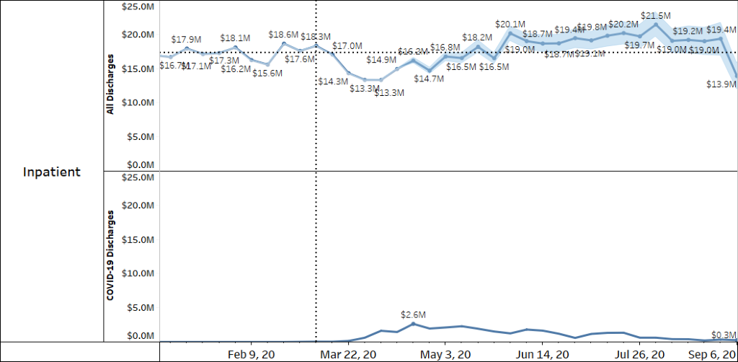
PHE: Changing Utilization Patterns Inpatient through 9/12/2020
Blue line is incurred weekly service utilization trends IBNR adjusted through 9/12
Blue shading is the range of uncertainty in the IBNR estimates
Vertical dotted line is the last week prior to social distancing
Horizontal dotted line is the weekly average paid before social distancing
Inpatient does NOT include interim billing where the Member has not yet been discharged
Notes:
Range of uncertainty is using a 95% confidence level

Slide 21
Outpatient Hospital through 9/19/2020
Blue line is incurred weekly service utilization trends IBNR adjusted through 9/19
Blue shading is the range of uncertainty in the IBNR estimates
Vertical dotted line is the last week prior to social distancing
Horizontal dotted line is the weekly average paid before social distancing
Notes:
Range of uncertainty is using a 95% confidence level

Slide 22
Emergency Dept through 9/19/2020
Blue line is incurred weekly service utilization trends IBNR adjusted through 9/19
Blue shading is the range of uncertainty in the IBNR estimates
Vertical dotted line is the last week prior to social distancing
Horizontal dotted line is the weekly average paid before social distancing
Notes:
Range of uncertainty is using a 95% confidence level

Slide 23
Dental through 9/19/2020
Blue line is incurred weekly service utilization trends IBNR adjusted through 9/19
Blue shading is the range of uncertainty in the IBNR estimates
Vertical dotted line is the last week prior to social distancing
Horizontal dotted line is the weekly average paid before social distancing
Notes:
Range of uncertainty is using a 95% confidence level
Only includes Dental paid through interChange

Slide 24
FQHC, RHC and IHS through 9/19/2020
Blue line is incurred weekly service utilization trends IBNR adjusted through 9/19
Blue shading is the range of uncertainty in the IBNR estimates
Vertical dotted line is the last week prior to social distancing
Horizontal dotted line is the weekly average paid before social distancing
Notes:
Range of uncertainty is using a 95% confidence level
Dental payments to these providers are included on the Dental slide

Slide 25
Thank you!

