Slide 1
Health First Colorado
Outpatient Speech Therapy Utilization Review
The Department of Health Care Policy & Financing administers Health First Colorado (Colorado’s Medicaid program), Child Health Plan Plus (CHP+) and other health care programs for Coloradans who qualify.

Slide 2
Table of Contents
EPSDT
About Kepro
Scope of Services
Kepro Services for Providers
Provider Responsibilities
PAR Submission
General Requirements
PAR Process
ST PAR Guidance
ST PAR Requirements
Service Units for Speech Therapy
Response Times (TAT)
Medicaid Rule for Medical Necessity
PAR Revision
Recap

Slide 3
EPSDT
Kepro follows the Early and Periodic Screening, Diagnostic and Treatment (EPSDT) requirements for all medical necessity reviews for Health First Colorado members. All medical necessity reviews on treatments, products or services requested or prescribed for all members ages 20 years of age and under are based on compliance with federal EPSDT criteria. Medical necessity is decided based on an individualized, child specific, clinical review of the requested treatment to ‘correct or ameliorate’ a diagnosed health condition in physical or mental illnesses and conditions. EPSDT includes both preventive and treatment components as well as those services which may not be covered for other members in the Colorado State Plan.
For more information, please review the EPSDT website: https://hcpf.colorado.gov/early-and-periodic-screening-diagnostic-and-treatment-epsdt

Slide 4
About Kepro
426M In Savings through Care Management
In 2021, Kepro was awarded the Colorado Department of Health Care Policy and Financing (HCPF) contract with the state of Colorado for Utilization Management and Physician Administered Drug (PAD) UM review, including outpatient, inpatient, specialty, and EPSDT.
In addition, Kepro will administer or participate in:
Client Overutilization Program (COUP)
Annual Healthcare Common Procedure Coding System (HCPCS) code review
Quality Program
Reporting
Review Criteria selection
Customer Service Line
Appeals, Peer-to-Peer, and Reconsiderations
Fraud & False Claims reporting
35 YEARS Serving Government Sponsored Healthcare Programs
1.8M UM Reviews a year

Slide 5
Scope of Services
Audiology
Diagnostic Imaging
Durable Medical Equipment
Inpatient Hospital Review Program (IHRP 2.0)
Medical Services including, but not limited to, select surgeries such as bariatric, solid organ transplants, transgender services, and elective surgeries
Molecular/Genetic Testing
Out-of-State Inpatient Services
Outpatient Physical and Occupational Therapy
Outpatient Speech Therapy
Pediatric Behavioral Therapy
Pediatric Private Duty Nursing
Personal Care Services
Physician Administered Drugs

Slide 6
Kepro Services for Providers
24-hours/365 days provider portal can be accessed at: https://portal.kepro.com
Provider Communication and Support email: coproviderissue@kepro.com
Provider Education and Outreach, as well as system training materials (including slide decks and FAQs) are located at: https://hcpf.colorado.gov/par
Prior Authorization Review (PAR)
Retrospective Review (when allowed by CO HCPF)
PAR Reconsiderations & Peer-To-Peer Reviews
PAR Revisions
Access to provider reports and case statuses with Atrezzo Portal
Provider Manual is posted at: https://hcpf.colorado.gov/par

Slide 7
Provider Responsibilities
Providers must request prior authorization for services through our direct data entry portal, Atrezzo, unless criteria are met and approved for the fax exempt list.
The Fax Exempt method of requests must be approved by submitting a Fax Exempt Request form and meeting specific criteria, such as: the provider is Out-of-State, or the request is for an out of area service; the provider group submits on average 5 or fewer PARs per month and would prefer to submit a PAR via fax; or the provider is visually impaired.
The form can be located at https://hcpf.colorado.gov/par.
Utilization of the Atrezzo portal allows the provider to:
request prior authorization for services
upload clinical information to aid in review of prior authorization requests, and
submit reconsideration and/or peer-to-peer requests for services denied.
The system will give warnings if a PAR is not required.
Always VERIFY the Member’s eligibility for Health First Colorado prior to submission by contacting Health First Colorado.
The generation of a Prior Authorization number does not guarantee payment.

Slide 8
PAR (Prior Authorization Request) Submission
PAR requests submitted within business hours: 8:00AM – 5:00PM (MT) will have the same day submission date.
Atrezzo portal is accessible 24/7. However, those submitted:
After business hours will have a receipt date of the following business day
Holidays – will have a receipt date of the following business day
Days following State approved closures, i.e., natural disasters, will have a receipt date of the following business day

Slide 9
PAR Submission – General Requirements
PAR submissions will require providers to provide the following:
Member ID
Member Name
Member DOB
CPT or HCPCS codes for services being requested
Dates of service(DOS)
ICD10 code for the diagnosis
Servicing provider (billing provider) NPI if different than the Requesting provider
Number of units requested, i.e., visits, number of items, etc.
Supporting Documentation: It will be necessary to provide supporting documentation with your submission. Supporting documentation may include valid signed order, office visit notes, laboratory results, imaging results, etc.
Requests for Additional Information will be initiated by Kepro if/when there is not substantial supporting documentation to complete a review.
A detailed step by step process for submitting both outpatient and inpatient requests can be found in the provider training manual at https://hcpf.colorado.gov/par
Timely Submission means entering the request before services are rendered and with enough advanced notice for the review to be completed.

Slide 10
PAR Requirements
Below is an overview of PAR requirements. A complete list of requirements can be found in the Speech Therapy billing manual at https://hcpf.colorado.gov/speech-therapy-manual
Independent speech therapists and outpatient hospital-based therapy clinics providing outpatient speech therapy must submit and have approved PARs for medically necessary services prior to rendering the services.
Prior Authorization Requests are approved for up to a 365-day period (depending on medical necessity determined by the authorizing agency).
Retroactive PAR requests will be accepted for children ages 0-4 who are under the direction of the Early Intervention program. Retro-authorization requests will be approved for a window of 30 calendar days from the date on which the provider submits the PAR, even if this does not encompass the start-date of the IFSP. Dates requested on the PAR must be within the dates on the IFSP.
Eligible members may receive Habilitative speech therapy in addition to Rehabilitative speech therapy so long as the therapies are not duplicative and rendered on the same date of service.
Overlapping PAR request dates for same provider types will not be accepted, except for Early Intervention PAR requests which may have overlapping dates of service and multiple provider types.
If member has an overlapping PAR with a different provider, a completed Change of Provider form will be required. This form can be located at https://hcpf.colorado.gov/par#forms . This form must be submitted, and an authorization number generated on the new request, PRIOR to any billing.
Submit PARs for the number of units for each specific procedure code requested, not for the number of services. Modifiers must be included on both the PAR and claim submission. When submitting a PAR for either rehabilitative or habilitative services, the procedure codes must include GN + 96/97 modifiers (e.g. 92507+GN+97).

Slide 11
PAR Requirements Continued
PAR Requests Must Include:
Legibly written and signed ordering practitioner prescription or approved Plan of Care, to include:
diagnosis
reason for therapy
the number of requested therapy sessions per week
total duration of therapy.
Member's speech therapy treatment history, to include current assessment and treatment, along with the duration of the previous treatment and treating diagnosis
Documentation indicating if the member has received ST under the Home Health Program or inpatient hospital treatment
Current treatment diagnosis
Course of treatment, measurable goals, and reasonable expectation of completed treatment
Documentation supporting medical necessity for the course and duration of treatment being requested

Slide 12
Speech Therapy
Speech Therapy has no yearly quantitative limit to services. However, there is a daily quantitative limit of five units.
The manual link for the Speech Therapy billing manual is https://hcpf.colorado.gov/speech-therapy-manual.l Link
Duration of a PAR
Manual Link
Duration of a PAR
Submissions at a Glance | Details
Provider Timely submission | Prior to rendering services
Retroactive Authorization (Member not eligible at time of service) | Not accepted by Kepro *Exceptions may be made by HCPF
PAR Duration | Change in Policy to allow up to 365 days
Servicing Provider (Billing Provider) | Providers enrolled as clinics, non-physician practitioner groups, rehab agencies, hospitals, or as individual speech therapists or audiologists.
Requesting Provider (Ordering Provider) | Hospital, Physician, physician assistant, or Nurse Practitioner, Audiologist, Speech Therapist, Rehabilitation Agency, Non-Physician Practitioner Group

Slide 13
Understanding Speech Therapy Services
Enrolled members ages 20 and under and adult clients in limited circumstances qualify for medically necessary Speech Therapy services.
https://hcpf.colorado.gov/speech-therapy-manual
These include but are not limited to:
Evaluation
Individual and group therapeutic treatment
Alternative and augmentative communication device evaluation
Assistive technology assessment
Cognitive skill development
Rehabilitative therapies are those meant to assist a member with recovery from an acute injury, illness, or surgical recovery; return to their baseline.
Habilitative therapies are those meant to help the member retain, learn, or improve skills and functions for daily living. This includes the treatment of long-term chronic conditions and meeting developmental milestones. Both children and adults have rehabilitative speech therapies covered, but only some adults have Habilitative speech therapies covered. All children have Habilitative speech therapies covered.
Early Intervention https://www.colorado.gov/pacific/hcpf/early-intervention-manual
Early Intervention Services provide developmental supports and services to children birth to four (4) years of age who have either a significant developmental delay or a diagnosed condition that has a high probability of resulting in a developmental delay and are determined to be eligible for the program. An approved IFSP may serve as an 'order for services', in lieu of a physician order for Speech Therapy.

Slide 14
ST Benefit Limitations
Eligible members may not receive both Rehabilitative and Habilitative speech therapy services on the same date of service.
Speech Therapy is limited to five (5) units of service per date of service. Some specific daily limits per procedure code apply. Please see below:
While a maximum of five units of service is allowed per date of service, providers are required to consult the American Medical Association's (AMA) Current Procedural Terminology (CPT) manual for each coded service. Some codes represent a treatment session without regard to its length of time (one unit maximum) while other codes may be billed incrementally as "timed" units.
Members determined to need a speech generating device (HCPCS codes E2500, E2502, E2504, E2510, E2211, E2512, and E2599) should be referred to a Health First Colorado participating medical supplier to be prior authorized.
This information can be found in the ST Billing Manual for reference.

Slide 15
Documentation Requirements
Providers need to submit the following documentation on new admissions:
Evaluation/Re-evaluation
An order/referral/plan of care that is signed by either an MD, DO, NP or PA with either a physical signature or a CMS compliant electronic signature
An order/referral/plan of care that includes the diagnosis, type of therapy, frequency and duration specification and covers the PAR dates requested
A plan of care that is within 90 calendar days prior to the requested start date and includes the diagnosis, type of therapy, therapeutic interventions, frequency and duration specifications and cover the PAR dates requested.
Providers need to submit the following documentation for continuation of care reviews:
Evaluation/Re-evaluation
An order/referral/plan of care that is signed by either an MD, DO, NP or PA with either a physical signature or a CMS compliant electronic signature
An order/referral/plan of care that includes the diagnosis, type of therapy, frequency and duration specification and covers the PAR dates requested
A plan of care that is within 90 calendar days prior to the requested start date and includes the diagnosis, type of therapy, therapeutic interventions, frequency and duration specifications and cover the PAR dates requested.
A recent complete therapy re-evaluation or updated progress notes on the current plan of that shows either progress, or lack thereof, for review. This must be performed within the last 60 days prior to start date.
For more information, please refer to the July Provider Bulletin https://hcpf.colorado.gov/bulletins and the Speech Therapy Billing Manual https://hcpf.colorado.gov/speech-therapy-manual .

Slide 16
ST: Two or more services performed
Example 1:
Doctor/clinic performs two separate services, both under 8 mins. Combine the two service minutes together. If the total time equals the time range of 8 to 22 mins, bill for the service performed with the most minutes as 1 unit.
Document the total number of timed minutes in the Visits/Encounter table.
To bill for multiple timed services over 8 mins, combine the total time together.
Example 2:
24 minutes of neuromuscular reeducation, code 97112
23 minutes of therapeutic exercise, code 97110
Total treatment time = 47 minutes or (3 units)
Example 3:
7 minutes of neuromuscular reeducation (97112)
7 minutes therapeutic exercise (97110)
7 minutes manual therapy (97140)
Total timed minutes = 21 minutes (1 unit)
Determining What Time Counts towards a 15-minute Timed Codes Unit
Only count time where services/treatment are being performed for/with the patient. Toileting, rest, waiting to use equipment, or for treatment to begin, etc., are not considered treatment time.

Slide 17
Service Units for Outpatient Therapies
Unit/Quantity Calculation
A unit equals either 1) a timed increment, or 2) one treatment session as described in the specific CPT procedure codes.
Submit PARs for the number of units for each specific procedure code requested, not for the number of services.
Time and Untimed Codes
Timed Codes: 1 unit = 15 minutes
Untimed Codes: based on the # of times the procedure is performed.
When reporting service units for the coding system and the procedure is not defined by a specific timeframe, the provider enters 1 in the labeled Units field. For these types of untimed codes, units are reported based on the number of times the procedure is performed.
Example A: 60 minutes of speech therapy has a Timed Code (97130), the provider reports 4 units.
Example B: Pathology evaluation used as an Untimed code: 92521 entered as 1; only 1 evaluation was completed.

Slide 18
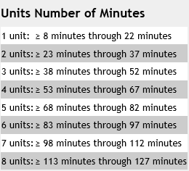
Counting Minutes for Timed Codes
Providers should not bill for services that occur in less than 8 minutes, but they can bill for services provided in the timespan of 8 to 22 minutes as 1 unit.

Slide 19
Outpatient Therapies- Modifier Requirements
Modifier codes must be included for all ST requests. The same modifiers used on the PAR must be used on the claim, in the same order.
Outpatient Therapy Type | Modifier 1 | Modifier 2 | Example
Rehabilitative Speech Therapy | GN | 97 | 92507 + GN + 97
Habilitative Speech Therapy | GN | 96 | 92507 + GN + 96
Early Intervention Speech Therapy | GN | TL | 92507 + GN + TL

Slide 20
PAR Outcomes
After submission of a request, you will see one of the following actions occur:
Approval: Met criteria/CCR applied for the service requested at first level review or was approved at physician level.
Request for additional information: Information for determination is not included and vendor requests this to be submitted to complete the review.
Technical Denial: Health First Colorado Policy is not met for reasons including, but not limited to, the following reasons:
* Untimely Request
*Requested information not received/Lack of Information (LOI)
*Duplicate to another request approved for the same provider
*Service is previously approved with another provider
Medical Necessity Denial: Physician level reviewer determines that medical necessity has not been met and has been reviewed under appropriate guidelines. The Physician may fully or partially deny a request.
When a member receiving services, changes providers during an active PAR certification, the receiving provider will need to complete a Change of Provider Form (COP) in order to transfer the member’s care from the previous provider to the receiving agency. This form is located on the Provider Forms webpage under the Prior Authorization Request (PAR) Forms, drop-down menu, using the instructions located under “How to Complete Change of Provider Form.”

Slide 21
PAR Denials
Denials:
If a Technical Denial is determined, the provider can request a Reconsideration.
If a Medical Necessity Denial was determined, it was determined by the Medical Director. Therefore, the next step would be requesting a Peer to Peer.
Steps to consider after a Denial is determined:
Reconsideration Request: the servicing provider may request a reconsideration to Kepro within 10 business days of the initial denial. If the reconsideration is not overturned, the next option is a Peer-to-Peer (Physician to Physician).
Peer-to-Peer Request: an ordering provider may request a Peer-to-Peer review within 10 business days from the date of the medical necessity adverse determination by placing the request in the case notes, providing the physician’s full name, phone number, and three dates and times of availability. The peer-to-peer will be arranged on one of the provided dates and times for the conversation to be conducted. You may also call Customer Service at 720-689-6340 to request the peer-to-peer.

Slide 22
Turnaround Times – Part 1
Turnaround Time -- The vendor’s turnaround time (TAT) for completion of a PAR review ensures:
A thorough and quality review of all PARs by reviewing all necessary & required documentation when it is received
Decrease in the number of unnecessary pends to request additional documentation or information
Improved care coordination and data sharing between Kepro and the Department’s partners, like the Regional Accountable Entities (RAEs) and Case Management Agencies (CMAs)
**For additional information pends: The Provider will have 10 Business Days to respond, and if there is no response or insufficient response to the request, Kepro will complete the review and technically deny for Lack of Information (LOI), if appropriate.

Slide 23
Turnaround Times – Part 2
Expedited review is a PAR that is expedited because a delay could:
Jeopardize life/health of member
Jeopardize ability to regain maximum function
And/or subject to severe pain
Rapid review is a PAR that is requested because a longer TAT could result in a delay in the Health First Colorado (HFC) member receiving care or services that would be detrimental to their ongoing, long-term care. A Rapid review may be requested by the Provider in very specific circumstances including:
A service or benefit that requires a PAR and is needed prior to a HFC member’s inpatient hospital discharge
A lack of DME supplies that immediately and adversely impacts a HFC Member’s ability to perform activities of daily living (ADL)
Same Day Diagnostic studies required for cancer treatments
Genetic or Molecular testing requiring amniocentesis
Standard review is one that most cases would fall under as a prior authorization request is needed but not in a rapid or expedited time frame. These requests will be completed in no more than 10 business days.

Slide 24
Definition of Medical Necessity
10 CCR 2505-10; 8.076.1
8. Medical necessity means a Medical Assistance program good or service:
a. Will, or is reasonably expected to prevent, diagnose, cure, correct, reduce, or ameliorate the pain and suffering, or the physical, mental, cognitive, or developmental effects of an illness, condition, injury, or disability. This may include a course of treatment that includes mere observation or no treatment at all;
b. Is provided in accordance with generally accepted professional standards for health care in the United States;
c. Is clinically appropriate in terms of type, frequency, extent, site, and duration;
d. Is not primarily for the economic benefit of the provider or primarily for the convenience of the client, caretaker, or provider;
e. Is delivered in the most appropriate setting(s) required by the client's condition;
f. Is not experimental or investigational; and
g. Is not more costly than other equally effective treatment options.
For EPSDT, medical necessity includes a good or service that will, or is reasonably expected to, assist the member to achieve or maintain maximum functional capacity in performing one or more Activities of Daily Living, and meets the criteria, Code of Colorado Regulations, Program Rules (10 CCR 2505-10.8.280.4.E.2).

Slide 25
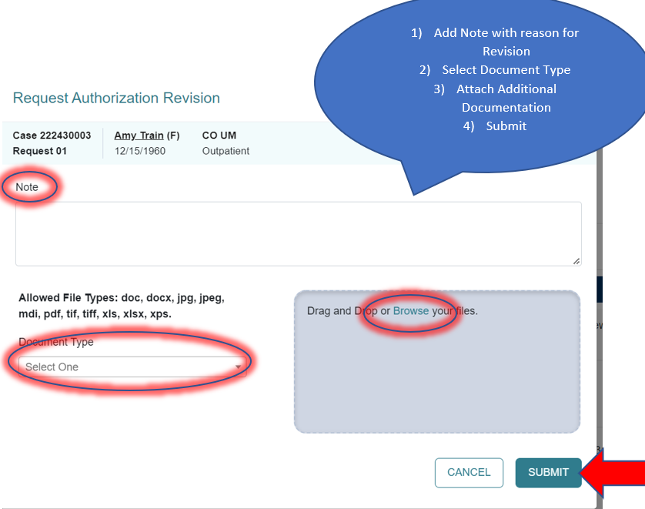
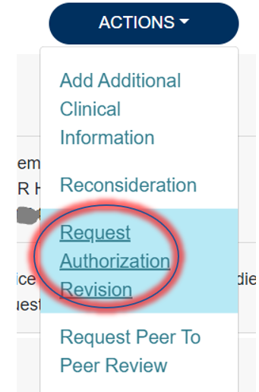
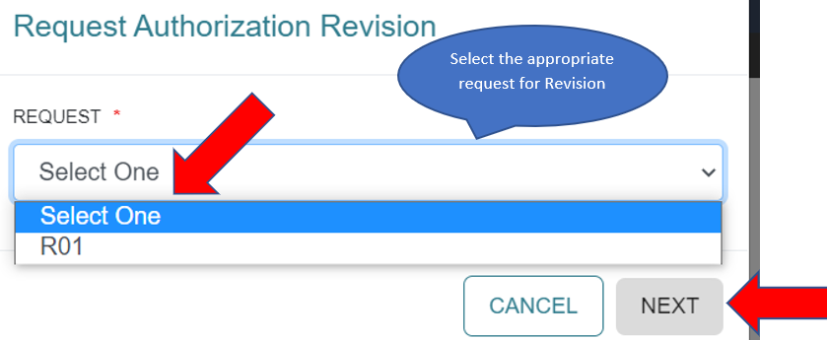
PAR Revision
If the number of approved units needs to be amended, the provider must submit a request for a PAR revision prior to the PAR end date. Kepro cannot make modifications to an expired PAR or a previously billed-upon PAR.
To make a revision, simply select “Request Revision” under the “Actions” drop-down, select the Request number, enter a note in the existing approved case of what revisions you are requesting, and upload additional documentation to support the request as appropriate.

Slide 26
Kepro Services for Providers - Recap
24-hours/365 days provider Atrezzo Portal may be accessed at: https://portal.kepro.com
System Training materials (including slide decks and FAQs) and the Provider Manual are located at: https://hcpf.colorado.gov/par
Provider Communication and Support email: coproviderissue@kepro.com

Slide 27
Conclusion
Thank you for your time and participation!
Contact Info
For escalated concerns please contact: hcpf_um@state.co.us
Kepro Call Center: 720-689-6340
PAR-related Questions: COproviderissue@kepro.com
Training-related Questions: Coproviderregistration@kepro.com
Notes:
Again, Kepro email addresses are shown here. Our call center is scheduled to be operational two weeks prior to Kepro accepting PARs.
In addition, for escalated concerns, providers should continue to use HCPF UM Inbox.

